Slide 1
Italian / Spain BAROQUE REVIEW

Slide 2
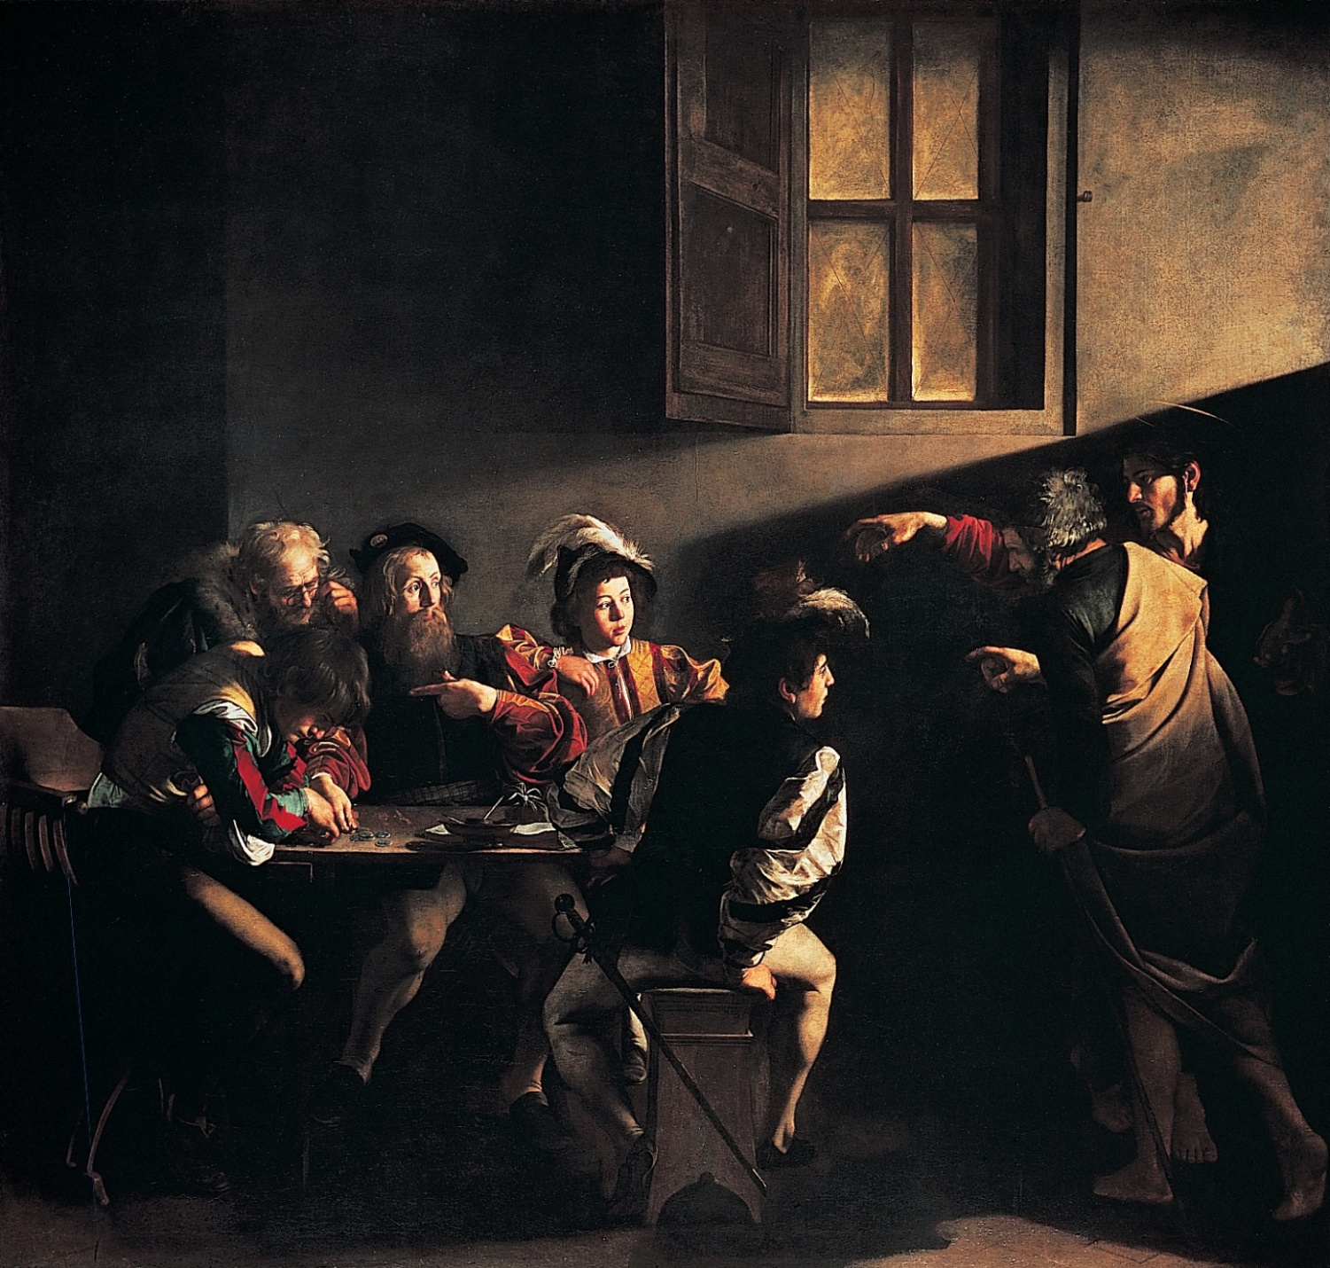
CARAVAGGIO - ITALY

Slide 3
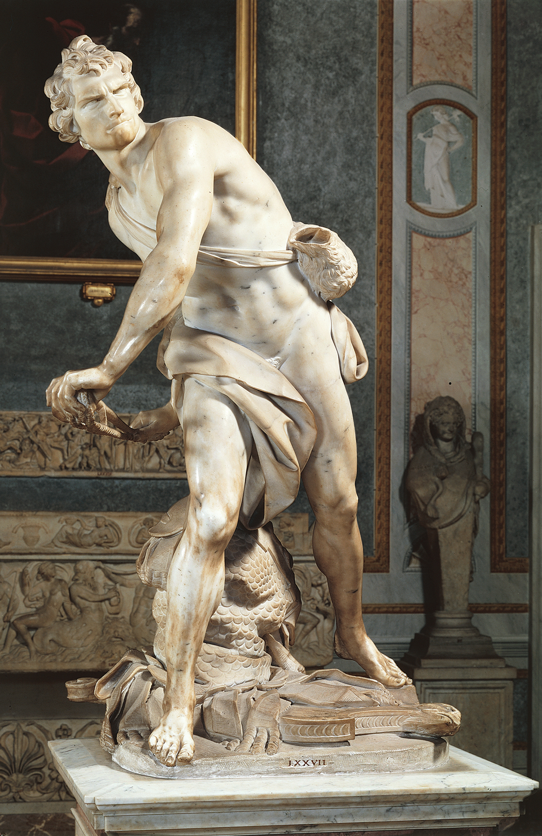
BERNINI

Slide 4
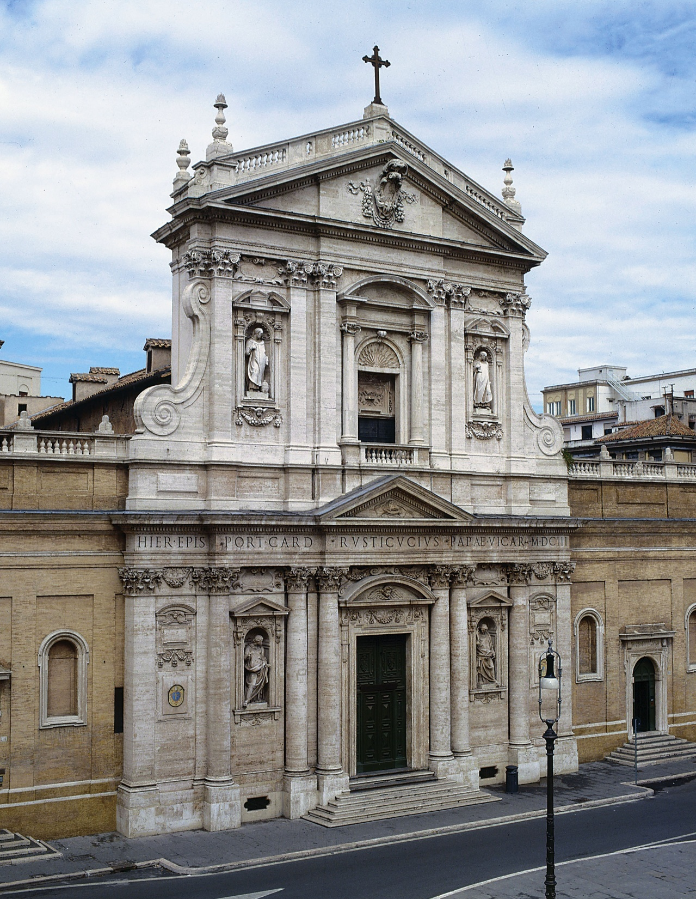
CARLO MADERNO

Slide 5
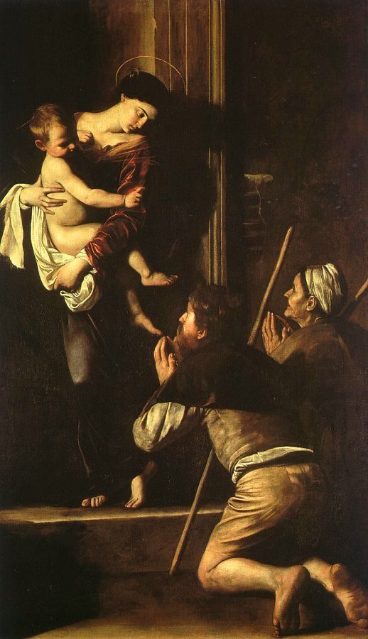
CARAVAGGIO

Slide 6
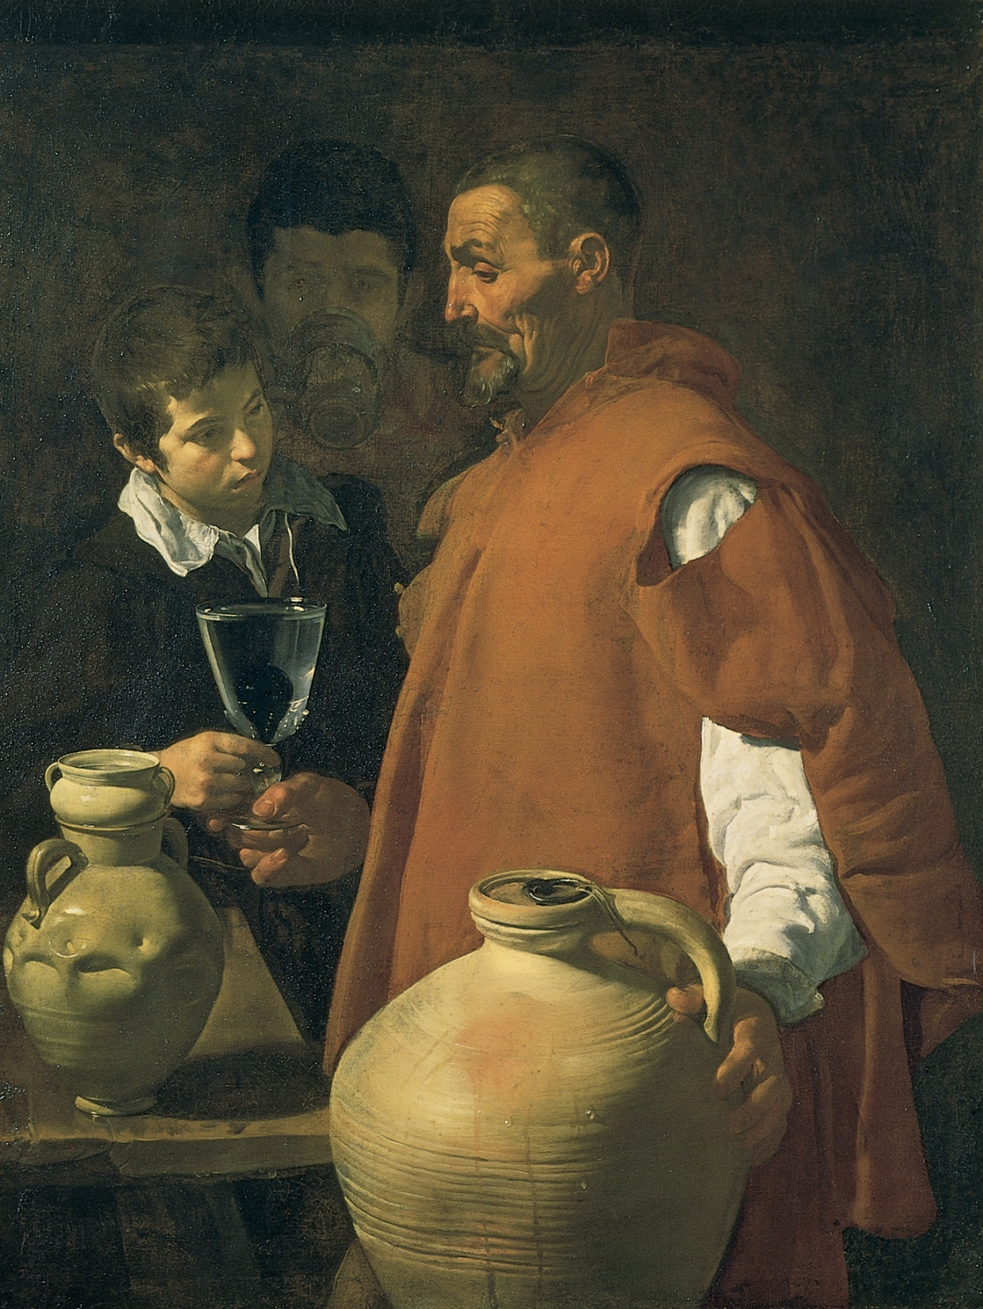
VELAZQUEZ
SPAIN

Slide 7
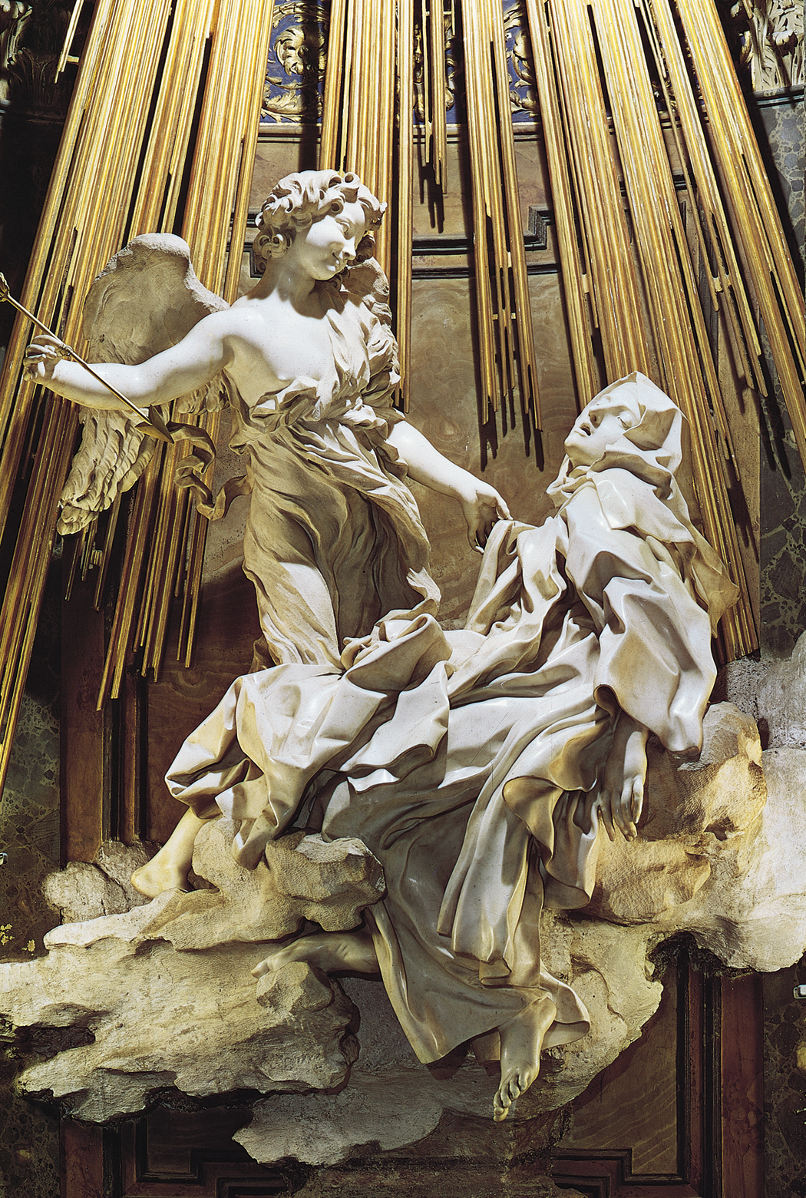
BERNINI
ITALY

Slide 8
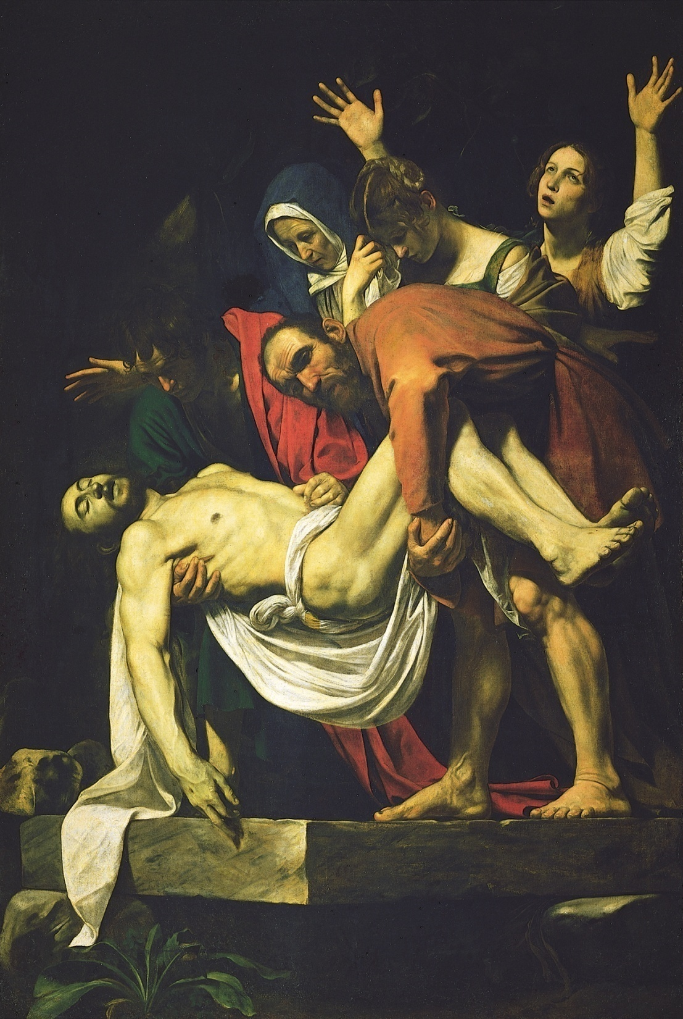
CARAVAGGIO
ITALY

Slide 9
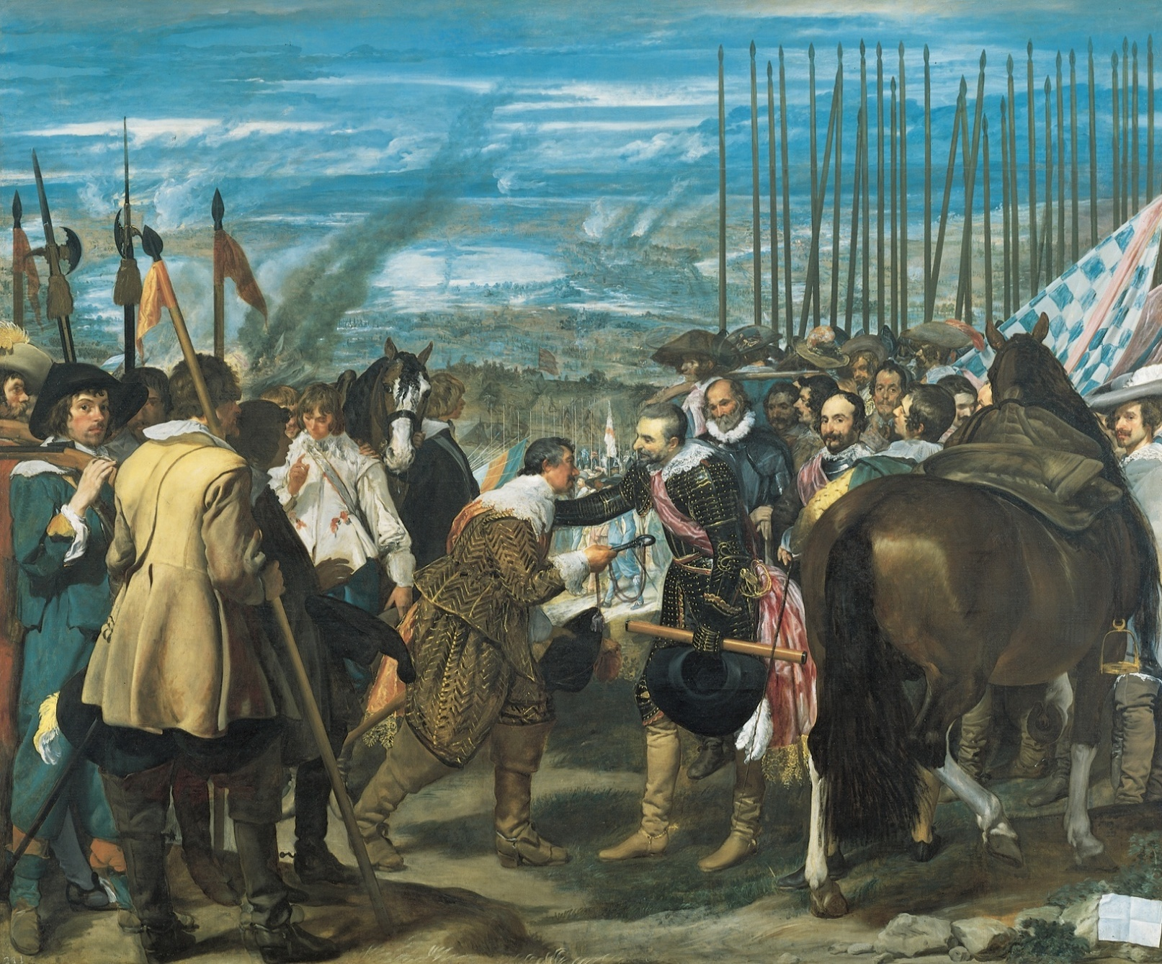
VELAZQUEZ
SPAIN

Slide 10
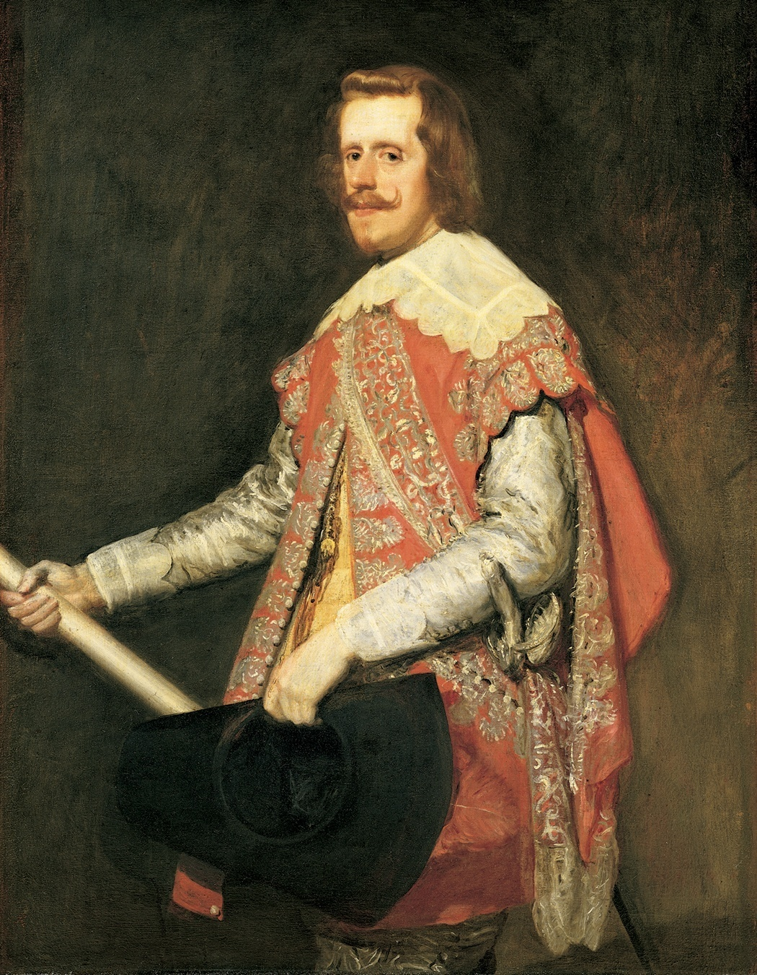
VELAZQUEZ
SPAIN

Slide 11
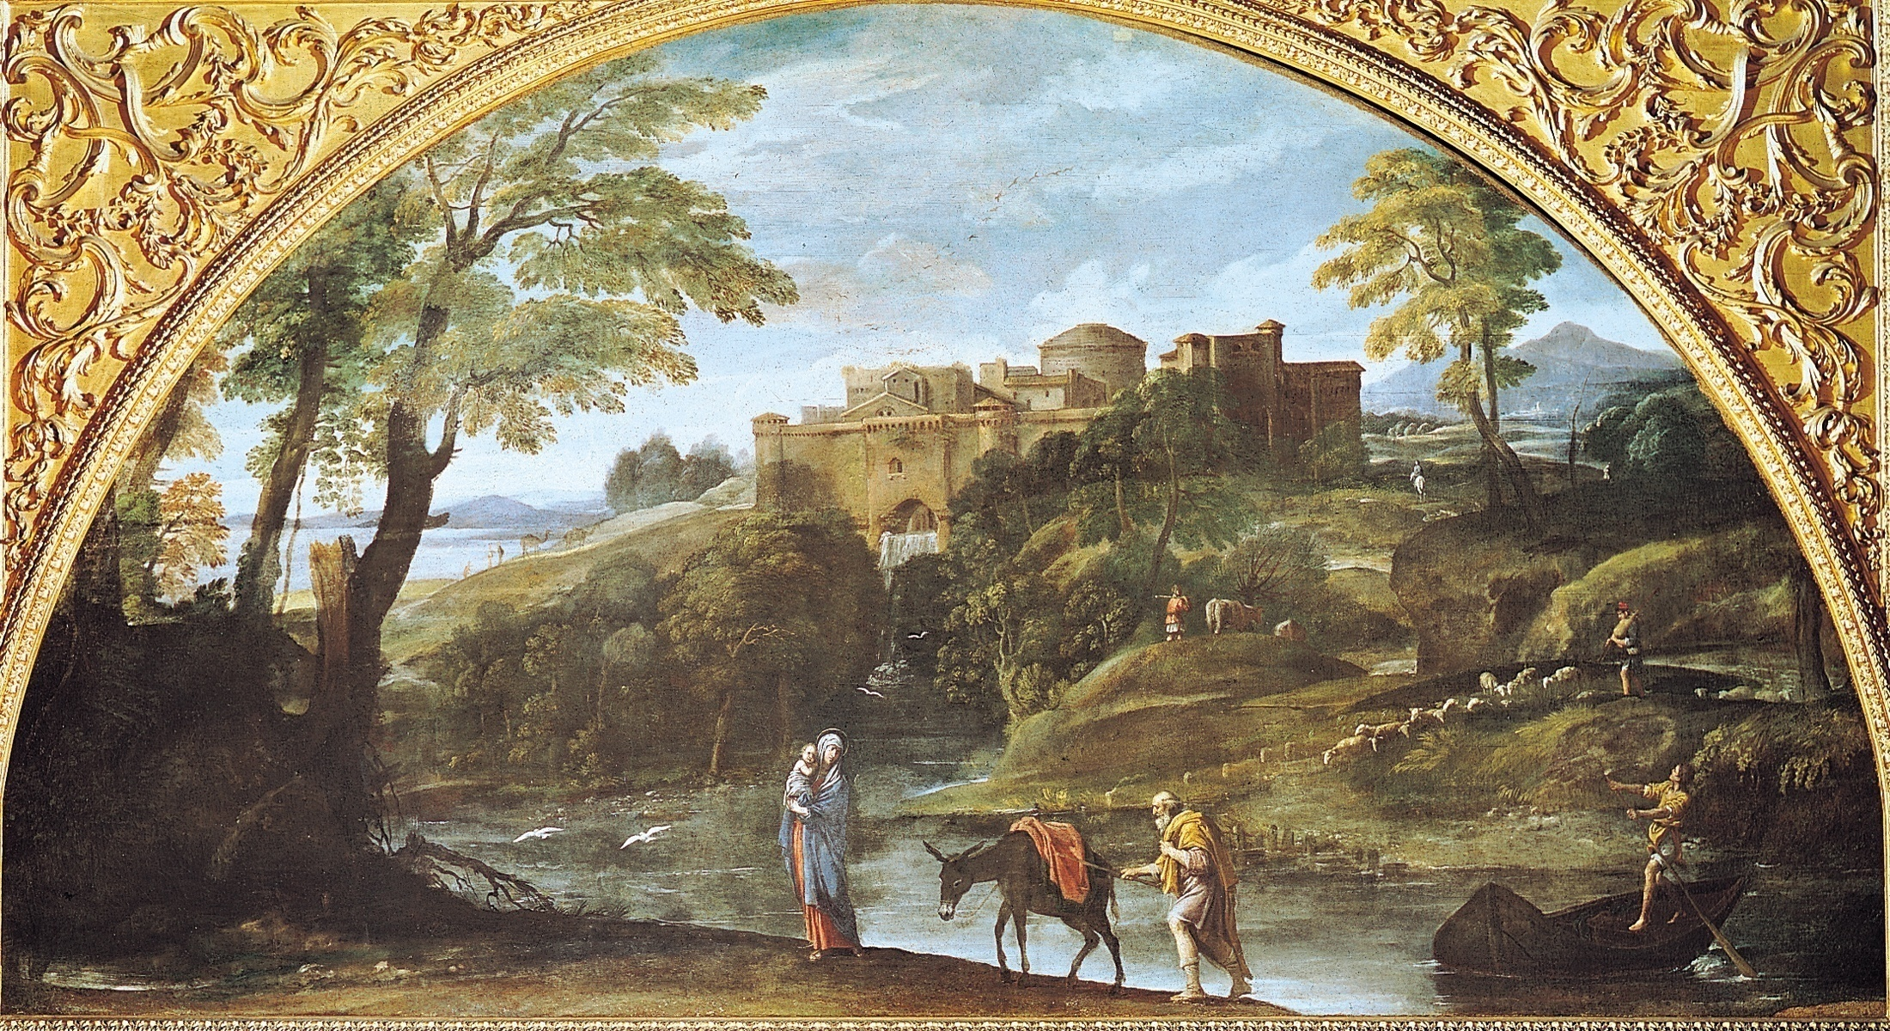
CARRACCI

Slide 12
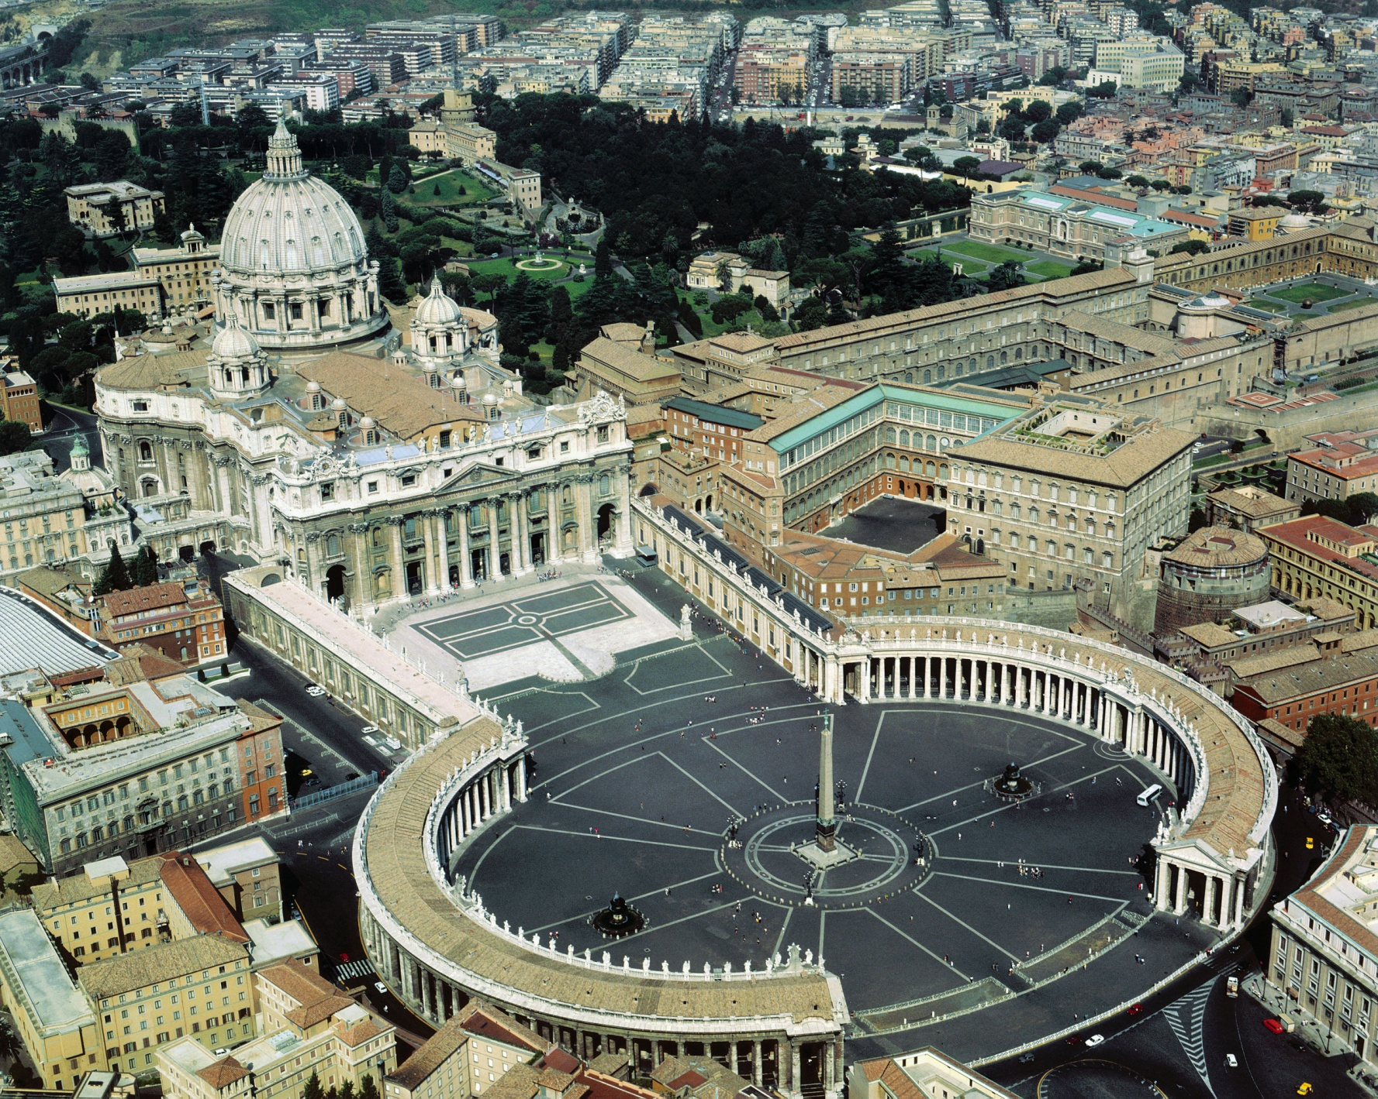
BERNINI

Slide 13
CARAVAGGIO
ITALY

Slide 14
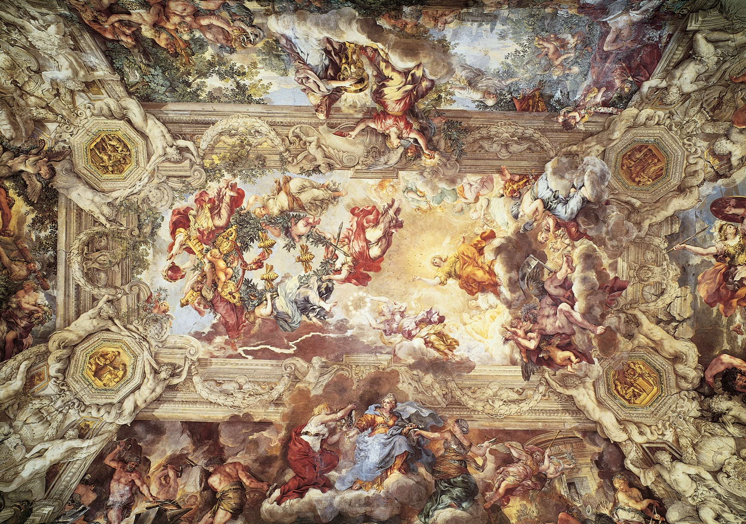
DA CORTONA - ITALY

Slide 15
BERNINI
ITALY

Slide 16
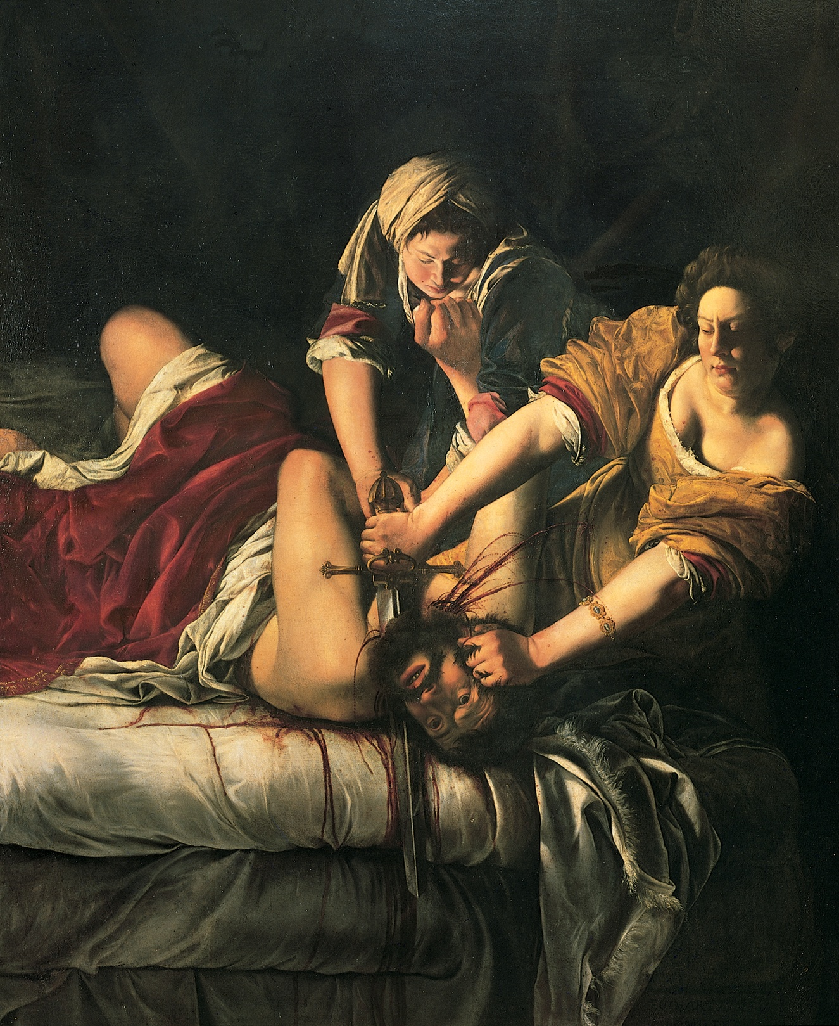
ARTEMISIA
GENTILESCHI-
ITALY

Slide 17
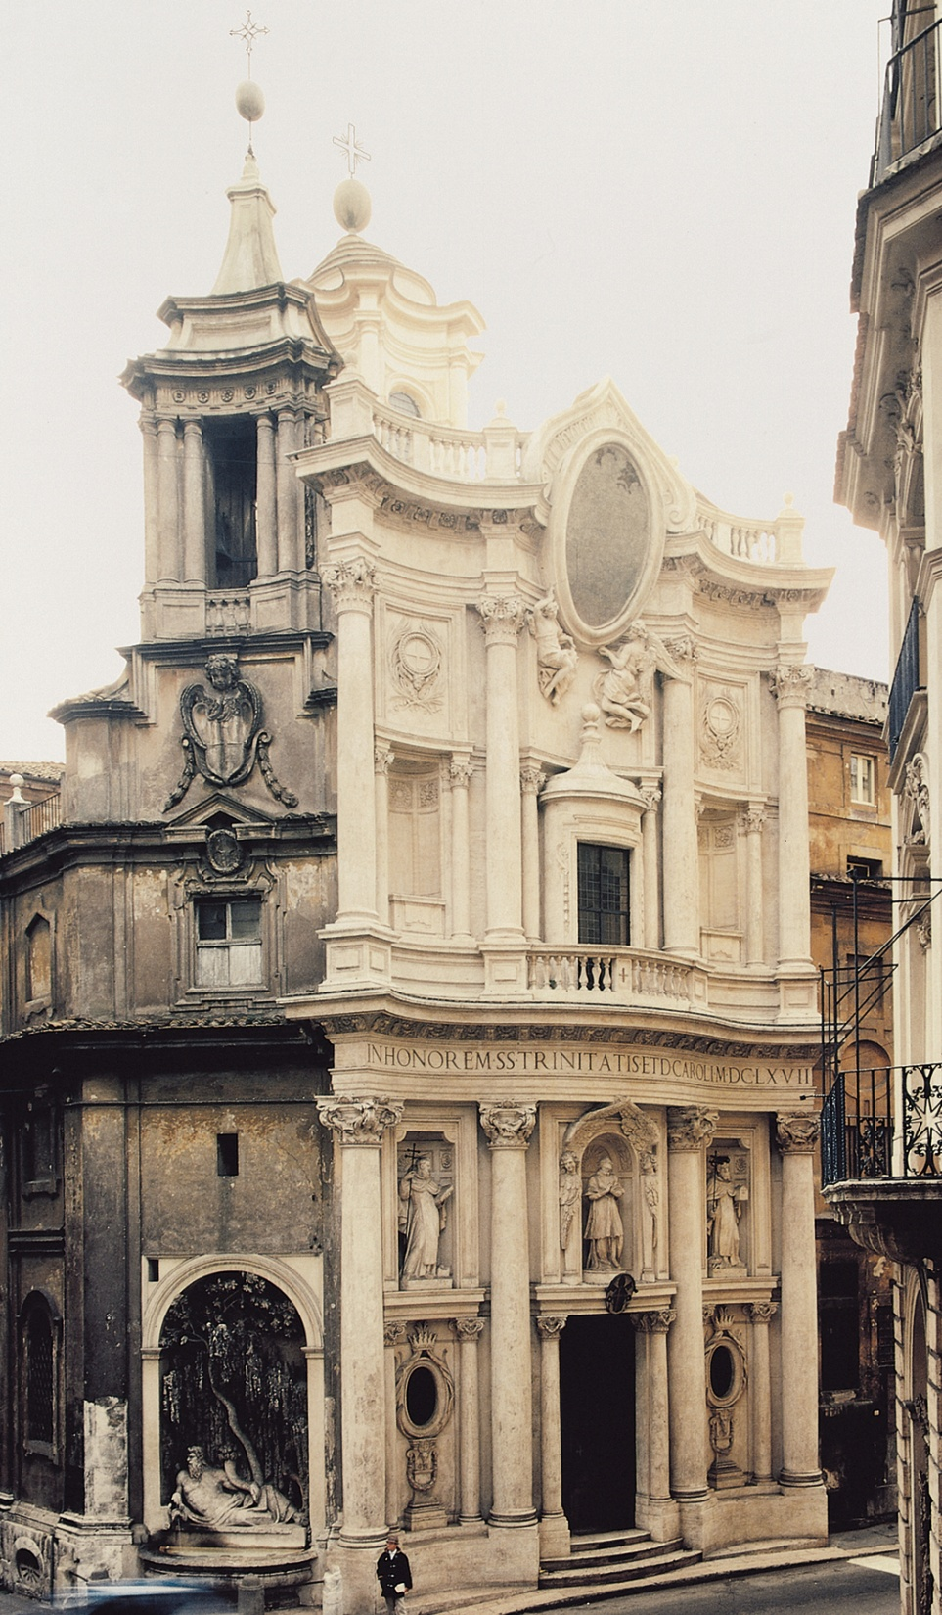
BORROMINI

Slide 18
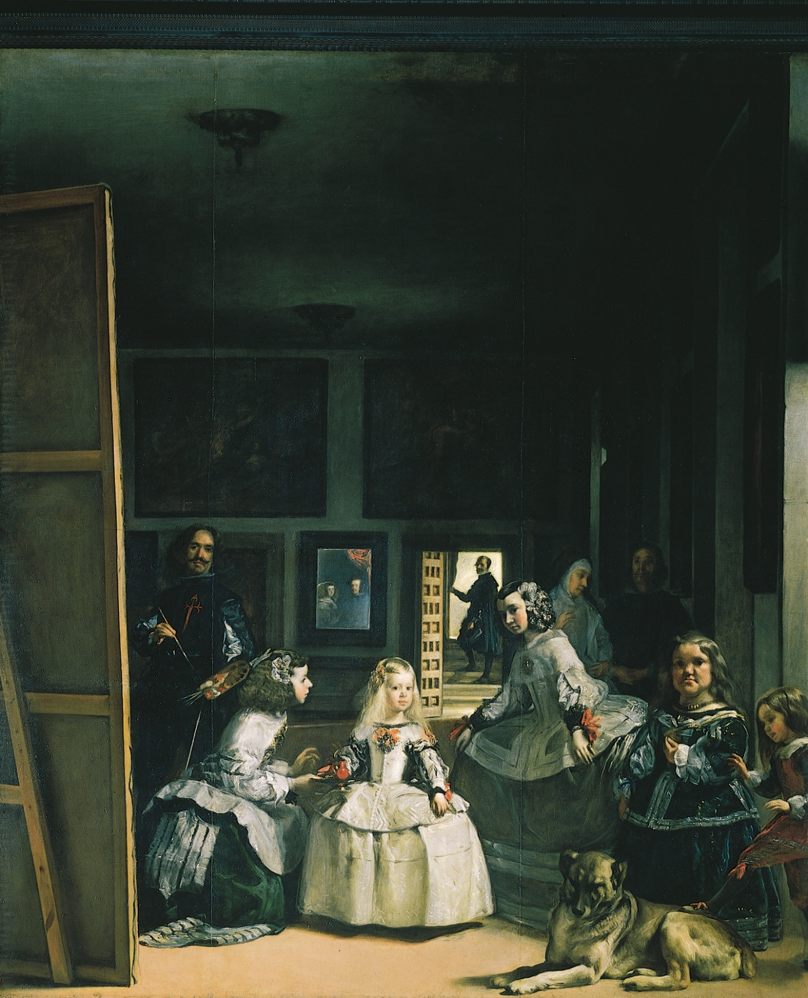
VELAZQUEZ
SPAIN

Slide 19
CARAVAGGIO - ITALY

Slide 20
VELAZQUEZ
SPAIN

Slide 21
BERNINI

Slide 22
VELAZQUEZ
SPAIN

Slide 23
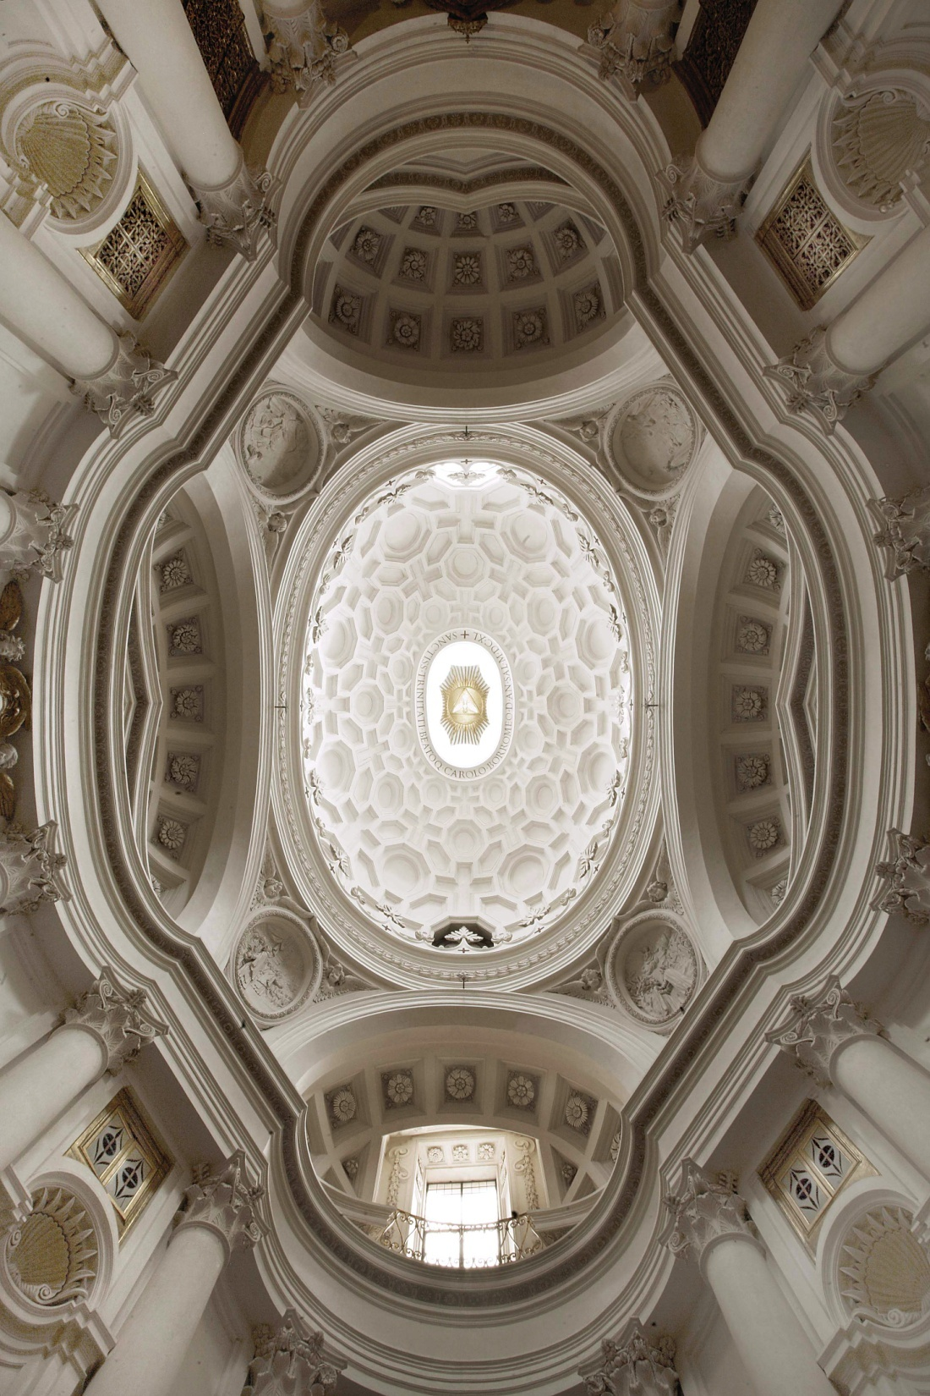
BORROMINI
ITALY

Slide 24
ARTEMISIA
GENTILESCHI-
ITALY

Slide 25
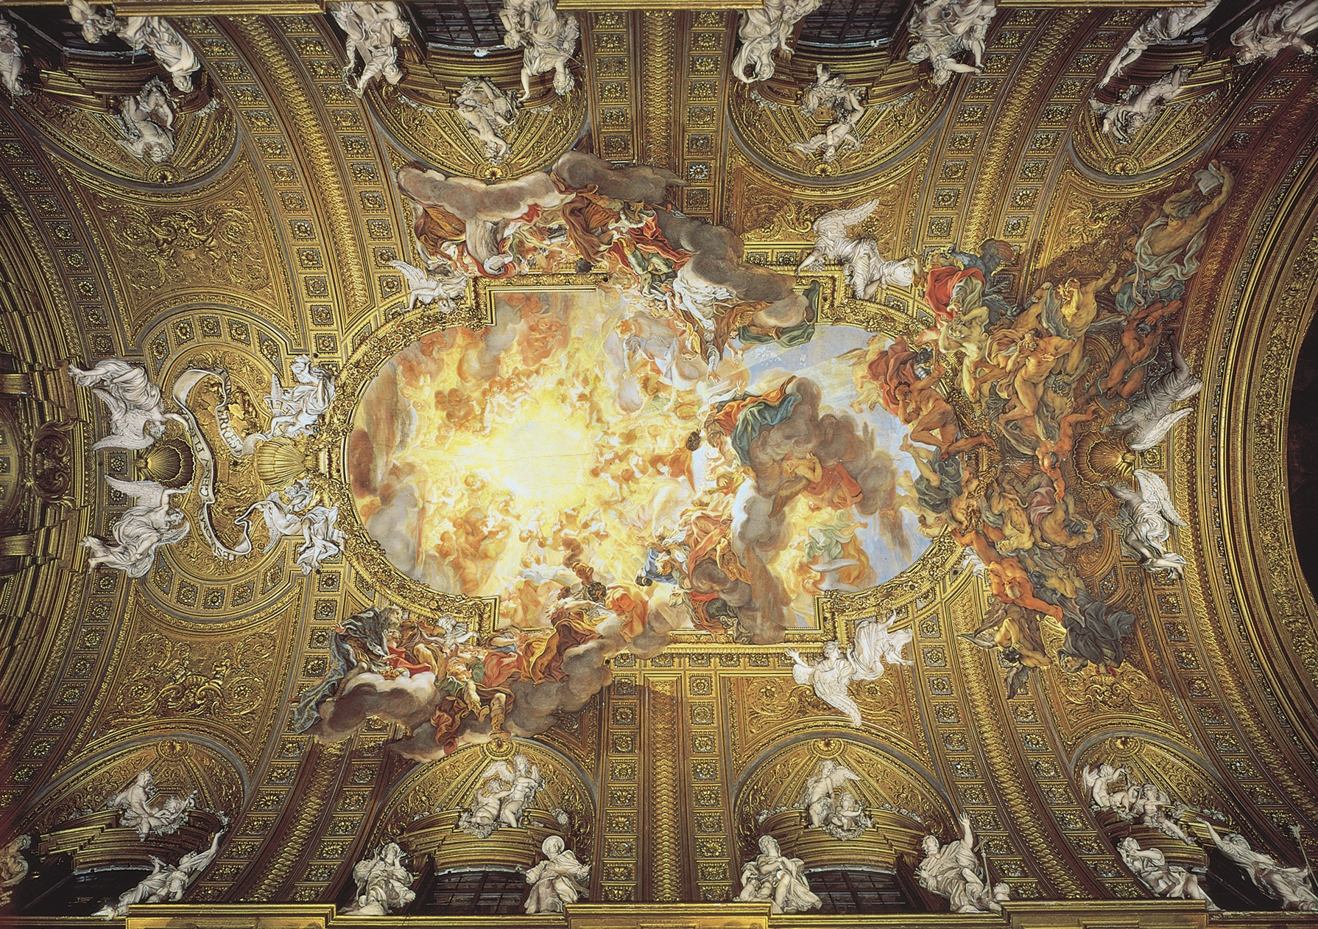
BATTISTA

Slide 26
CARAVAGGIO

Slide 27
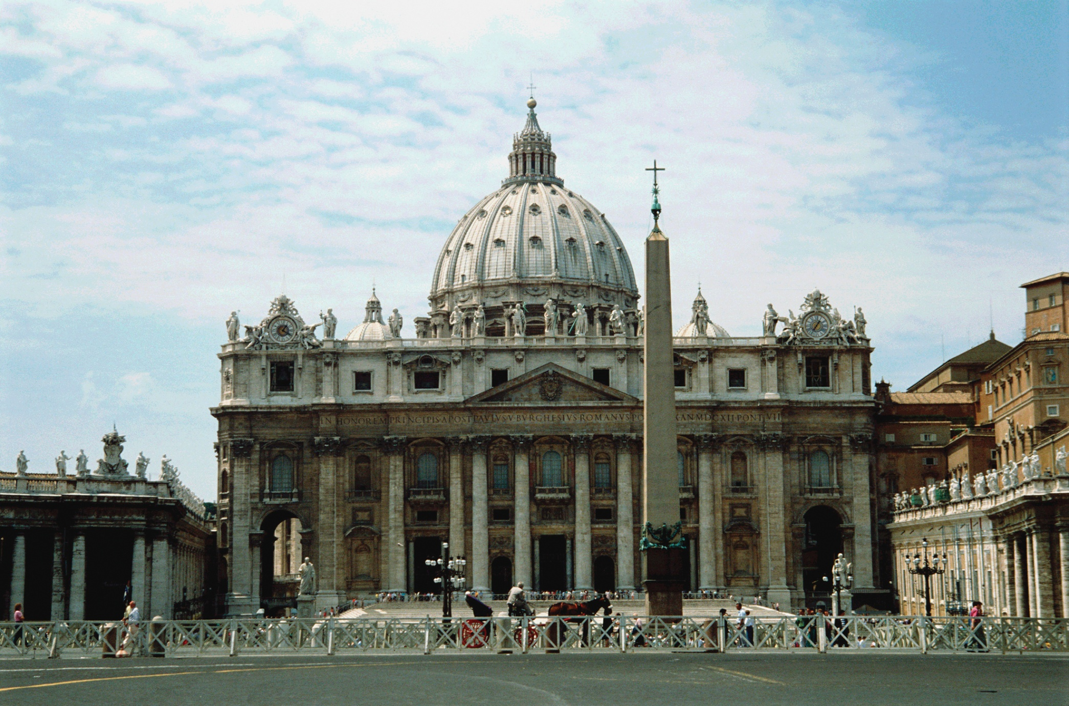
CARLO MADERNO

Slide 28
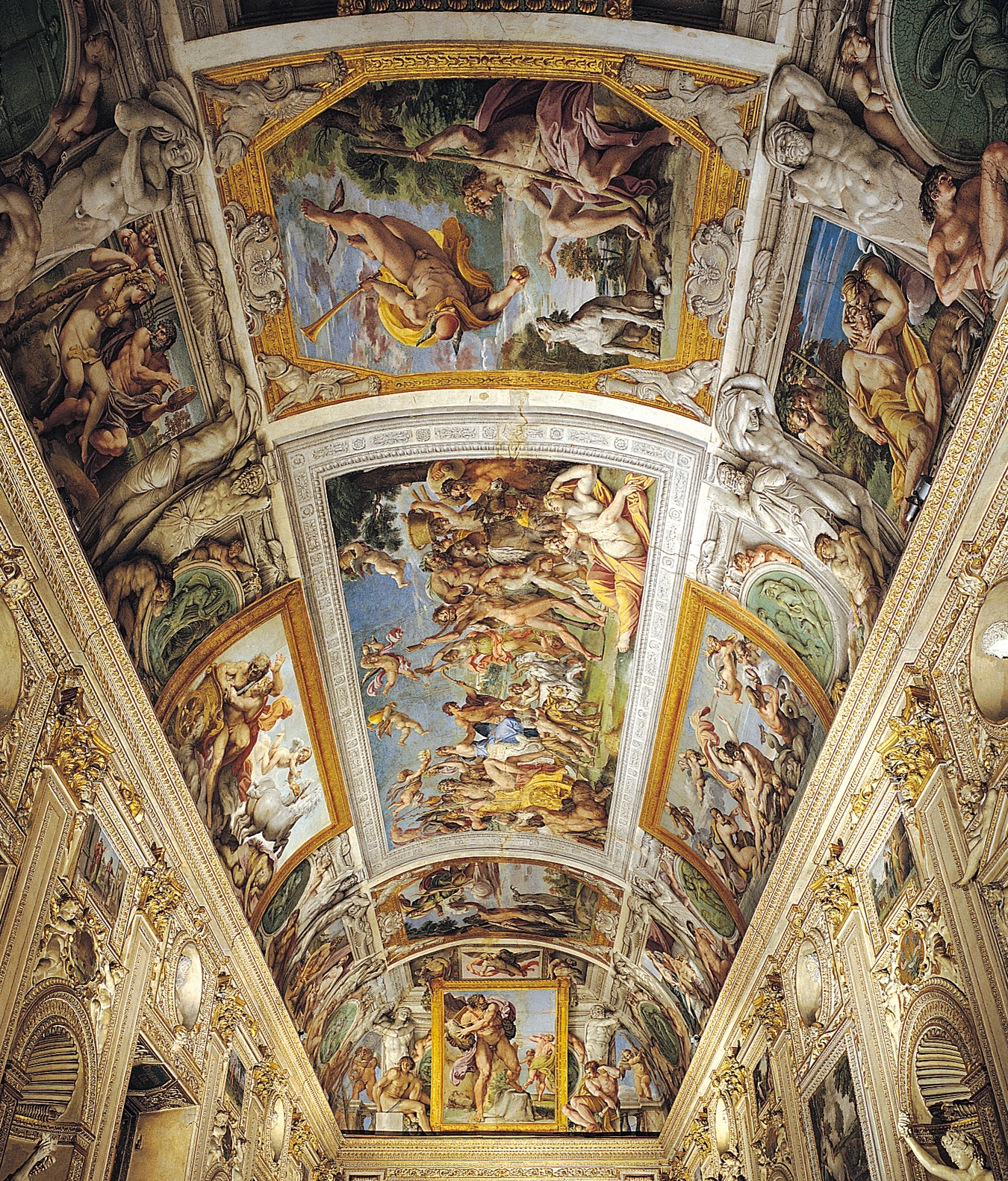
CARRACCI
ITALY

Slide 29
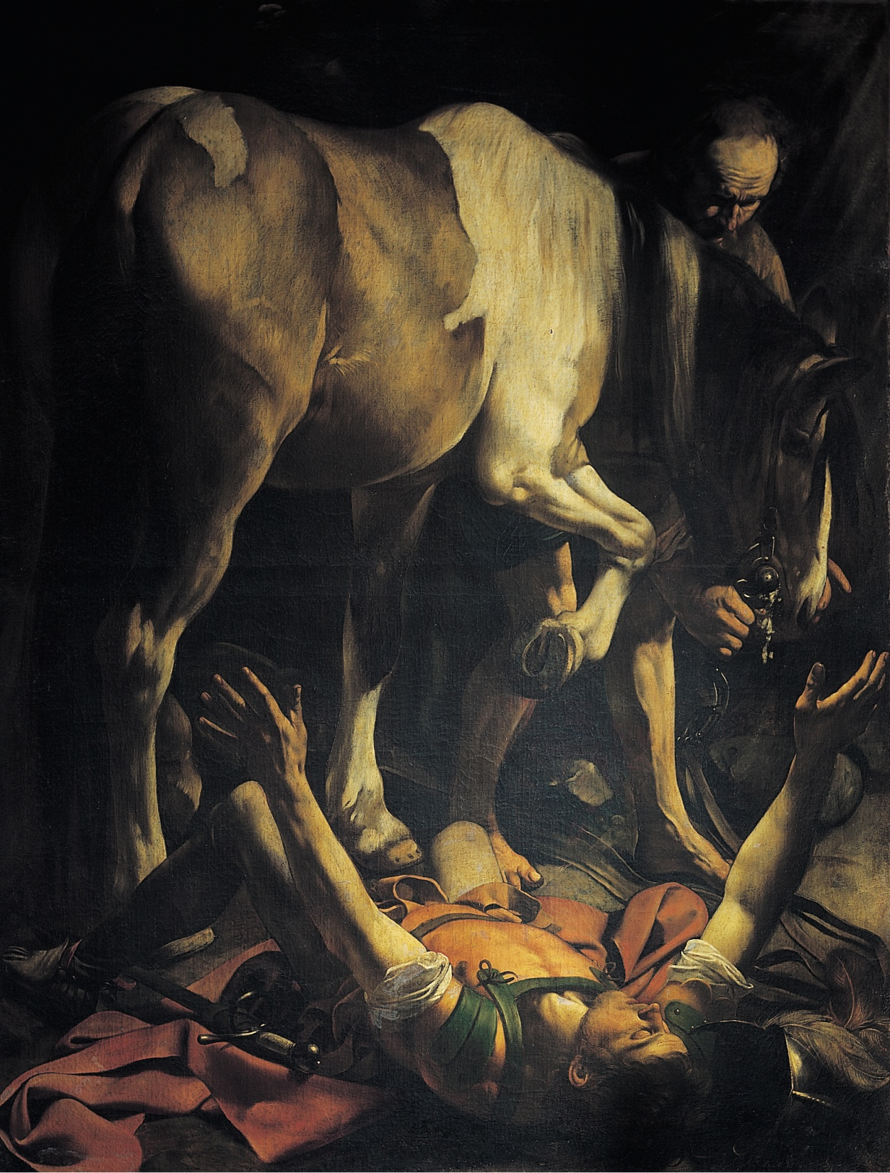
CARAVAGGIO

Slide 30
CARAVAGGIO
ITALY

Slide 31
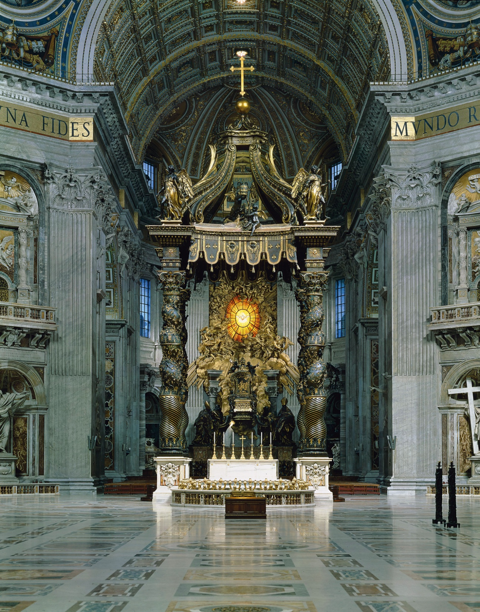
BERNINI

Slide 32
CARAVAGGIO

Slide 33
CARLO MADERNO

Slide 34
ARTEMISIA
GENTILESCHI-
ITALY

Slide 35
CARAVAGGIO - ITALY

Slide 36
BERNINI
ITALY

Slide 37
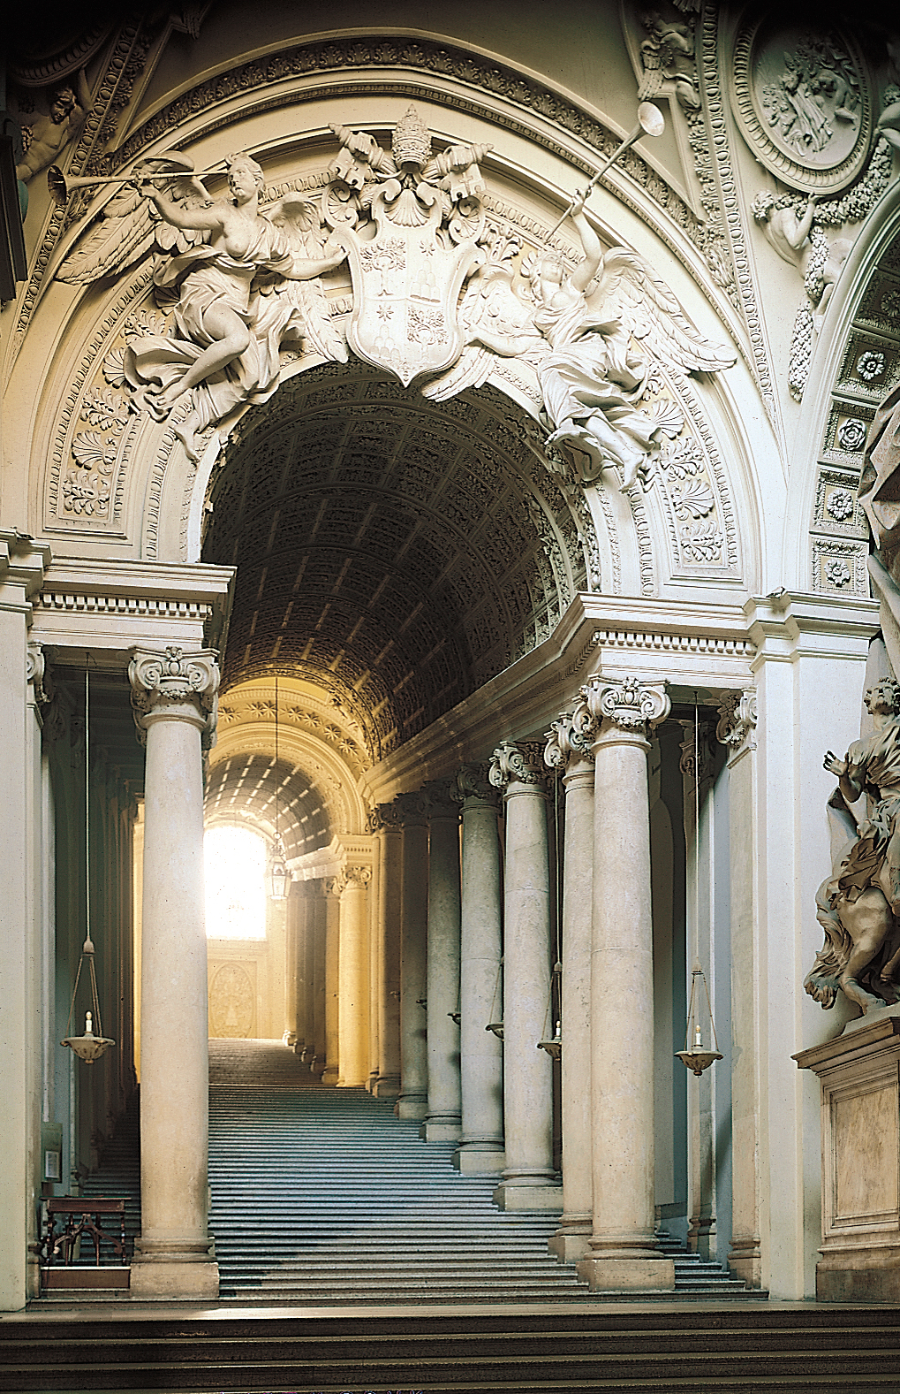
BERNINI
ITALY

Slide 38
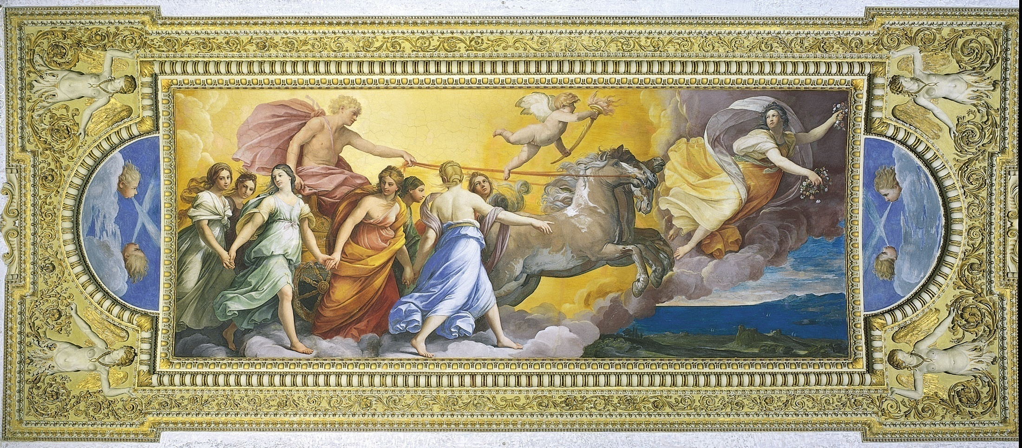
RENI - ITALY

Slide 39
BERNINI

Slide 40
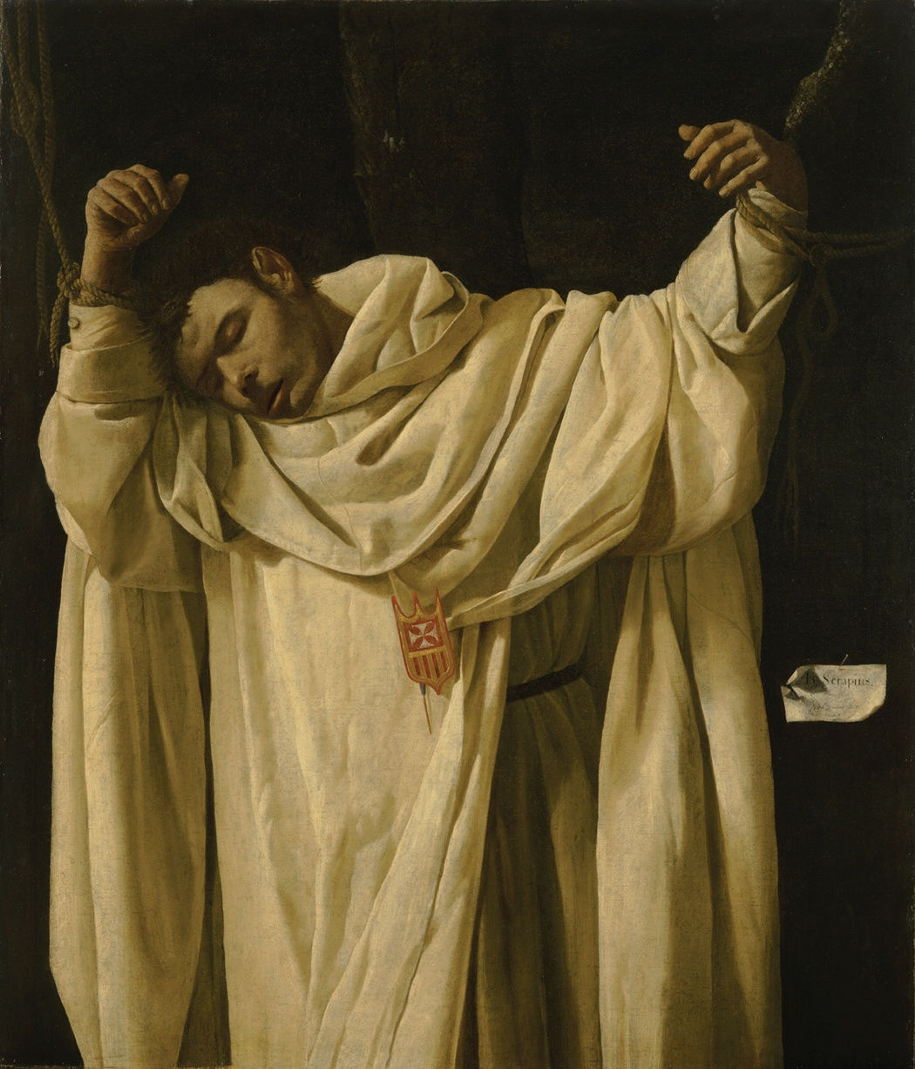
DE ZURBARÁN
SPAIN

Slide 41
VELAZQUEZ
SPAIN

Slide 42
Northern Europe BAROQUE REVIEW

Slide 43
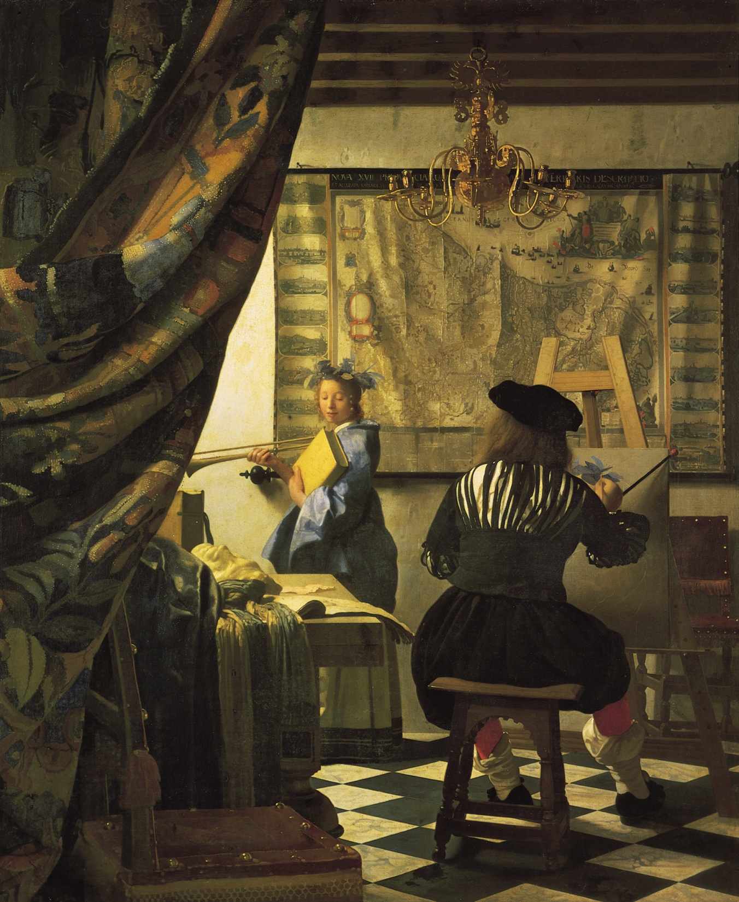
VERMEER
Dutch

Slide 44
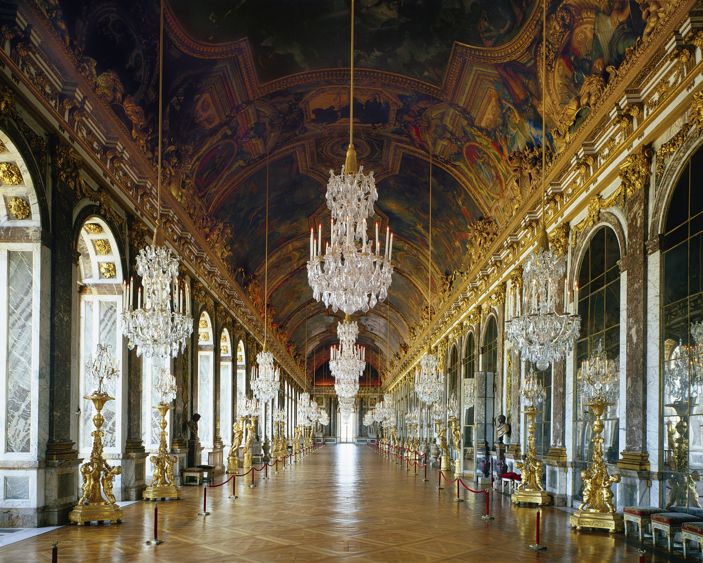
Hall of Mirrors, palace of Louis XIV, Versailles

Slide 45
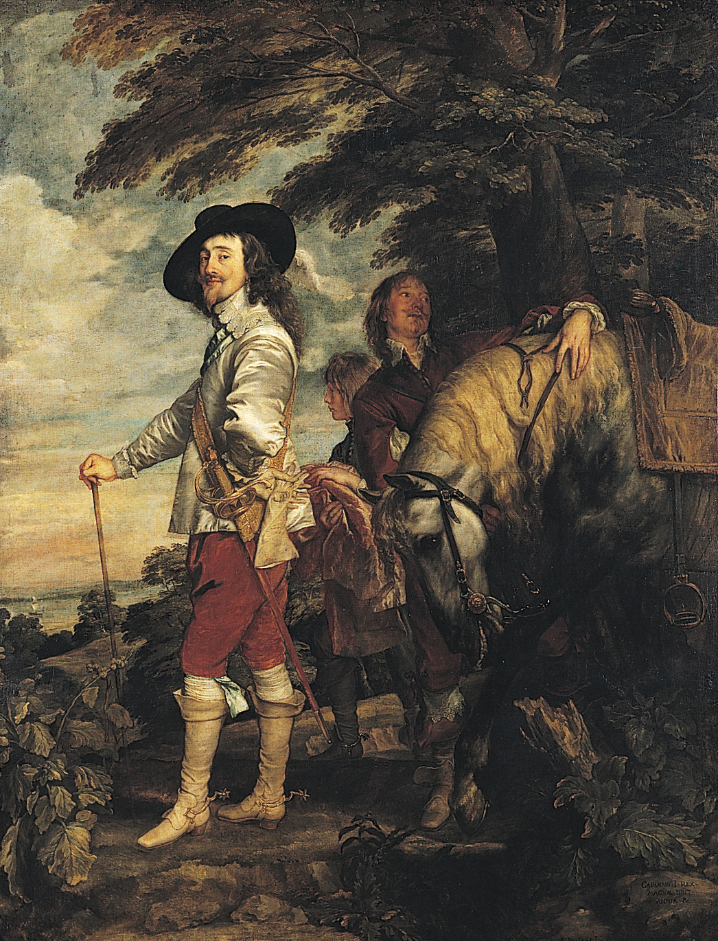
Van Dyke
Flanders

Slide 46
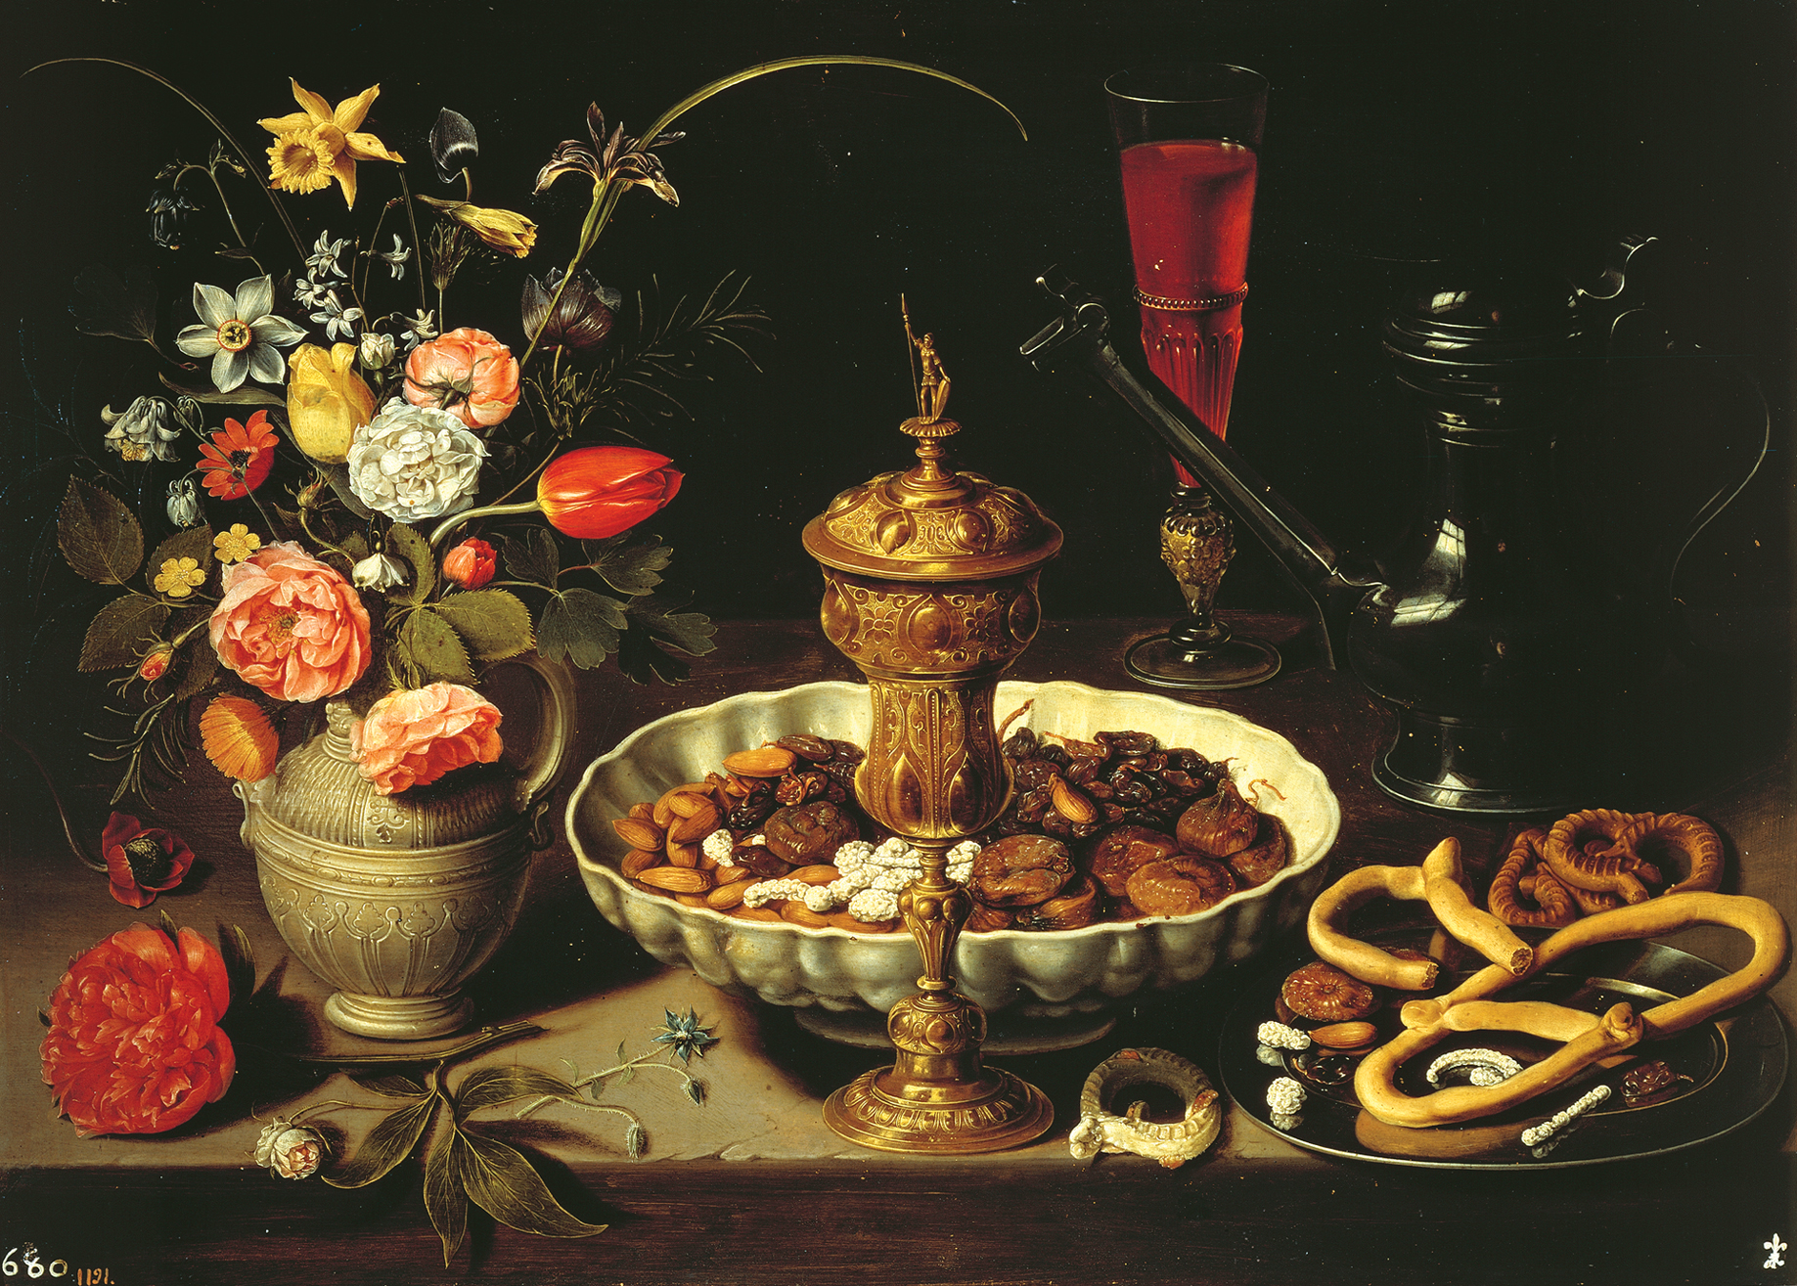
Clara Peeters- Flanders

Slide 47
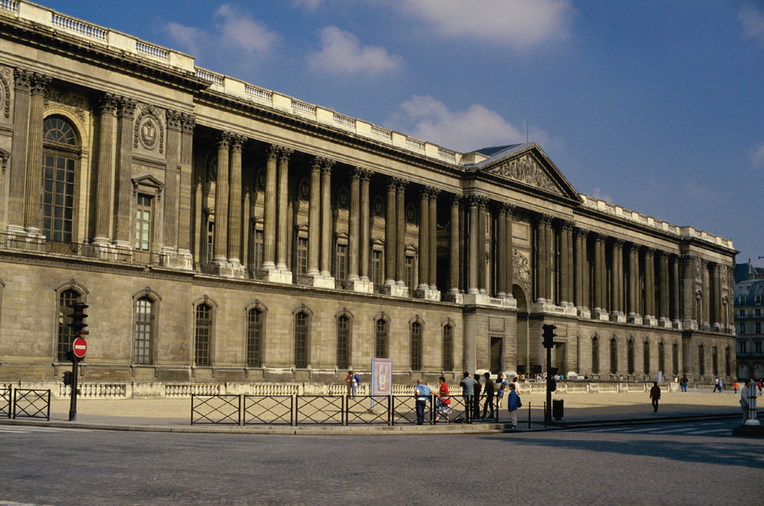
East facade of the Louvre, Paris, France

Slide 48
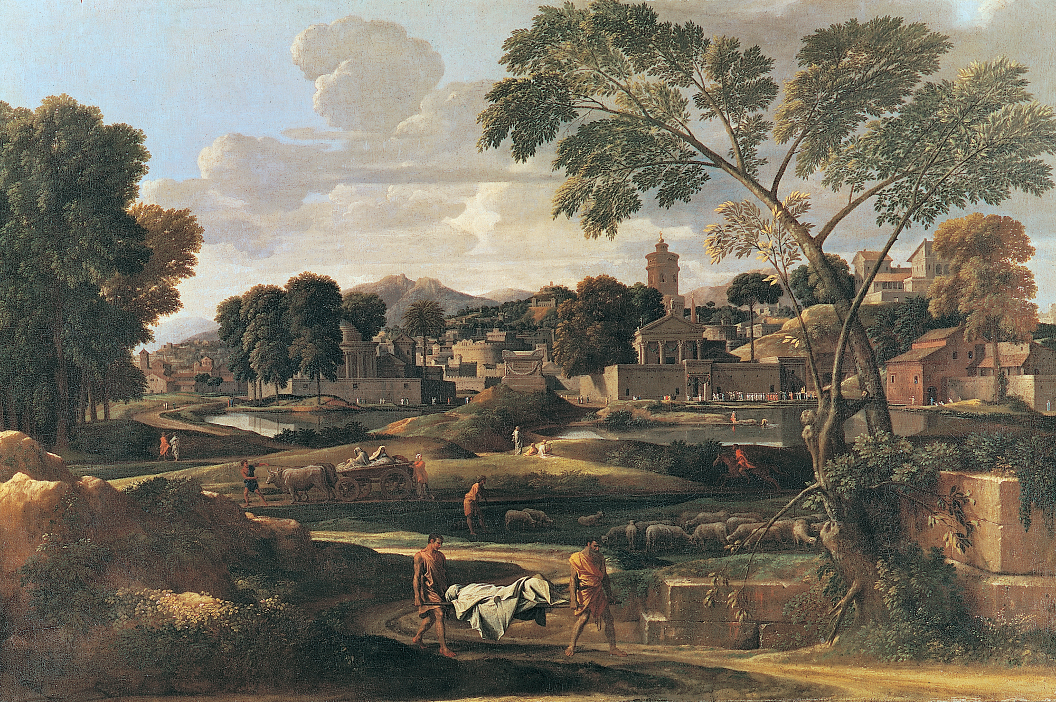
NICOLAS POUSSIN - France

Slide 49
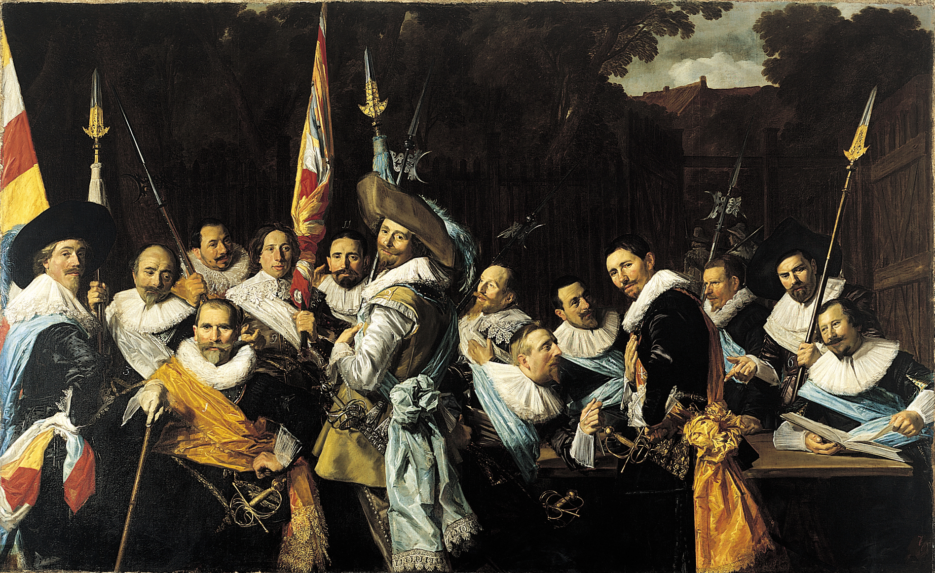
Hals - Dutch

Slide 50
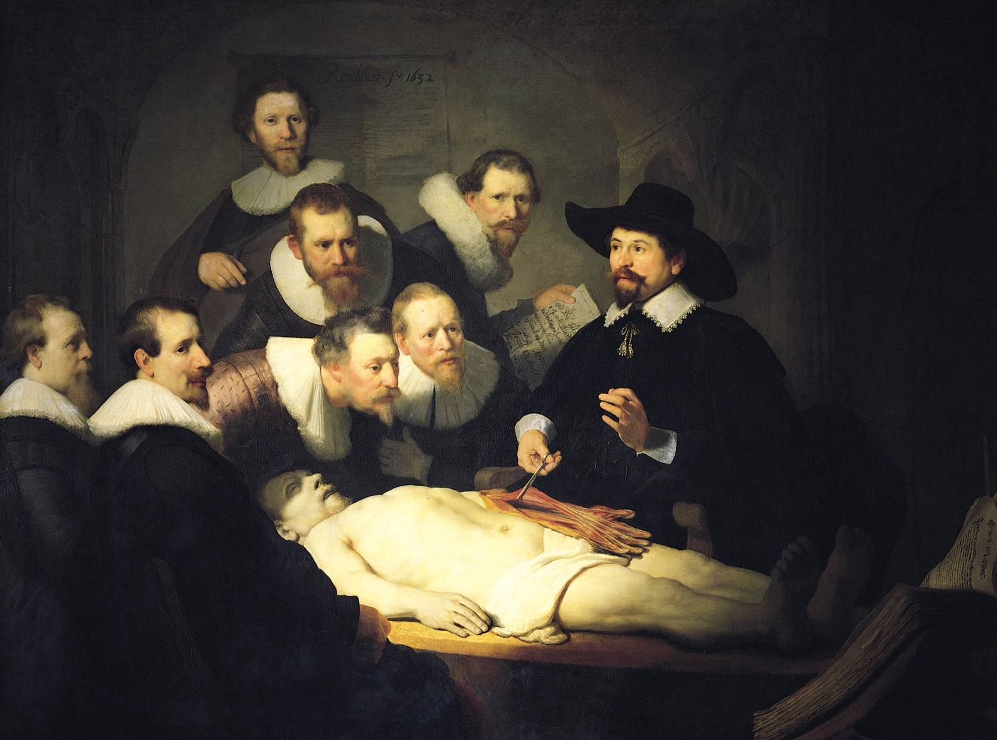
Rembrandt - Dutch

Slide 51
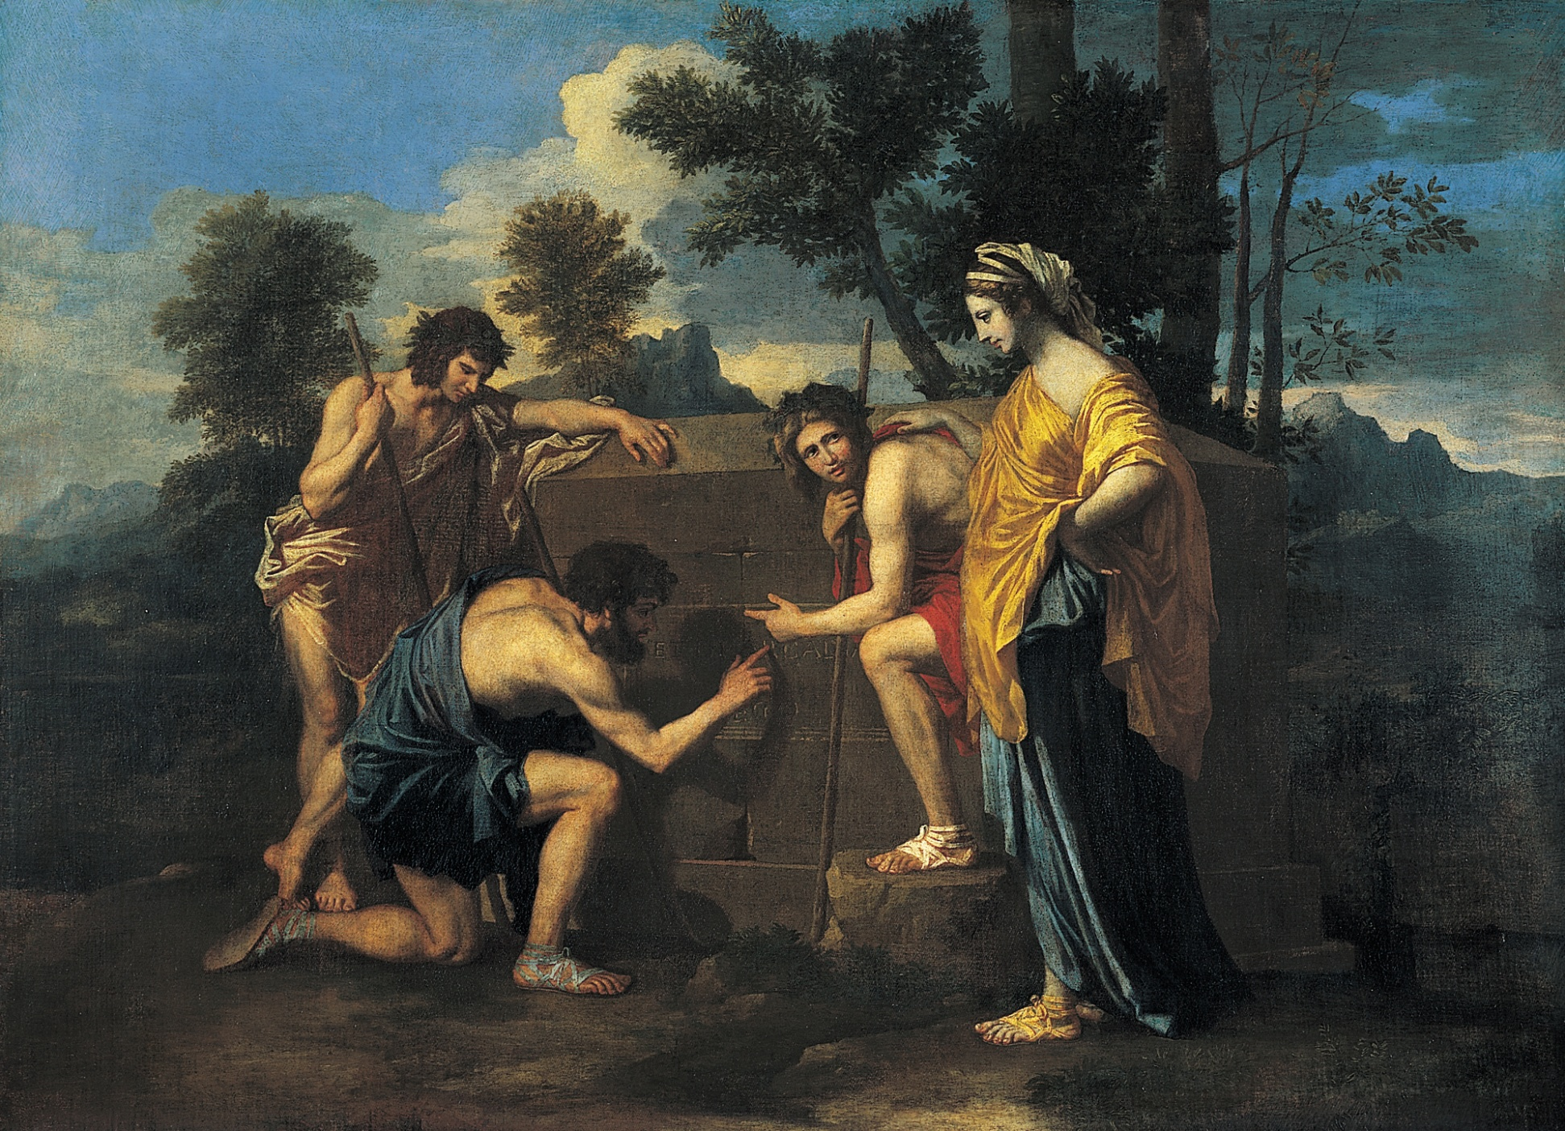
NICOLAS POUSSIN - France

Slide 52
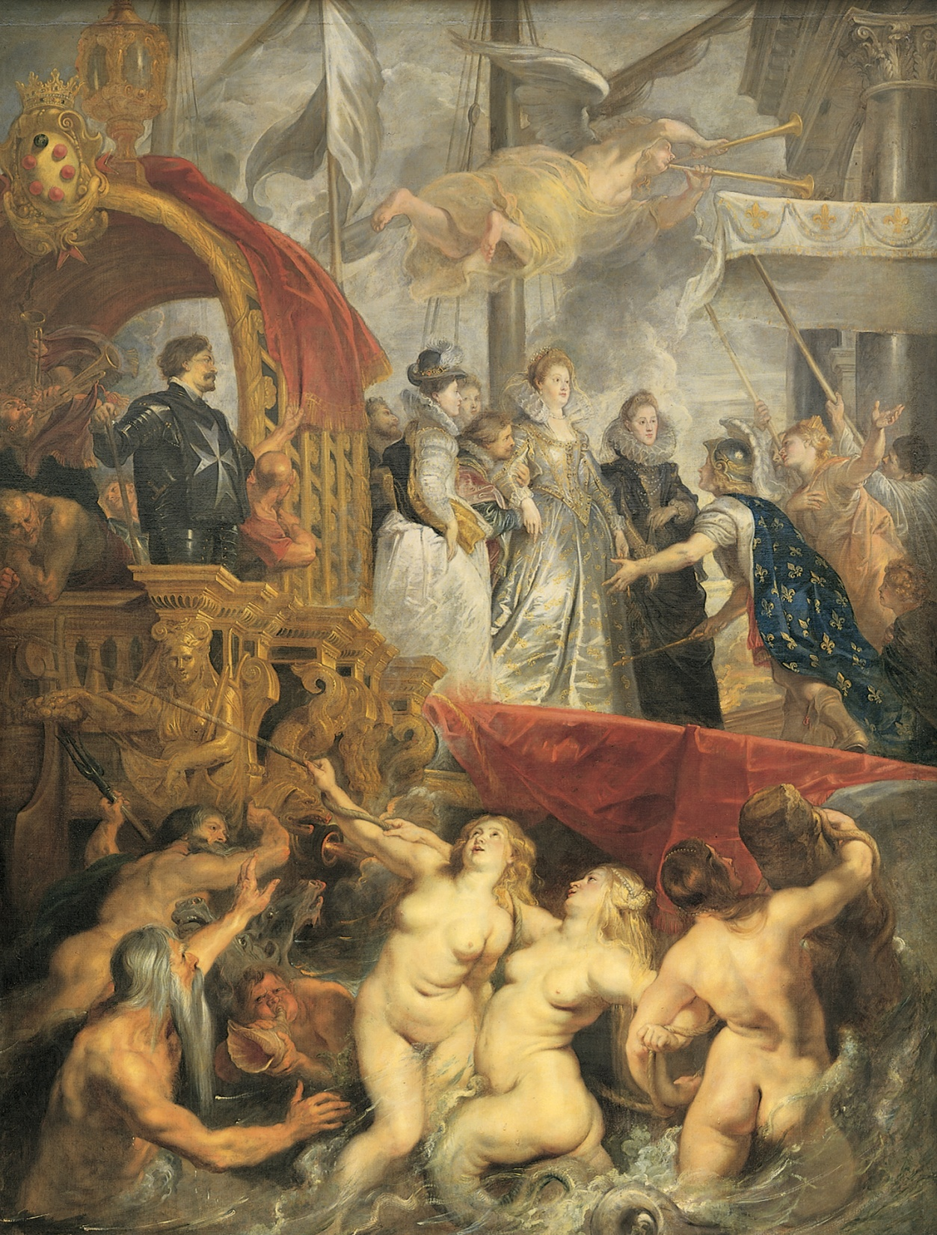
Rubens
Flanders

Slide 53
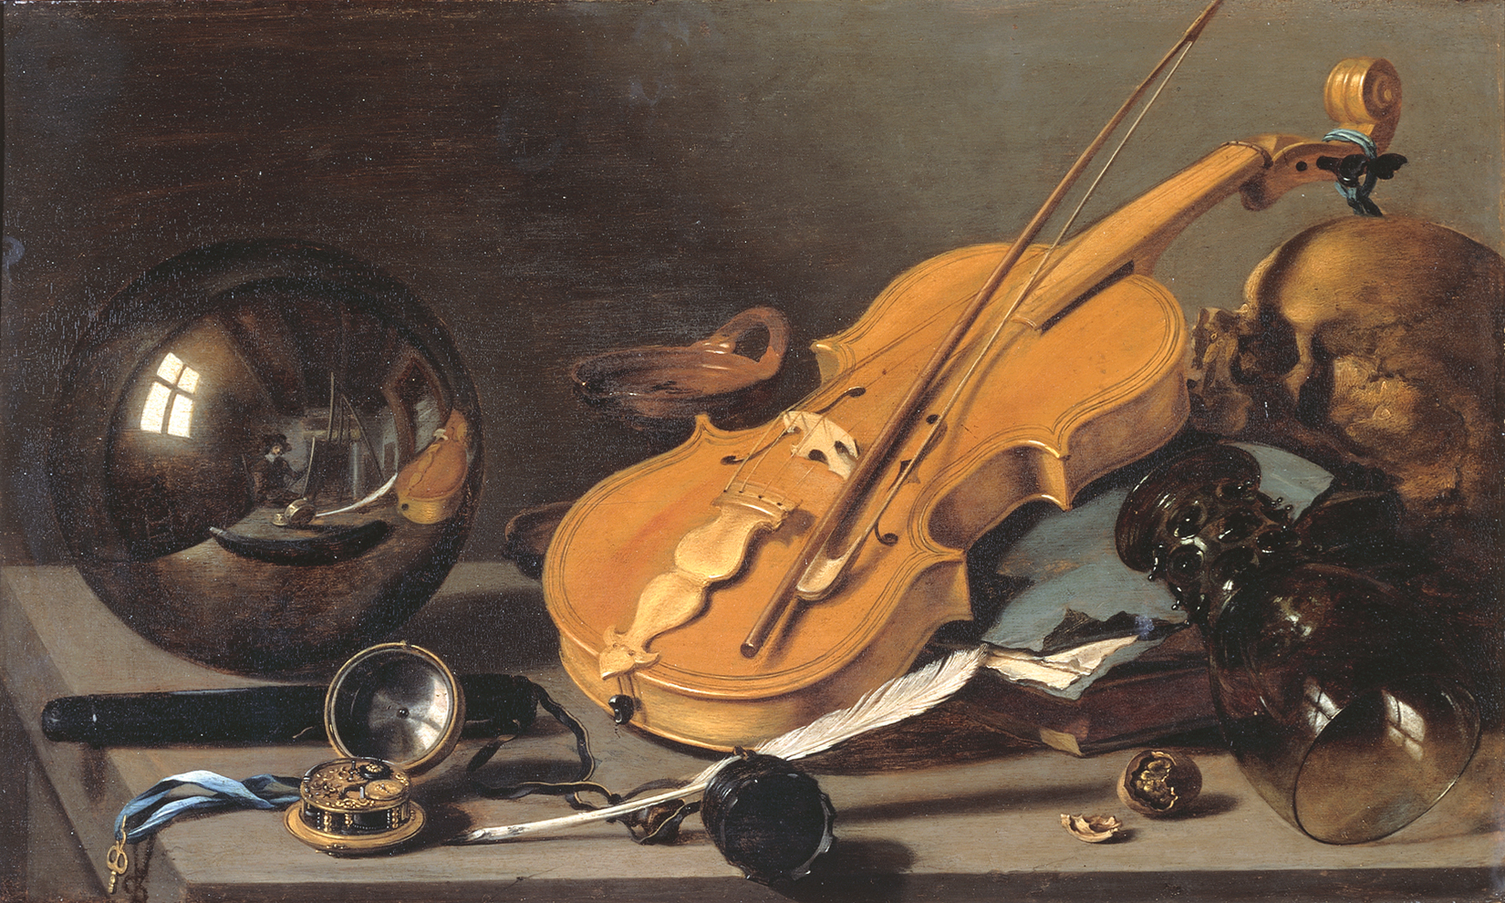
PIETER CLAESZ -Dutch

Slide 54
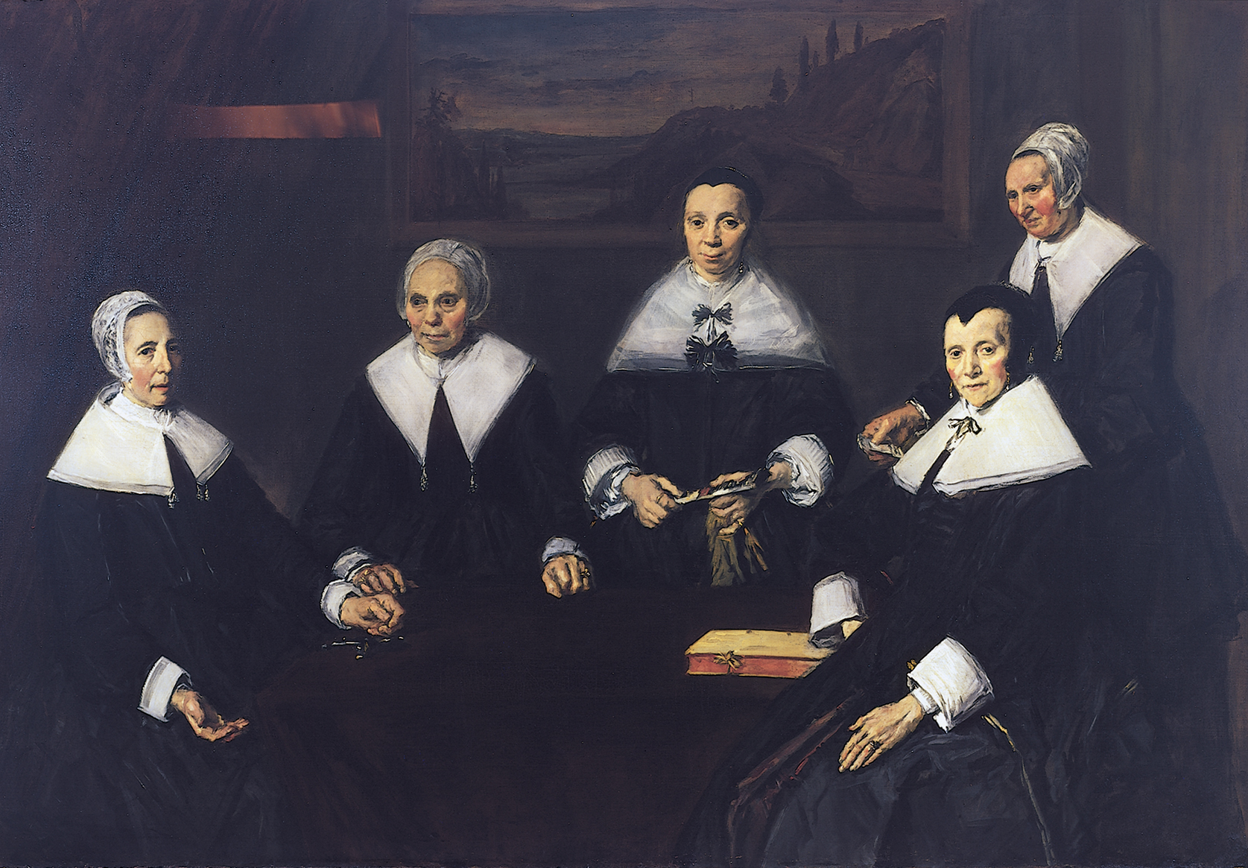
Hals - Dutch

Slide 55
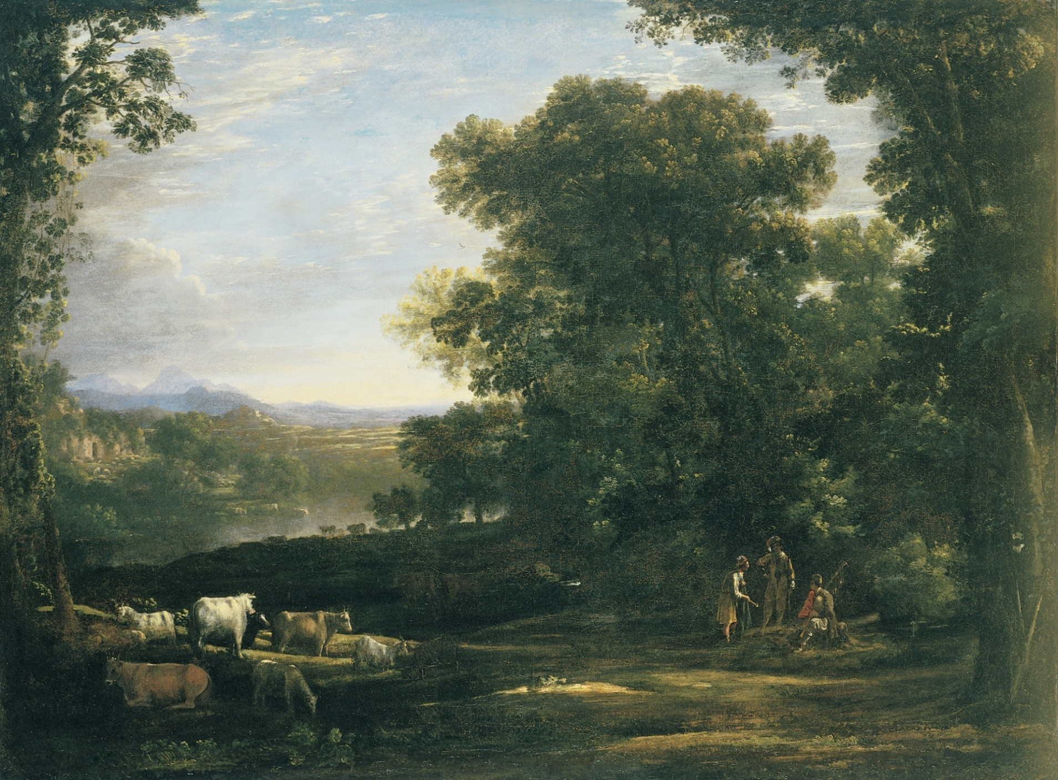
CLAUDE LORRAIN - France

Slide 56
Van Dyke
Flanders

Slide 57
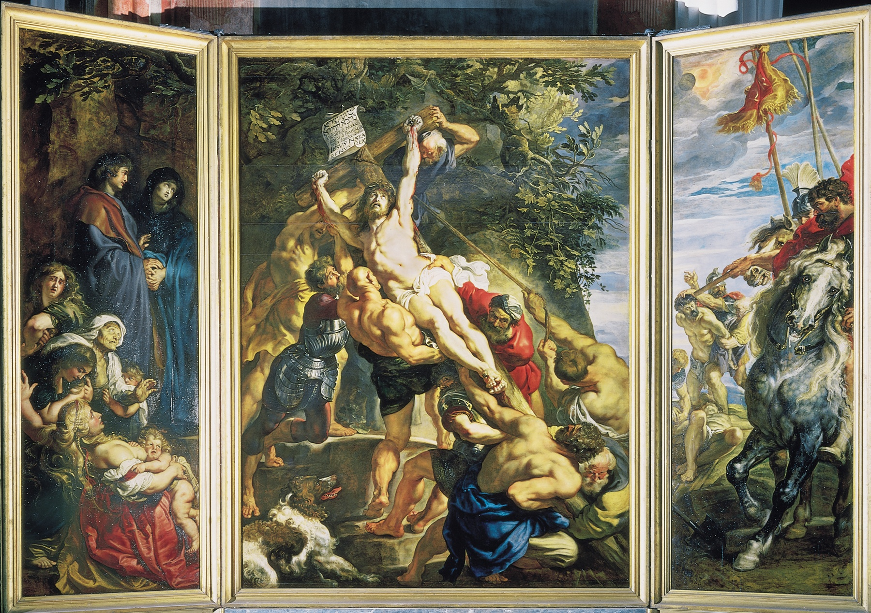
Rubens- Flanders

Slide 58
East facade of the Louvre, Paris, France

Slide 59
Hall of Mirrors, palace of Louis XIV, Versailles

Slide 60
NICOLAS POUSSIN - France

Slide 61
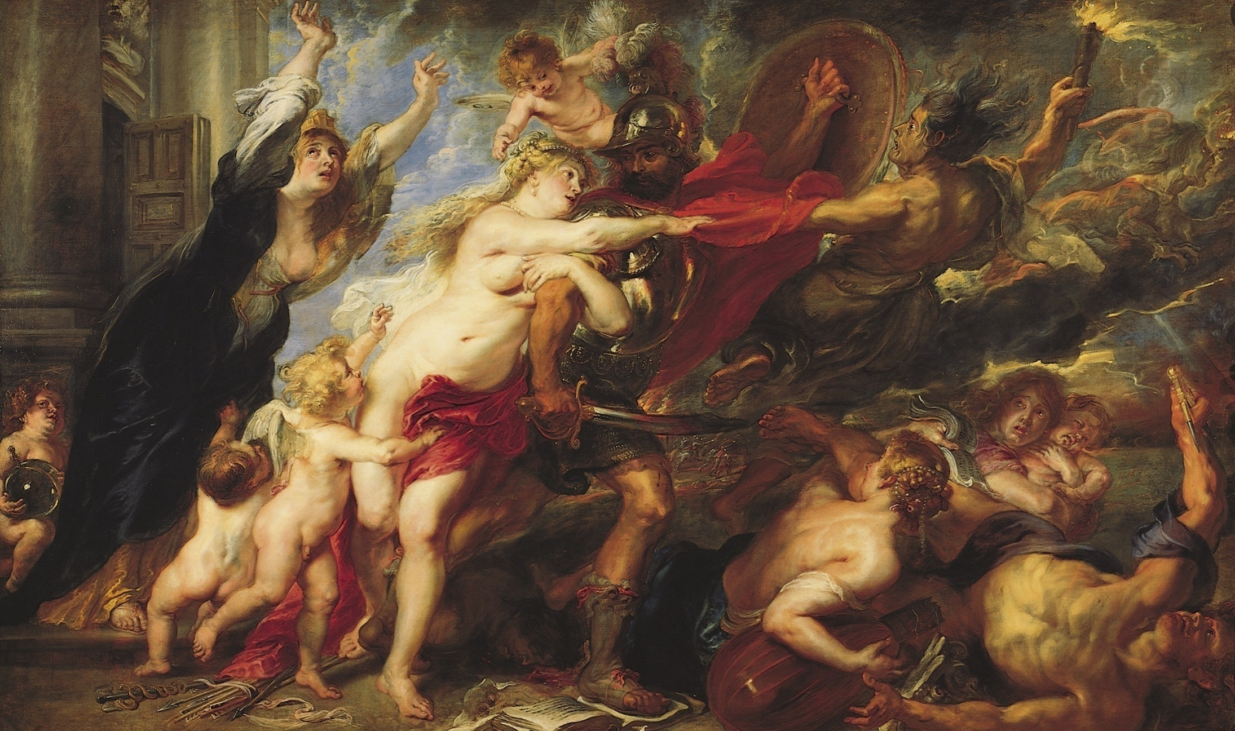
Rubens - Flanders

Slide 62
NICOLAS POUSSIN - France

Slide 63
PIETER CLAESZ -Dutch

Slide 64
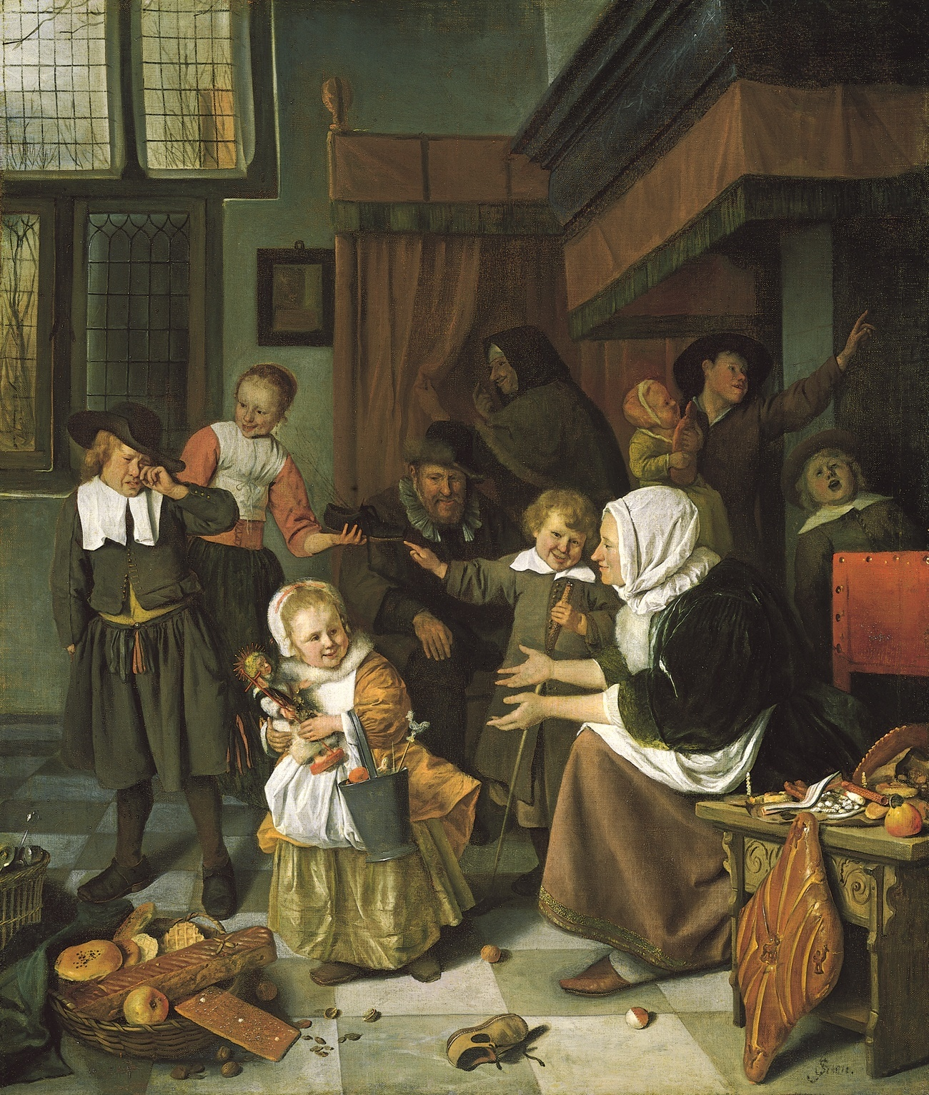
JAN STEEN
Dutch

Slide 65
VERMEER
Dutch

Slide 66
Rubens
Flanders

Slide 67
Clara Peeters- Flanders

Slide 68
Rembrandt - Dutch

Slide 69
CLAUDE LORRAIN - France

Slide 70
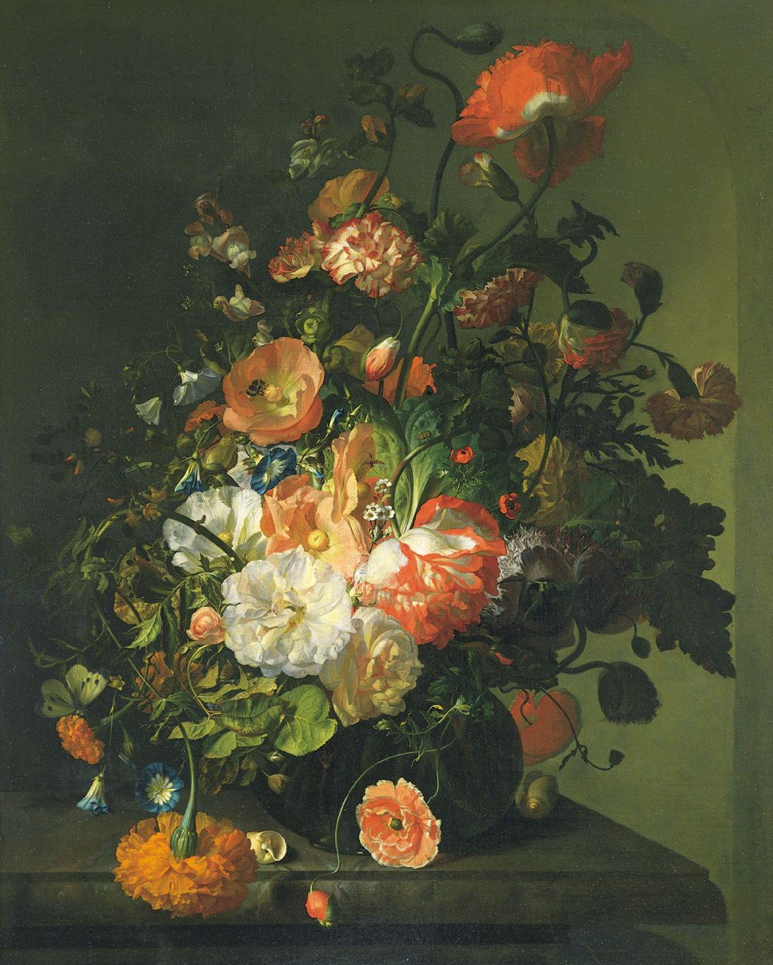
RUYSCH - Dutch

Slide 71
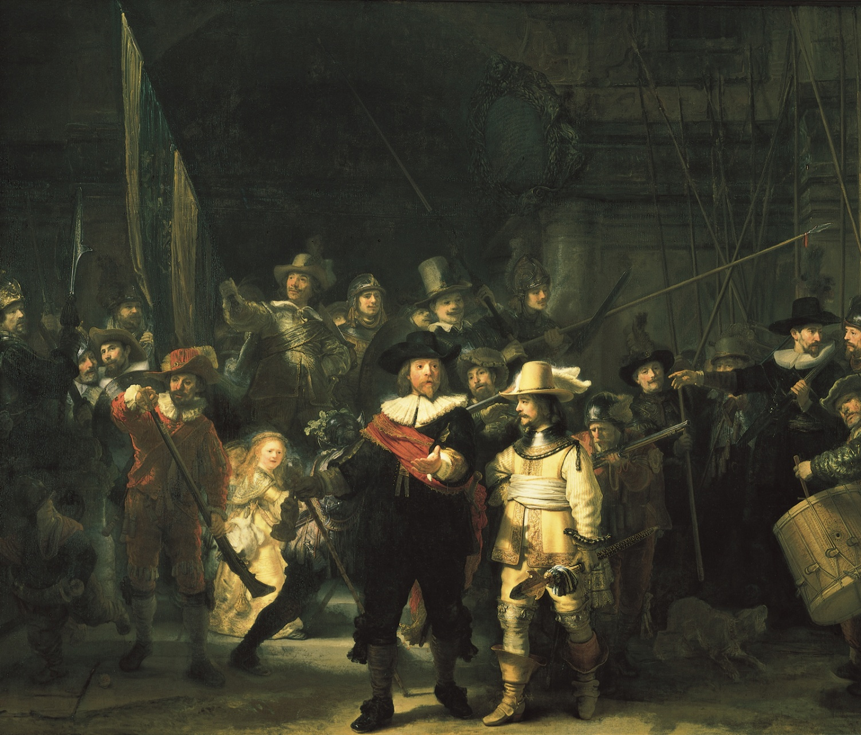
Rembrandt - Dutch

Slide 72
Rubens- Flanders

Slide 73
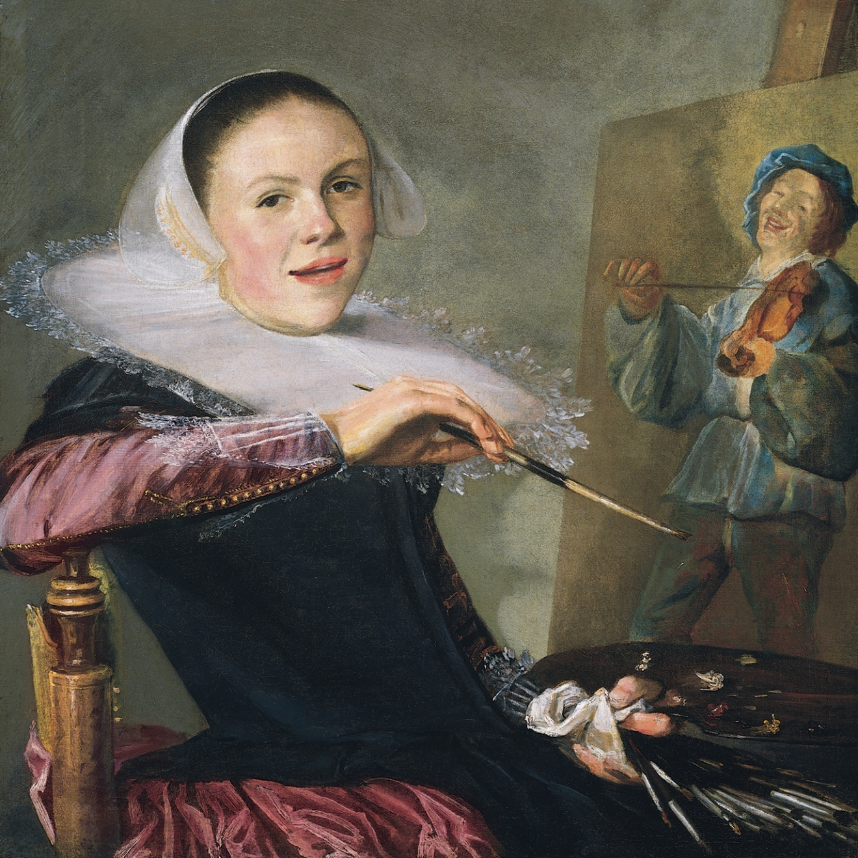
Leyster - Dutch

Slide 74
Clara Peeters- Flanders

Slide 75
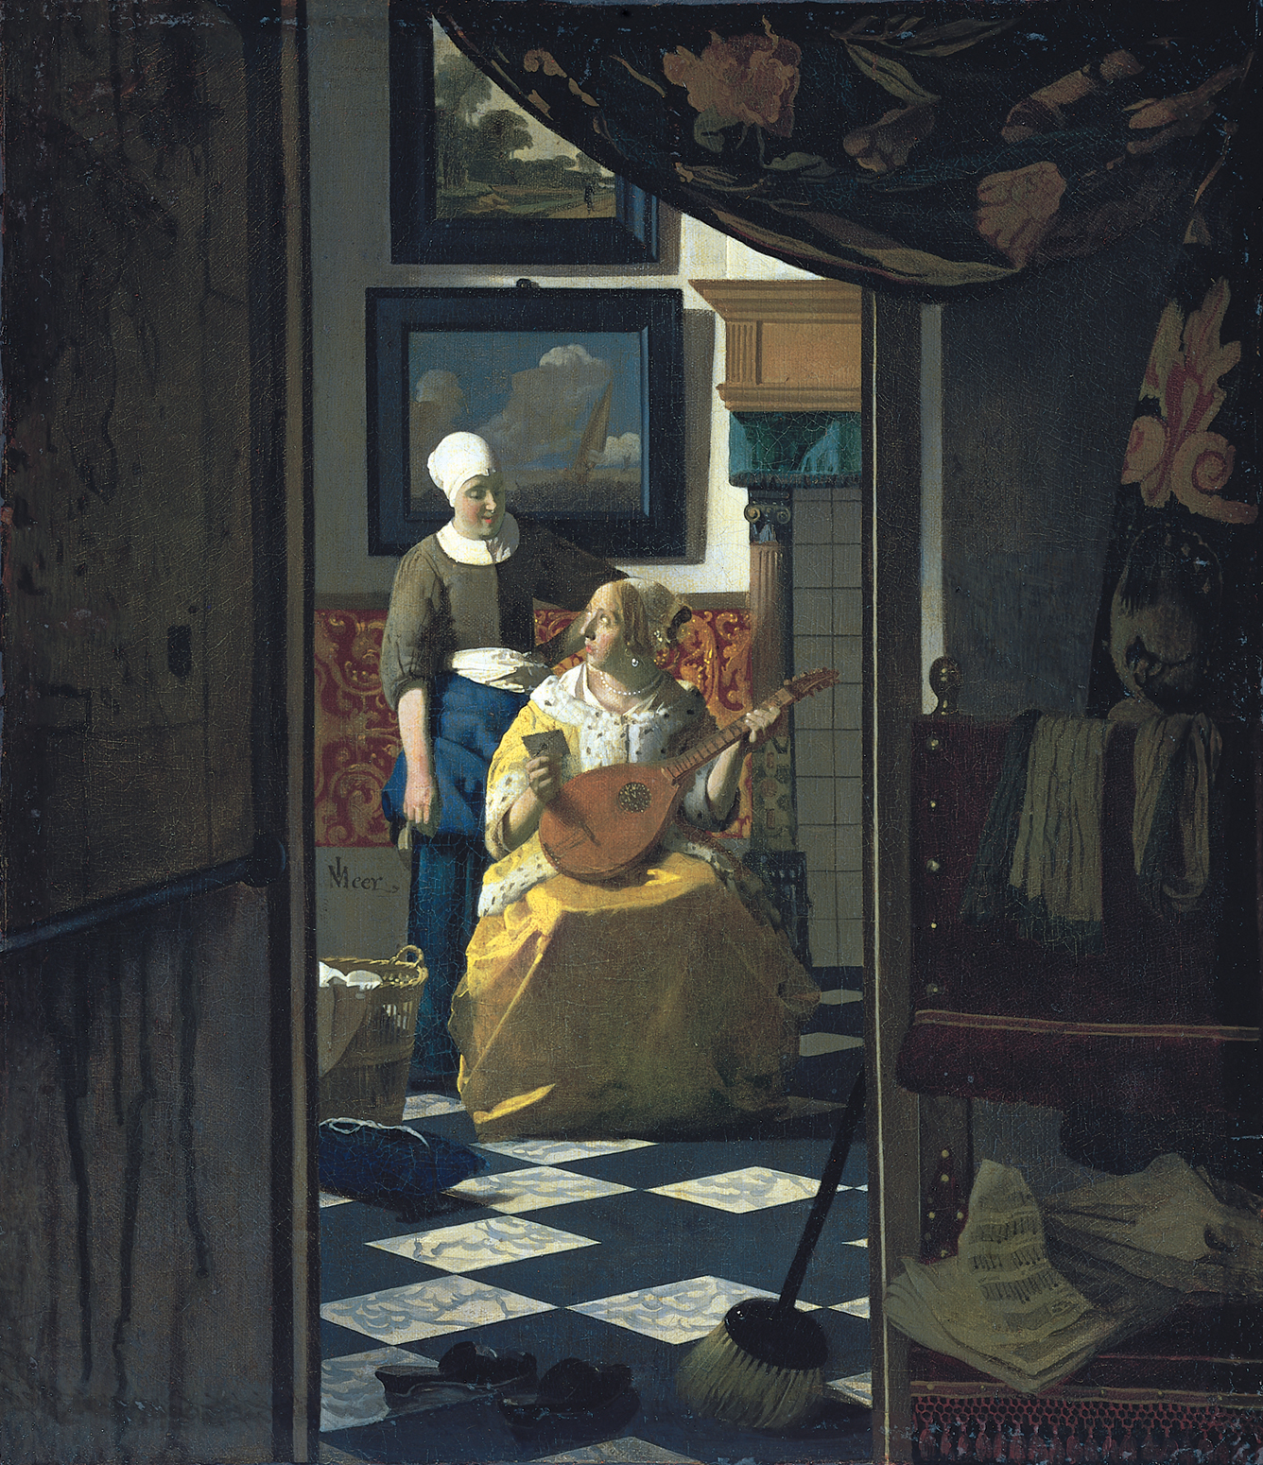
VERMEER
Dutch

Slide 76
Hals - Dutch

Slide 77
Hals - Dutch

Slide 78
JAN STEEN
Dutch

Slide 79
NICOLAS POUSSIN - France

Slide 80
Rembrandt - Dutch

