Slide 1
Chapter 29 artist review
Rococo to Neoclassicism
1700-1800

Slide 2
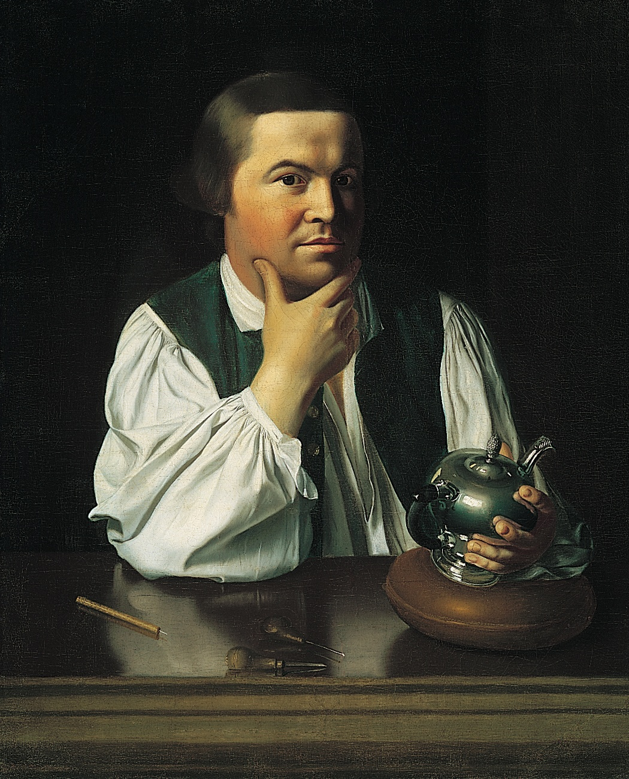
Copley
America
Enlightenment

Slide 3
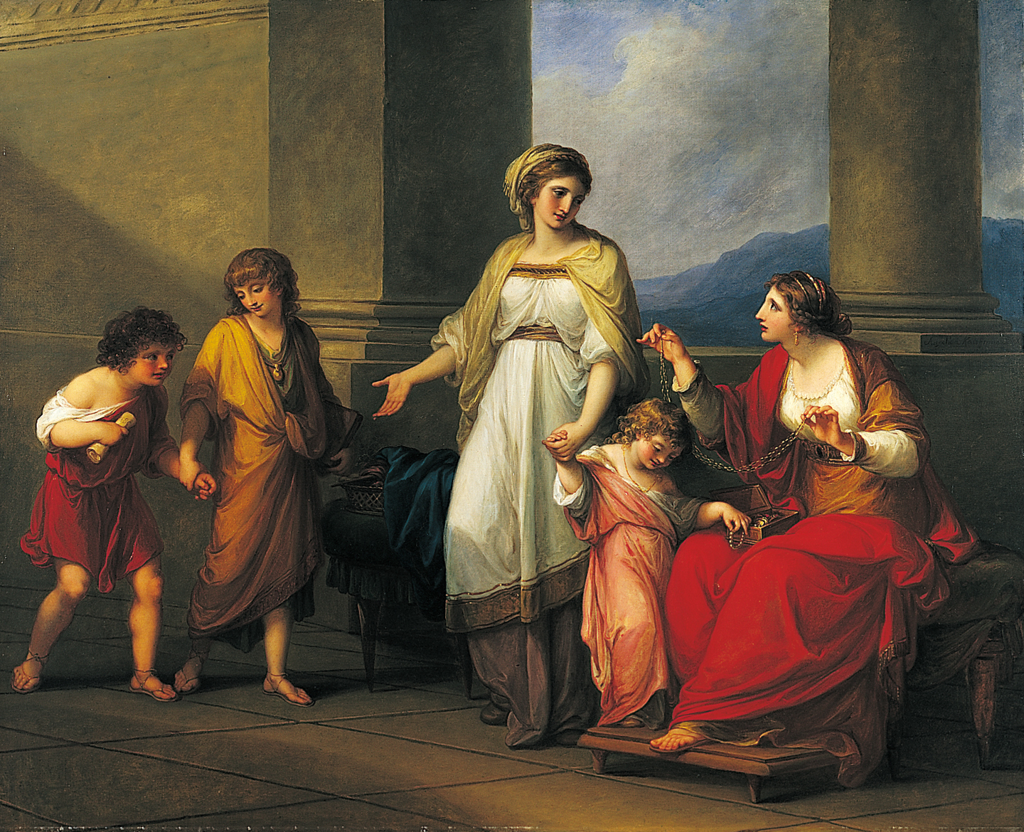
Kauffmann - England
Neoclassical

Slide 4
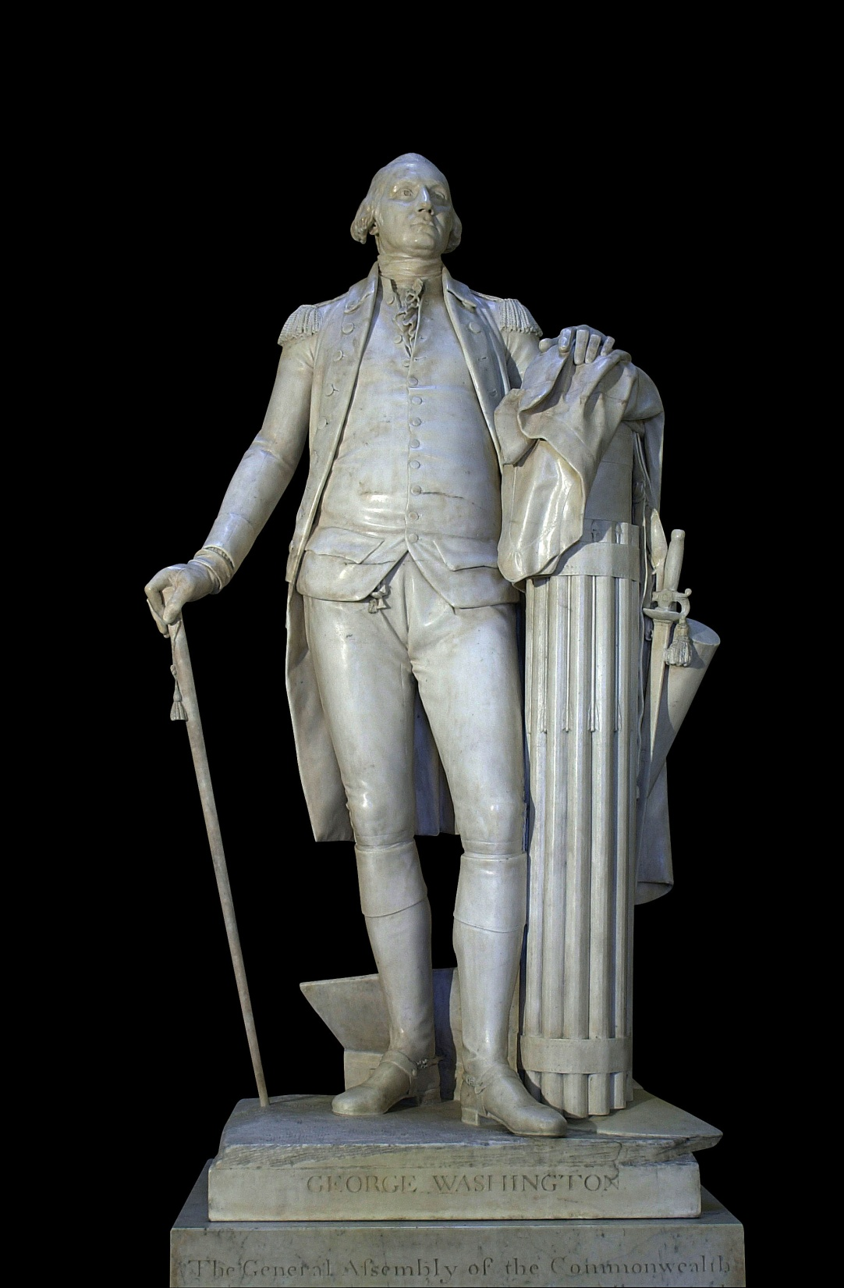
Houdon -
Neoclassical sculpture
France

Slide 5
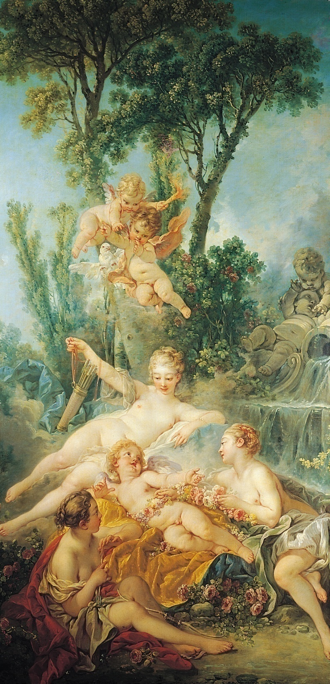
Boucher
Rococo - France

Slide 6
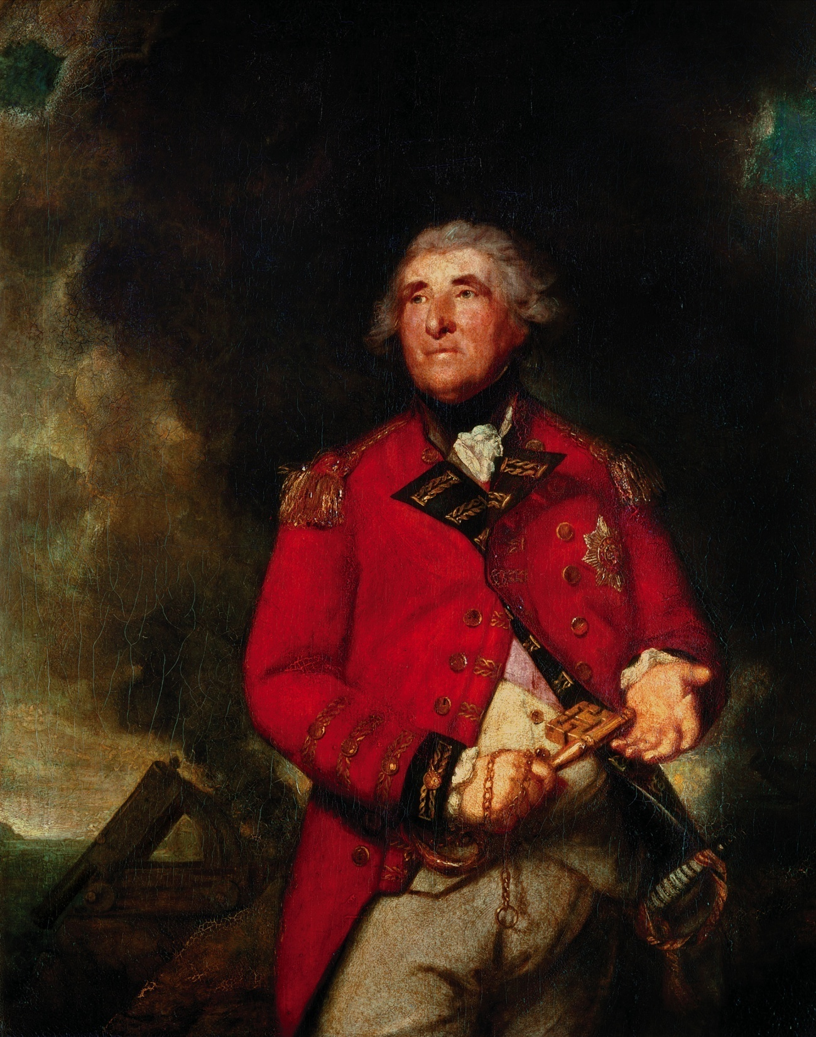
Reynolds –
Enlightenment
England

Slide 7
Boucher
Rococo - France

Slide 8
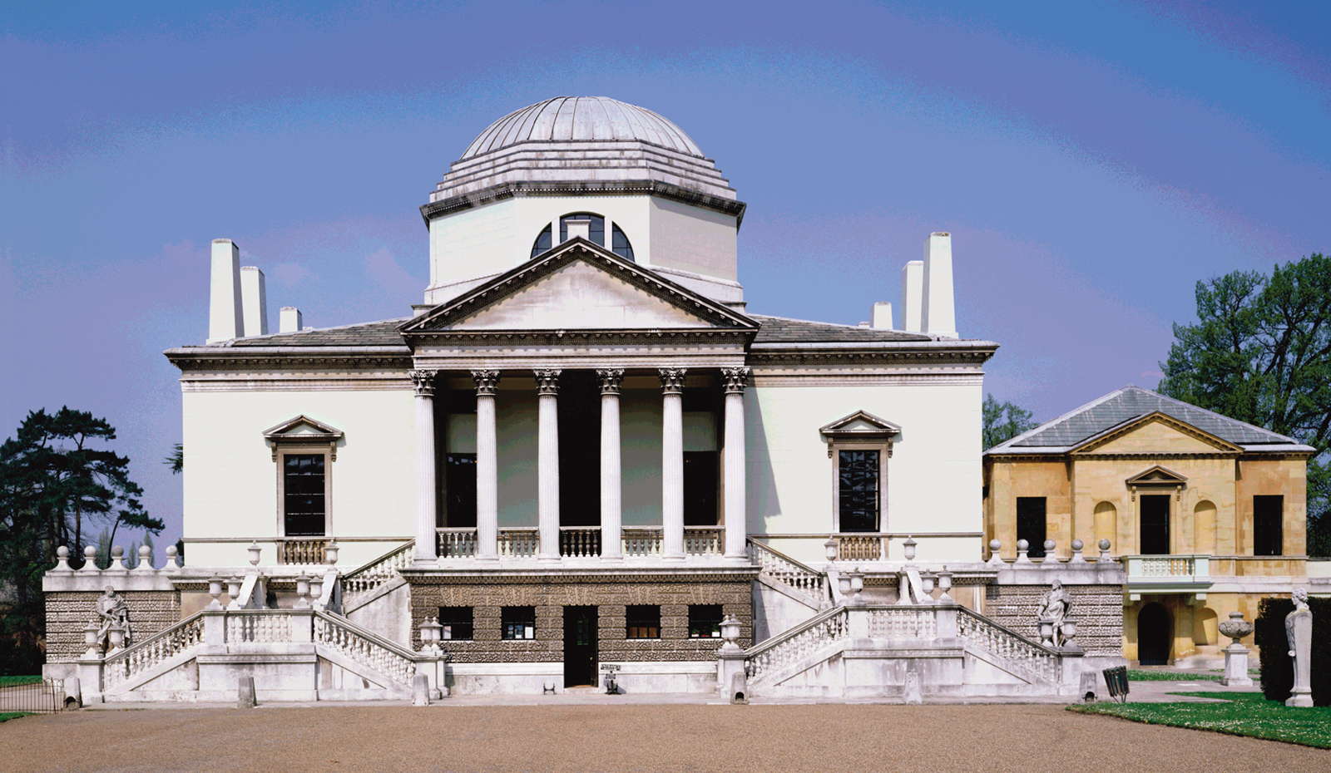
Boyle and Kent
Neoclassical architecture
England

Slide 9
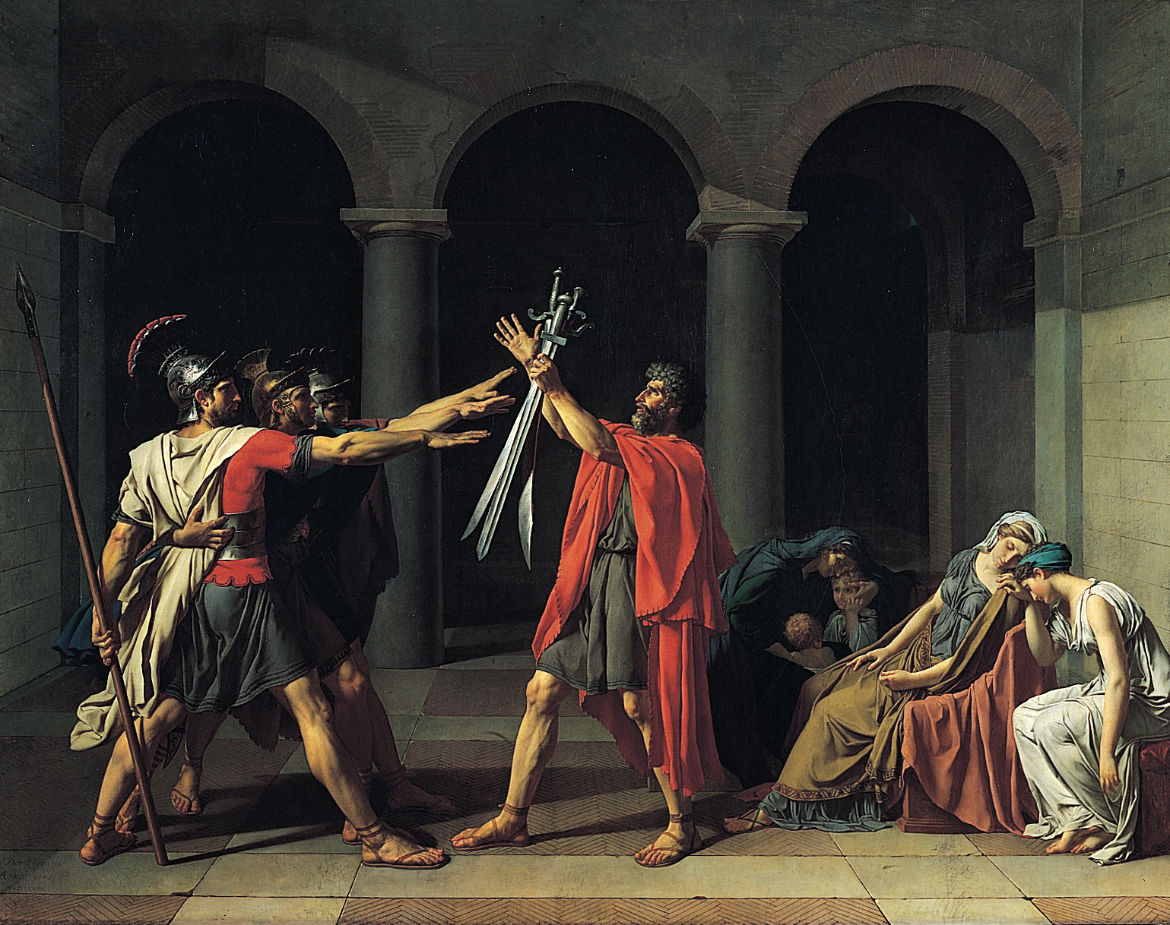
David – Neoclassical
France

Slide 10
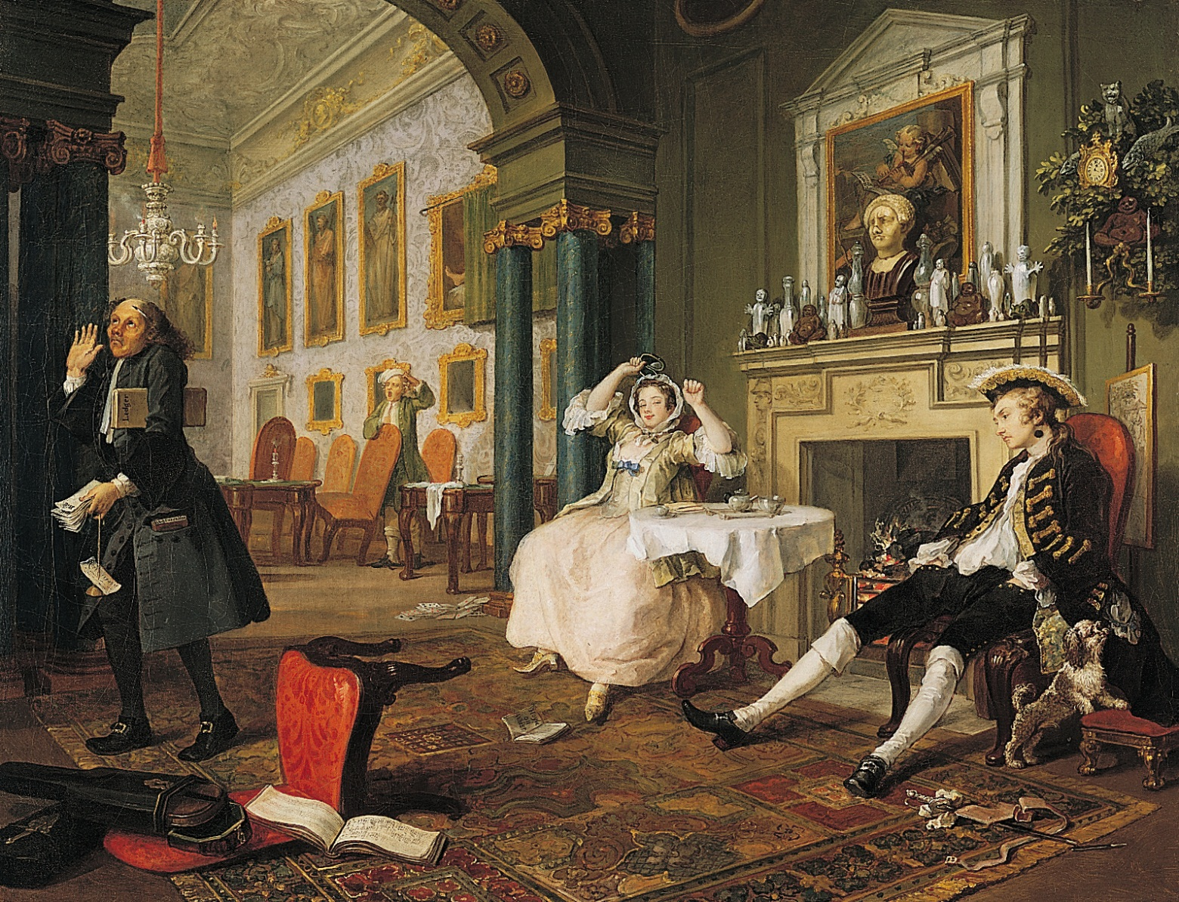
Hogarth –
Enlightenment - England

Slide 11
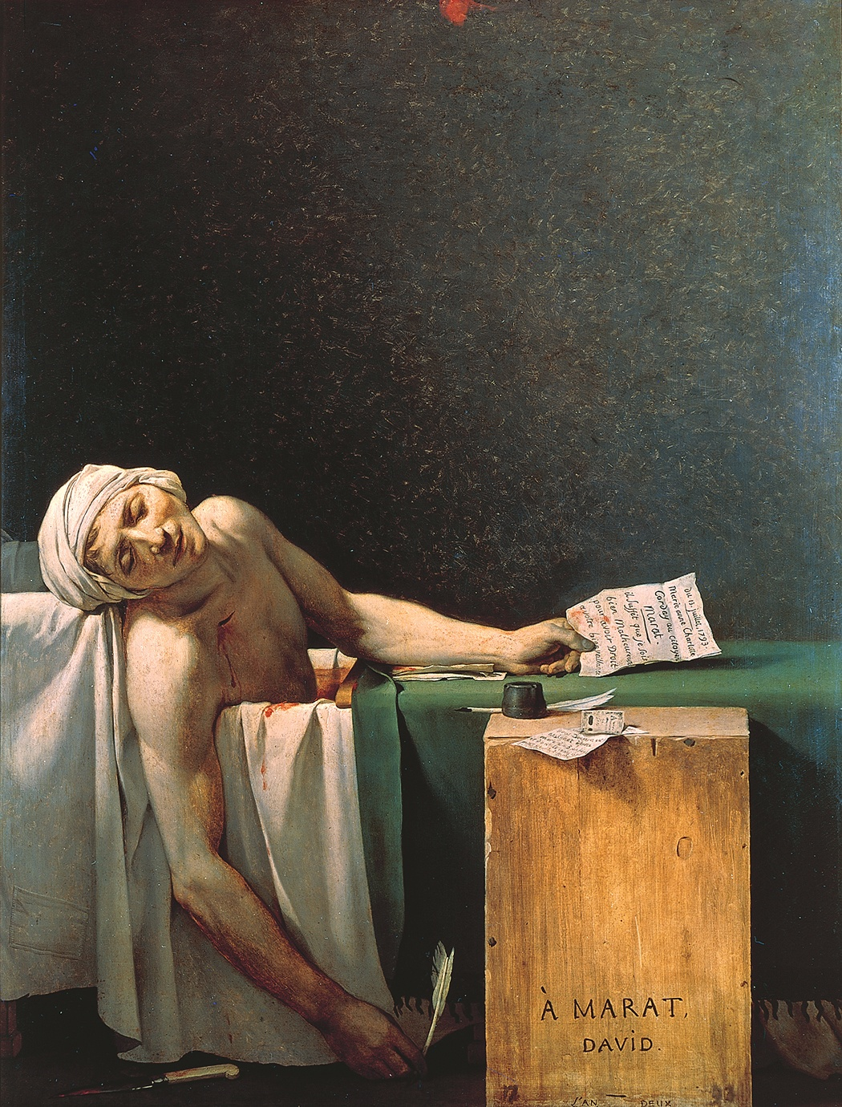
David – Neoclassical
France

Slide 12
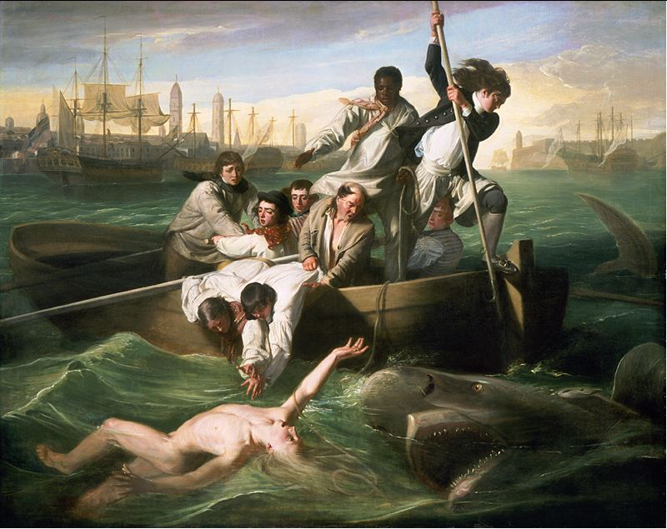
Copley –
America - Enlightenment

Slide 13
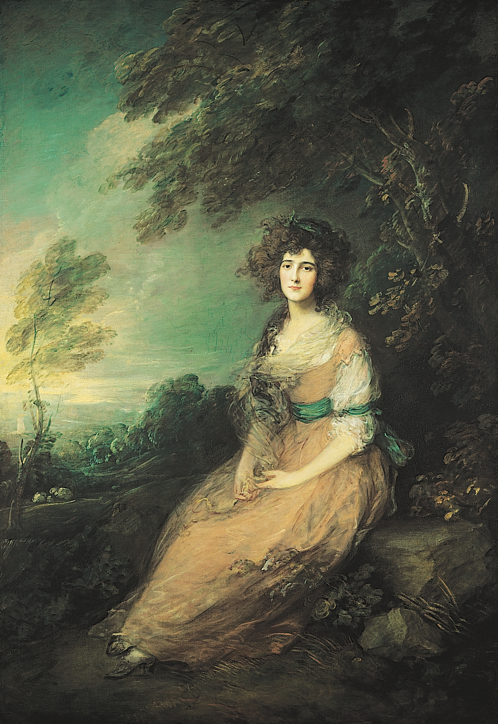
Gainsborough
Enlightenment
England

Slide 14
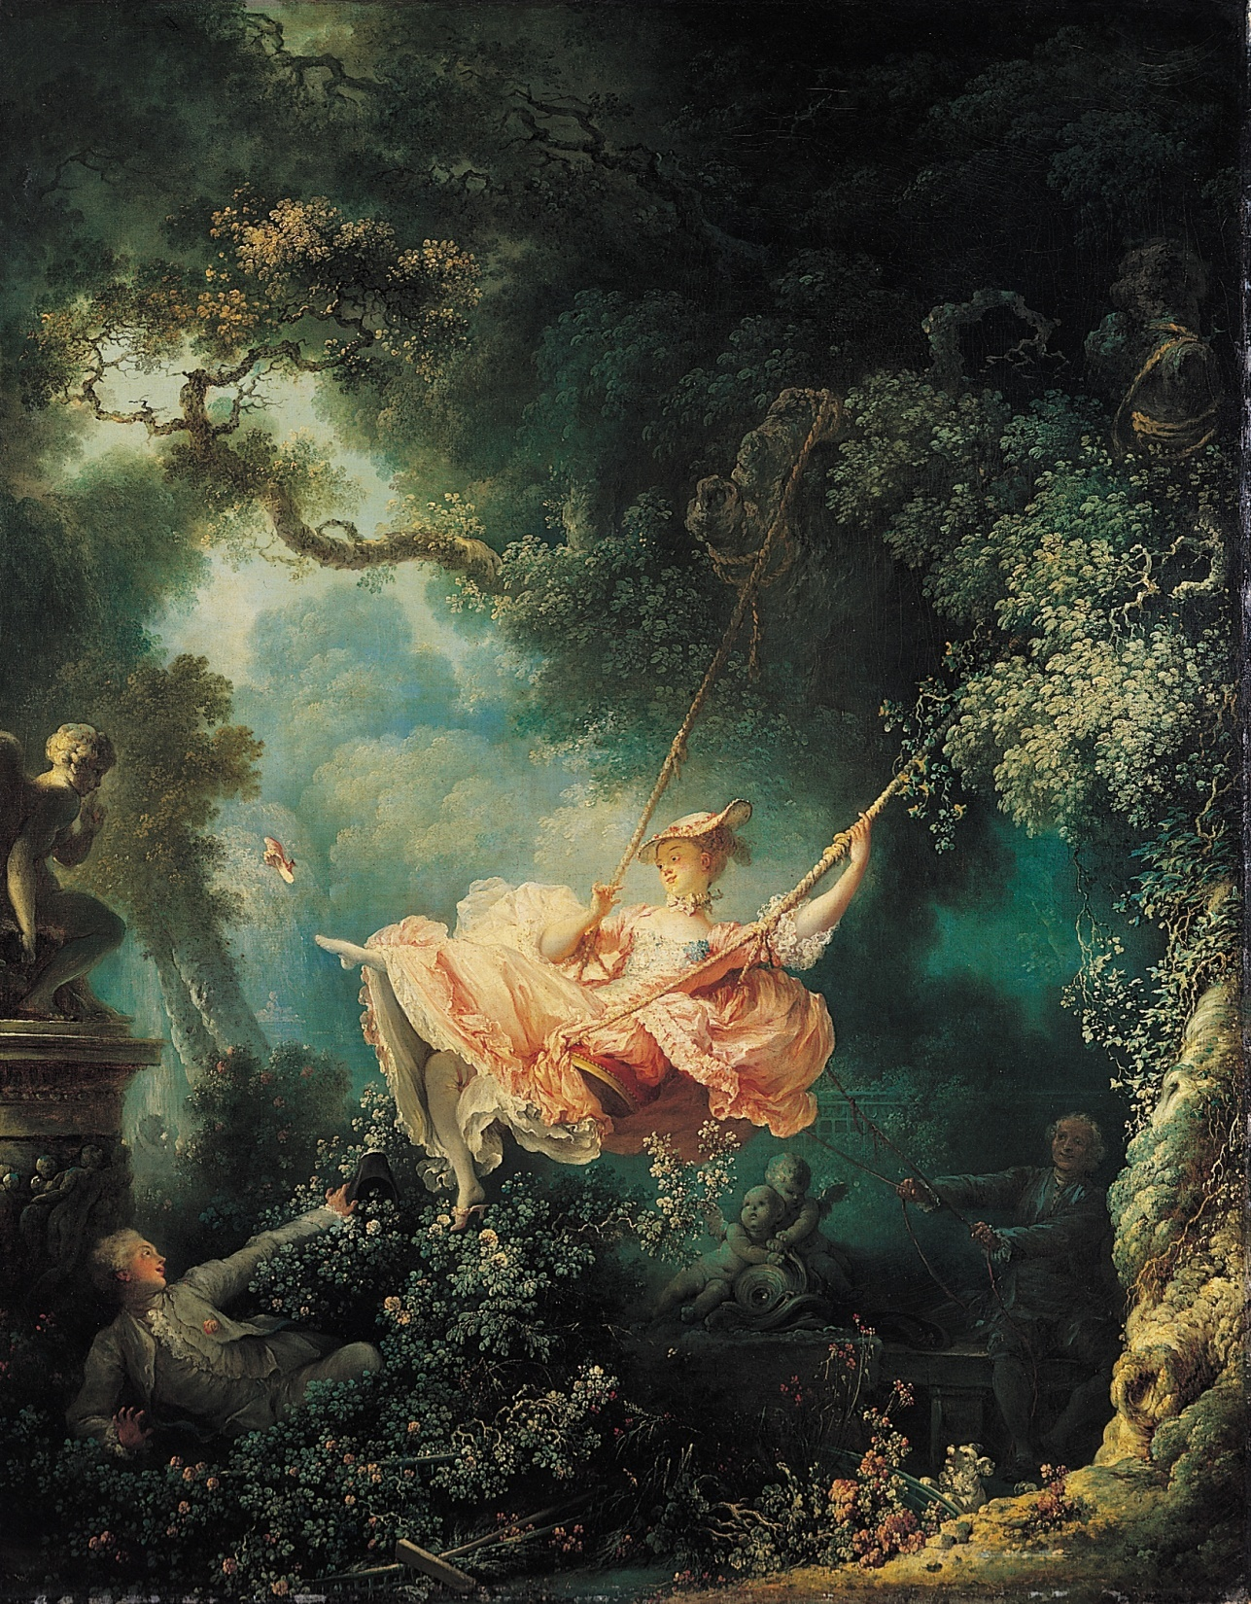
Fragonard
Rococo - France

Slide 15
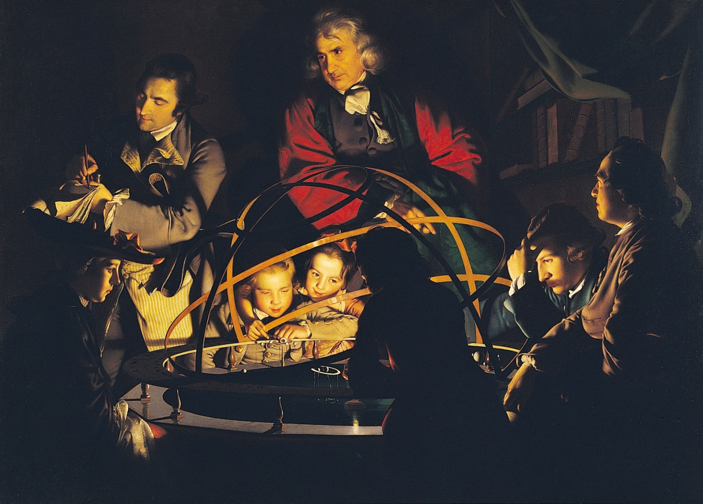
Wright
England - Enlightenment

Slide 16
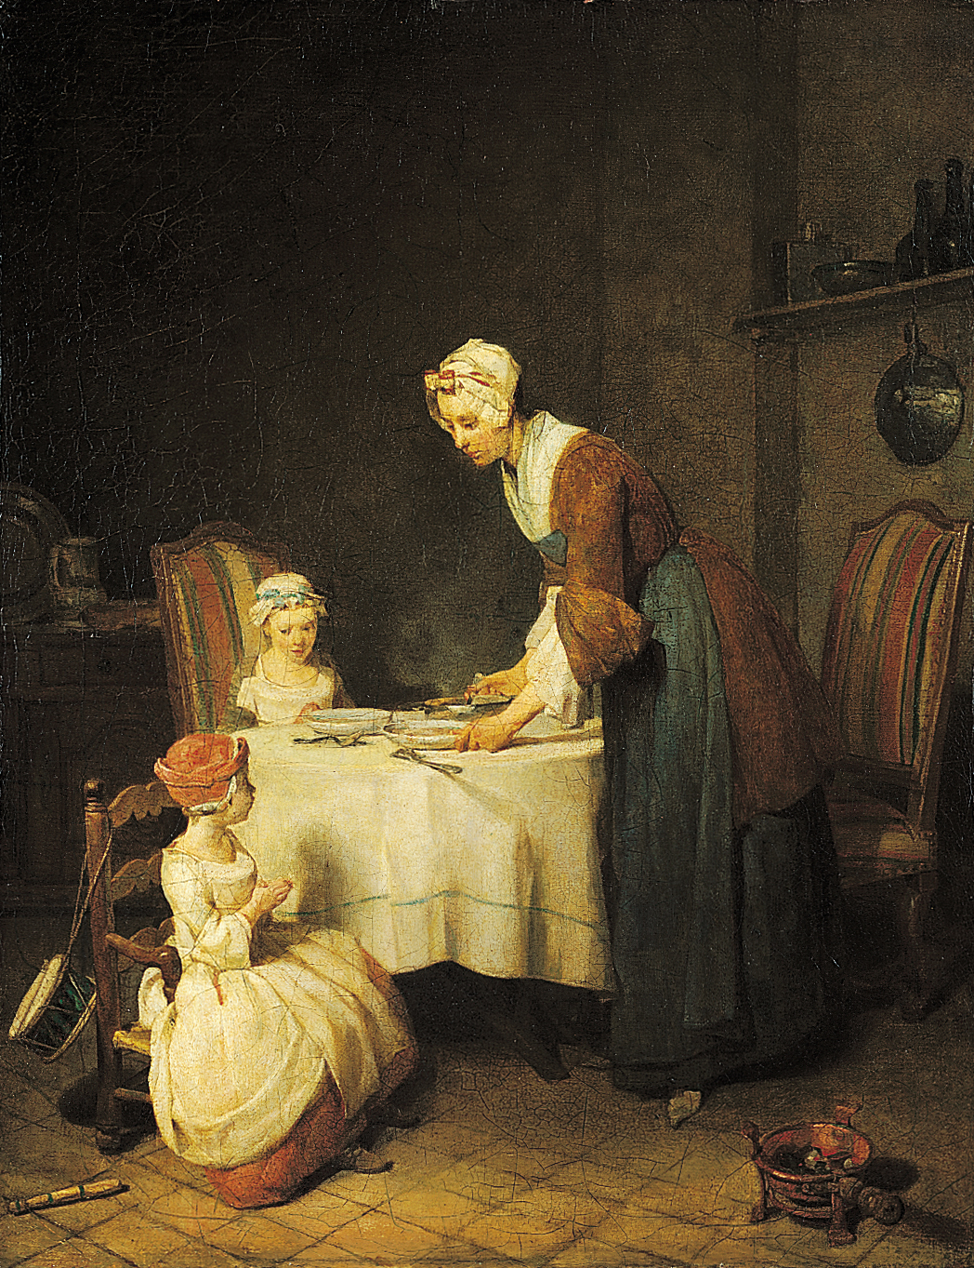
Chardin
France
Enlightenment

Slide 17
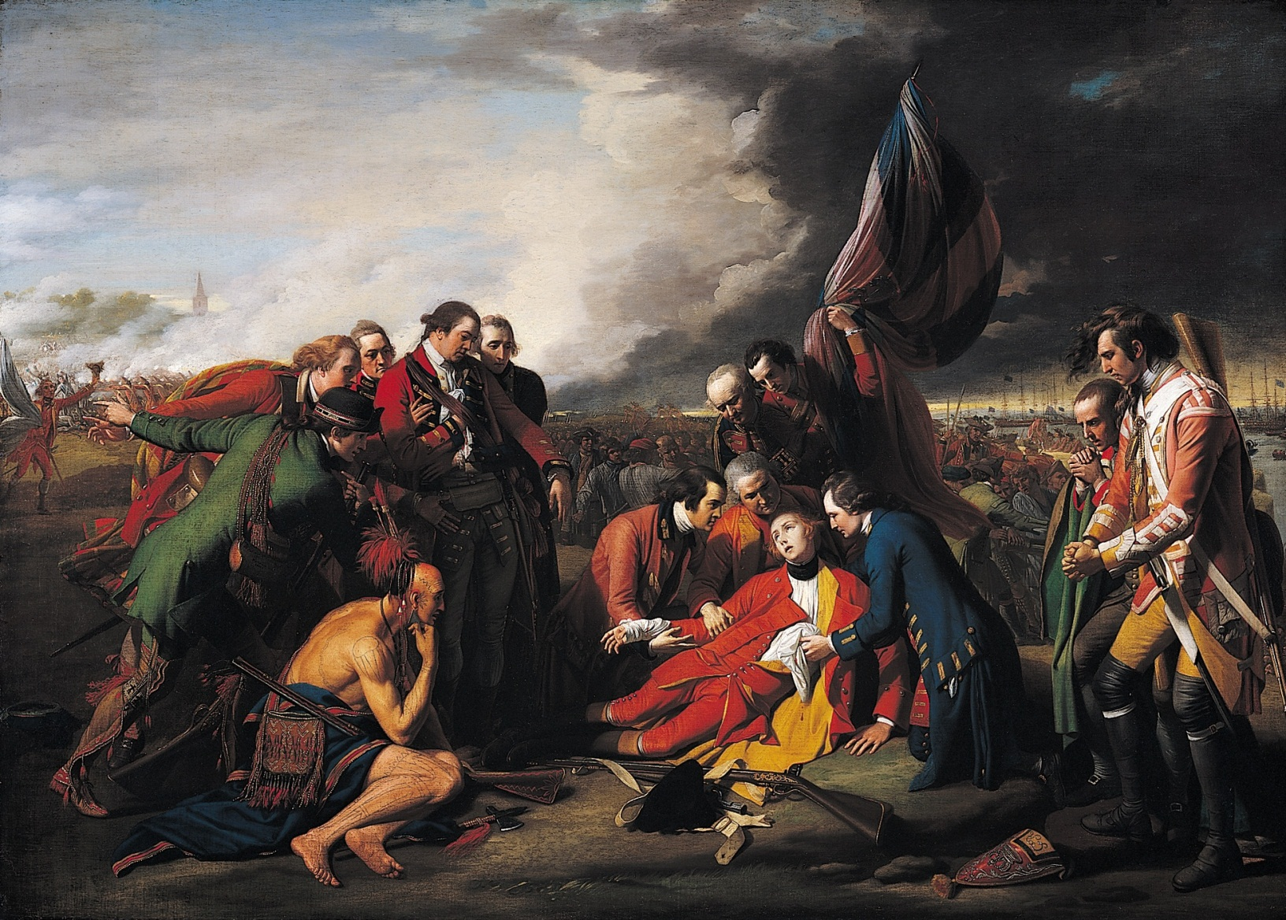
West
Enlightenment - America

Slide 18
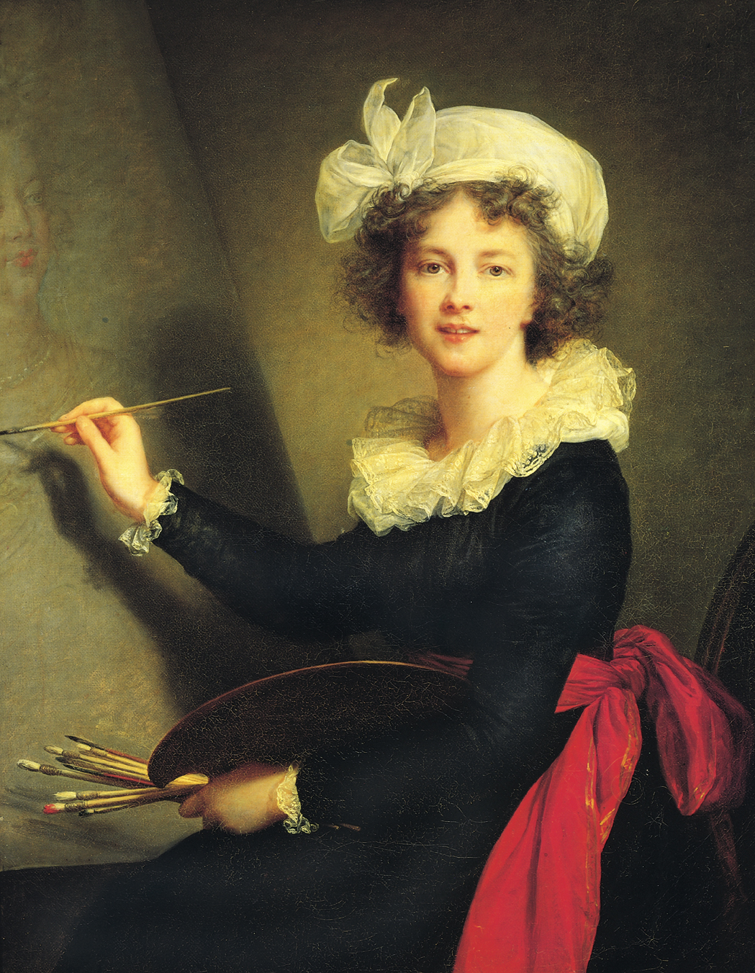
Lebrun
France
Enlightenment

Slide 19
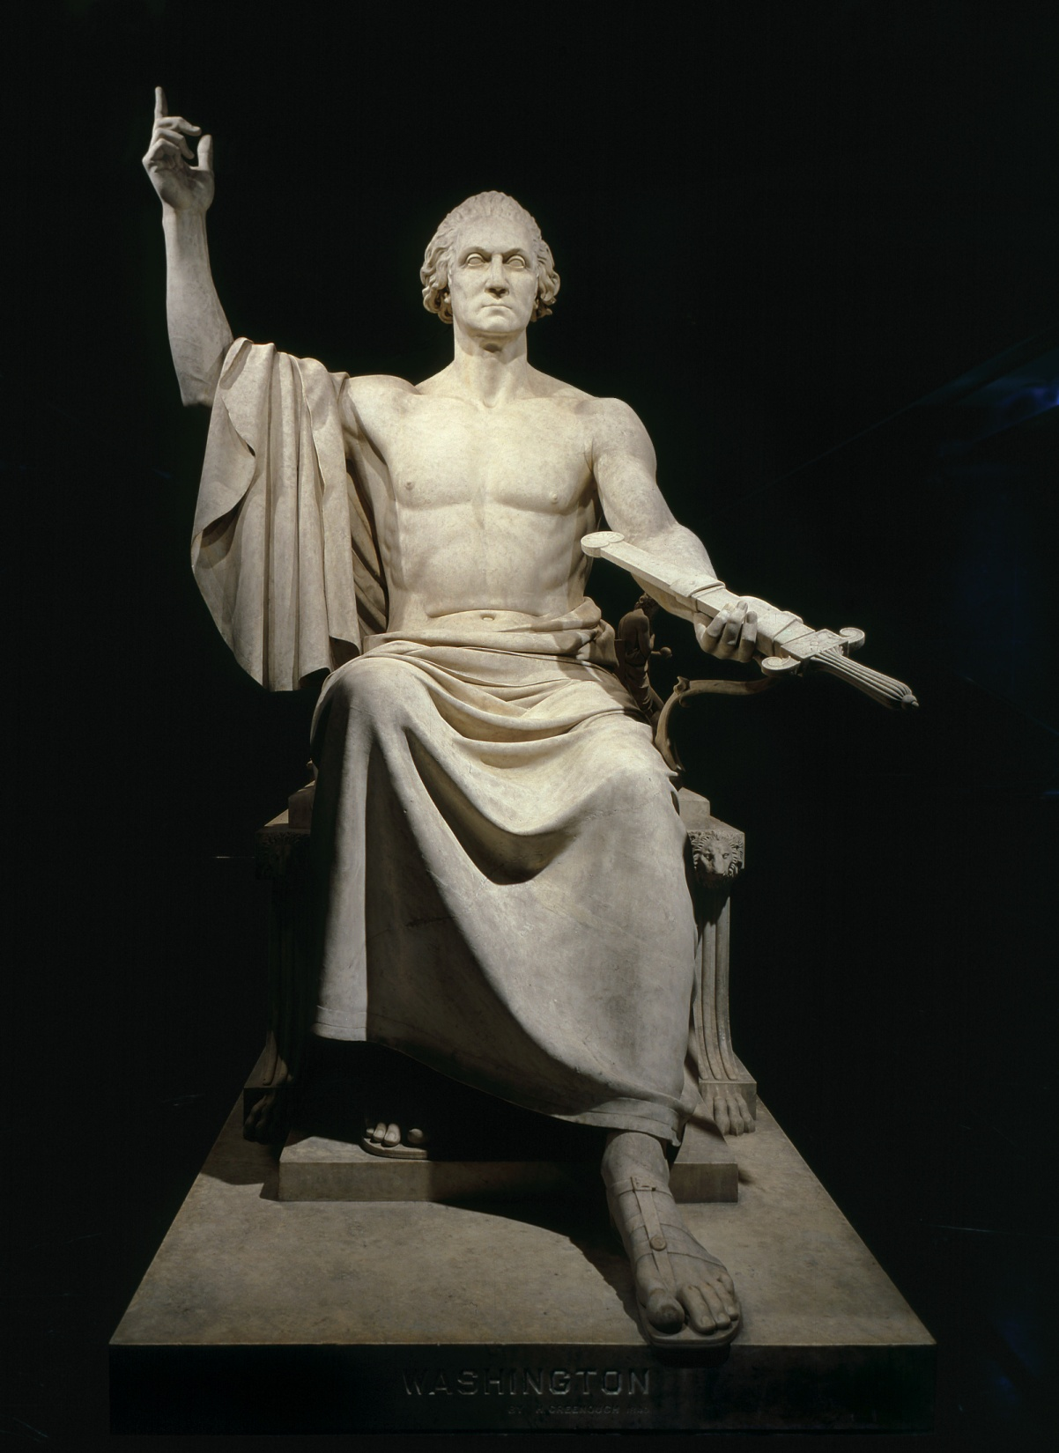
Horatio Greenough
Neoclassical Sculpture

Slide 20
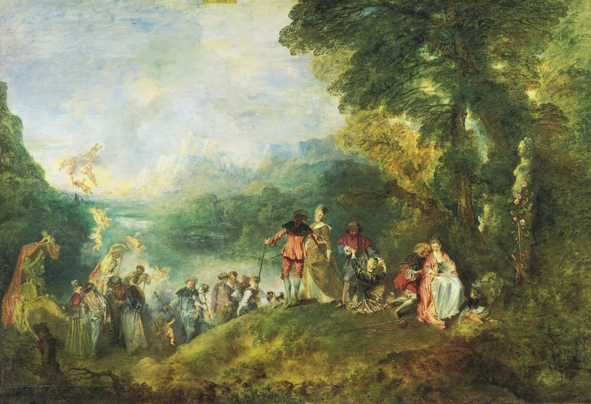
Watteau
Rococo - France

Slide 21
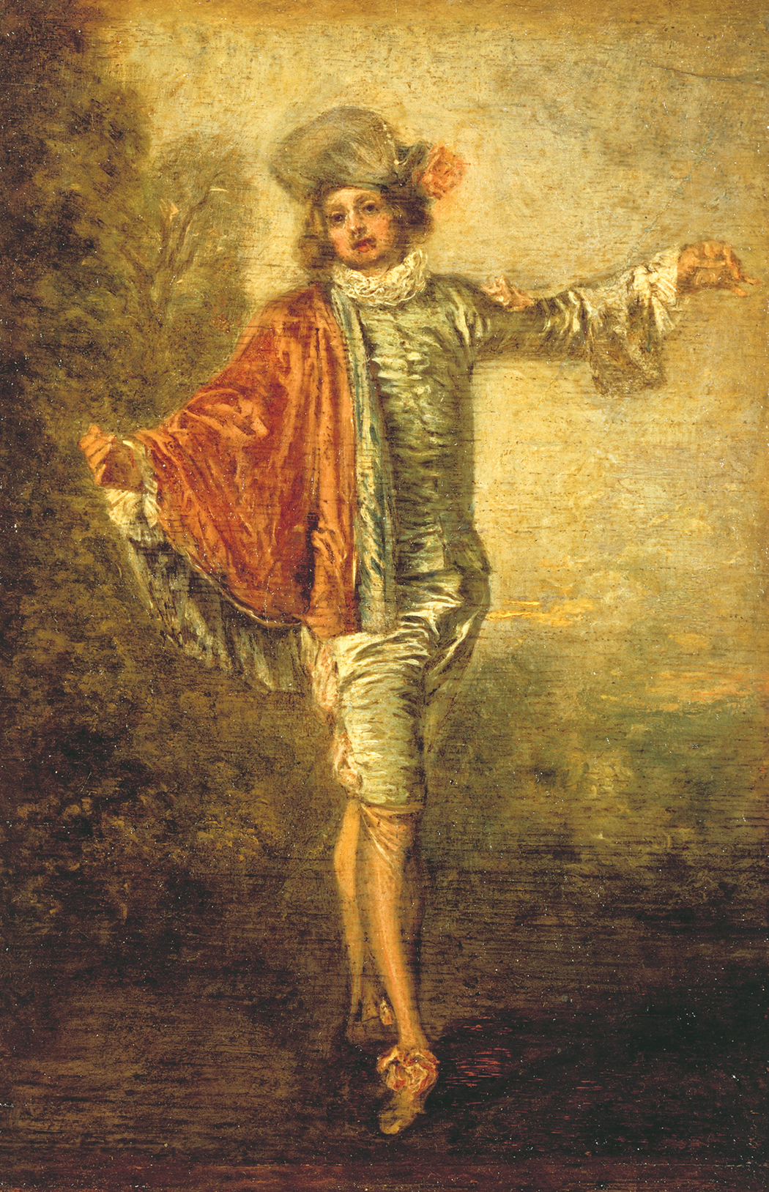
Watteau Rococo France

Slide 22
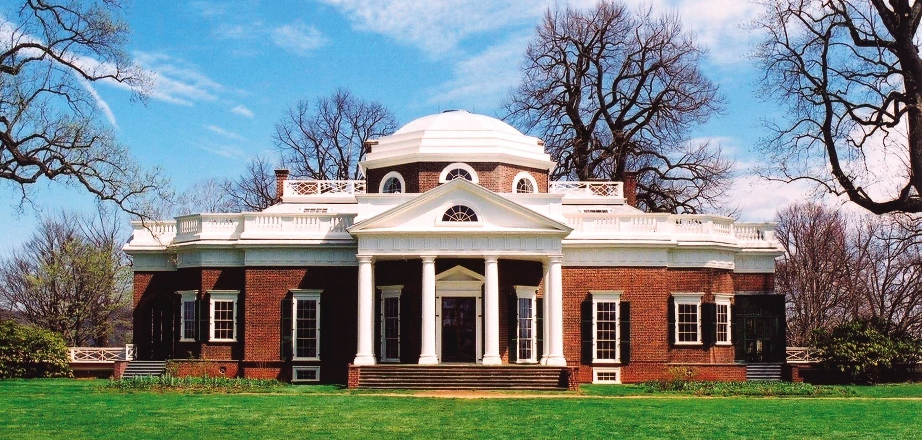
Jefferson House
Neoclassical Architecture
America

Slide 23
Gainsborough
Enlightenment
England

Slide 24
West
Enlightenment - America

Slide 25
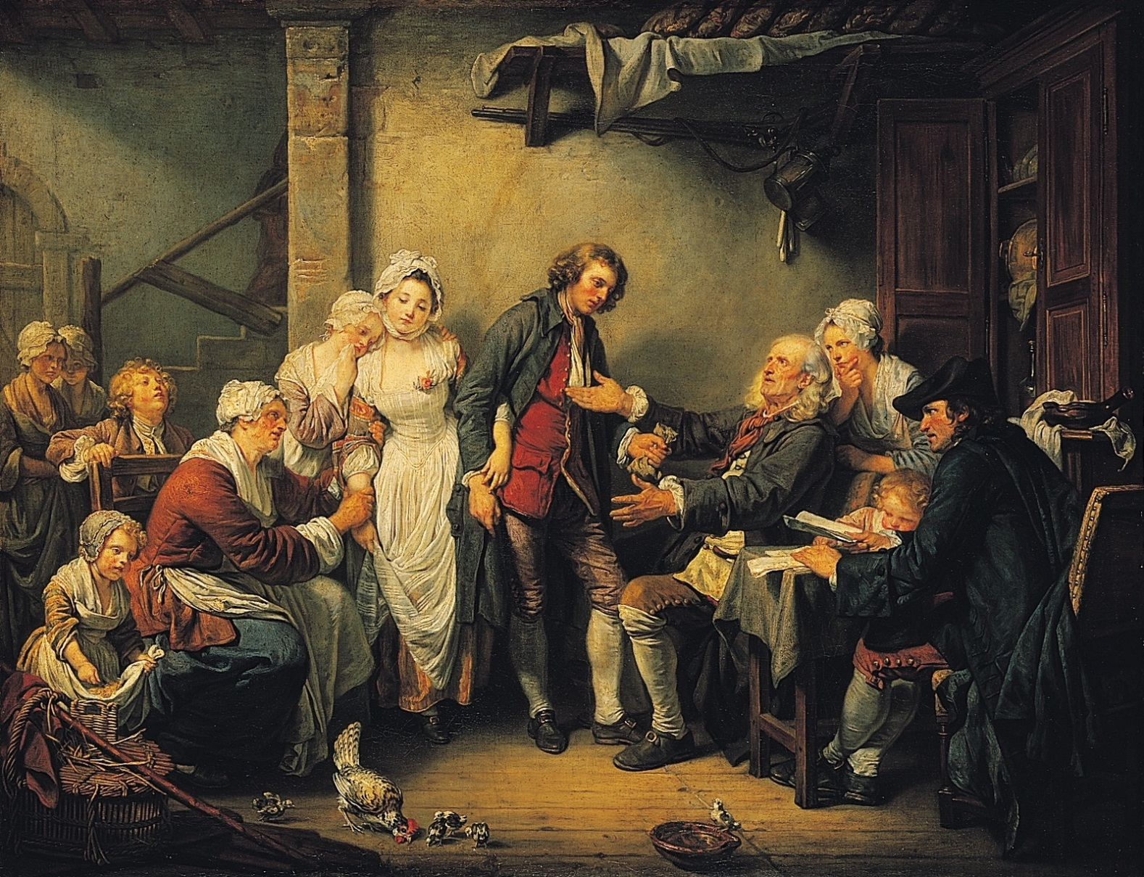
Greuze
France - Enlightenment

Slide 26
Fragonard
Rococo - France

Slide 27
Wright
England - Enlightenment

Slide 28
Copley
America
Enlightenment

Slide 29
Reynolds –
Enlightenment
England

Slide 30
Copley –
America - Enlightenment

Slide 31
Lebrun
France
Enlightenment

Slide 32
Hogarth –
Enlightenment - England

Slide 33
Chardin
France
Enlightenment

Slide 34
Kauffmann - England
Neoclassical

Slide 35
David – Neoclassical
France

Slide 36
David – Neoclassical
France

Slide 37
Boyle and Kent
Neoclassical architecture
England

Slide 38
Jefferson House
Neoclassical Architecture
America

Slide 39
Houdon -
Neoclassical sculpture
France

Slide 40
Watteau
Rococo - France

Slide 41
Horatio Greenough
Neoclassical Sculpture

Slide 42
Watteau Rococo France

Slide 43
Greuze
France - Enlightenment

