Slide 1
Chapter 36: 1945 – 2000 REVIEW

Slide 2
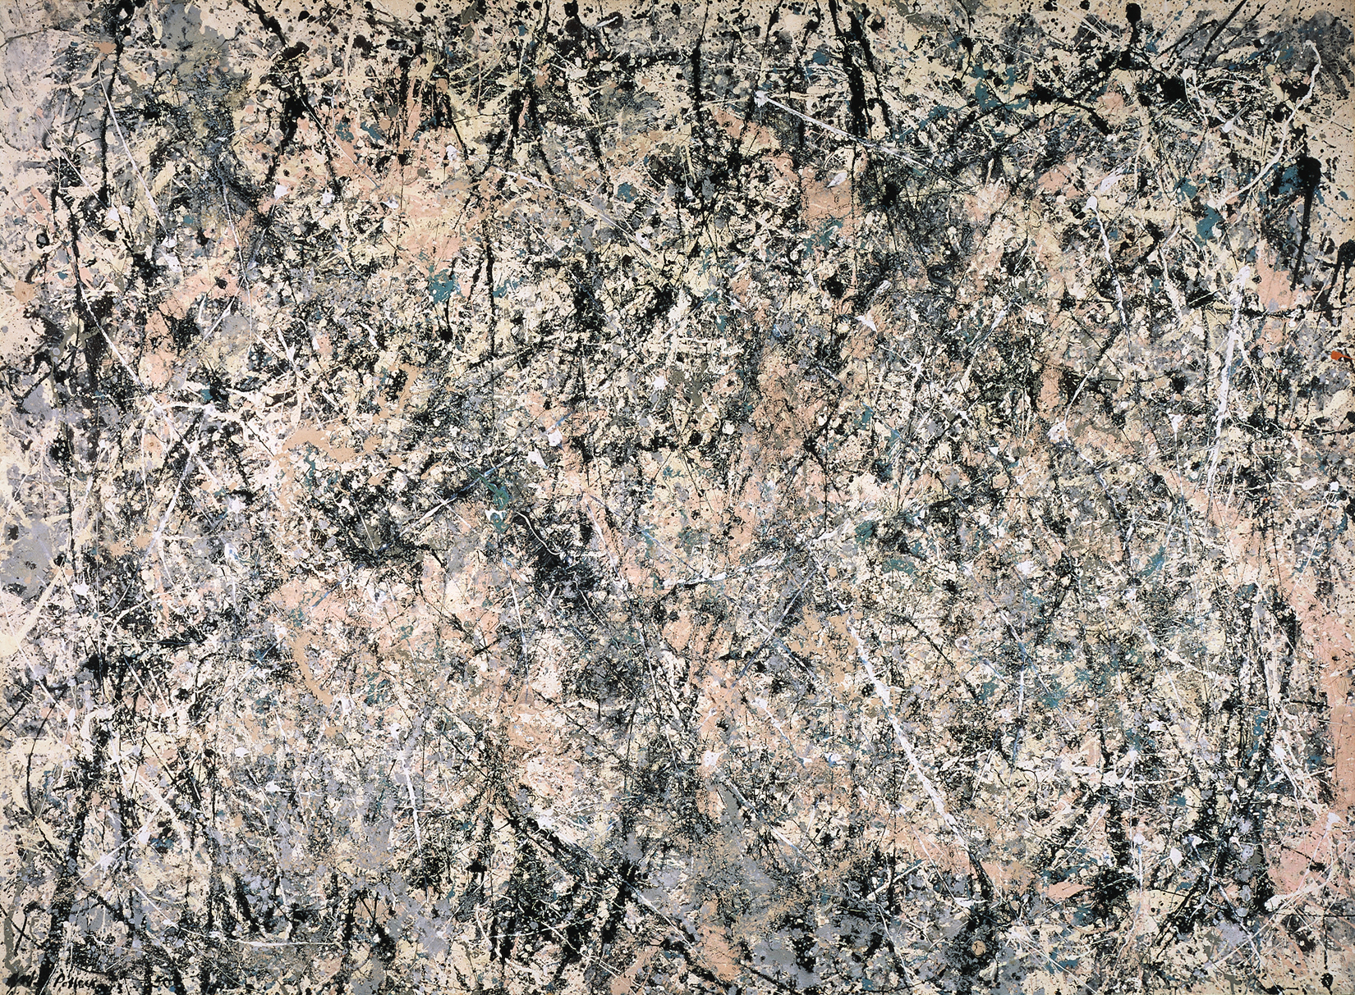
Jackson Pollock - Post War Expressionism

Slide 3
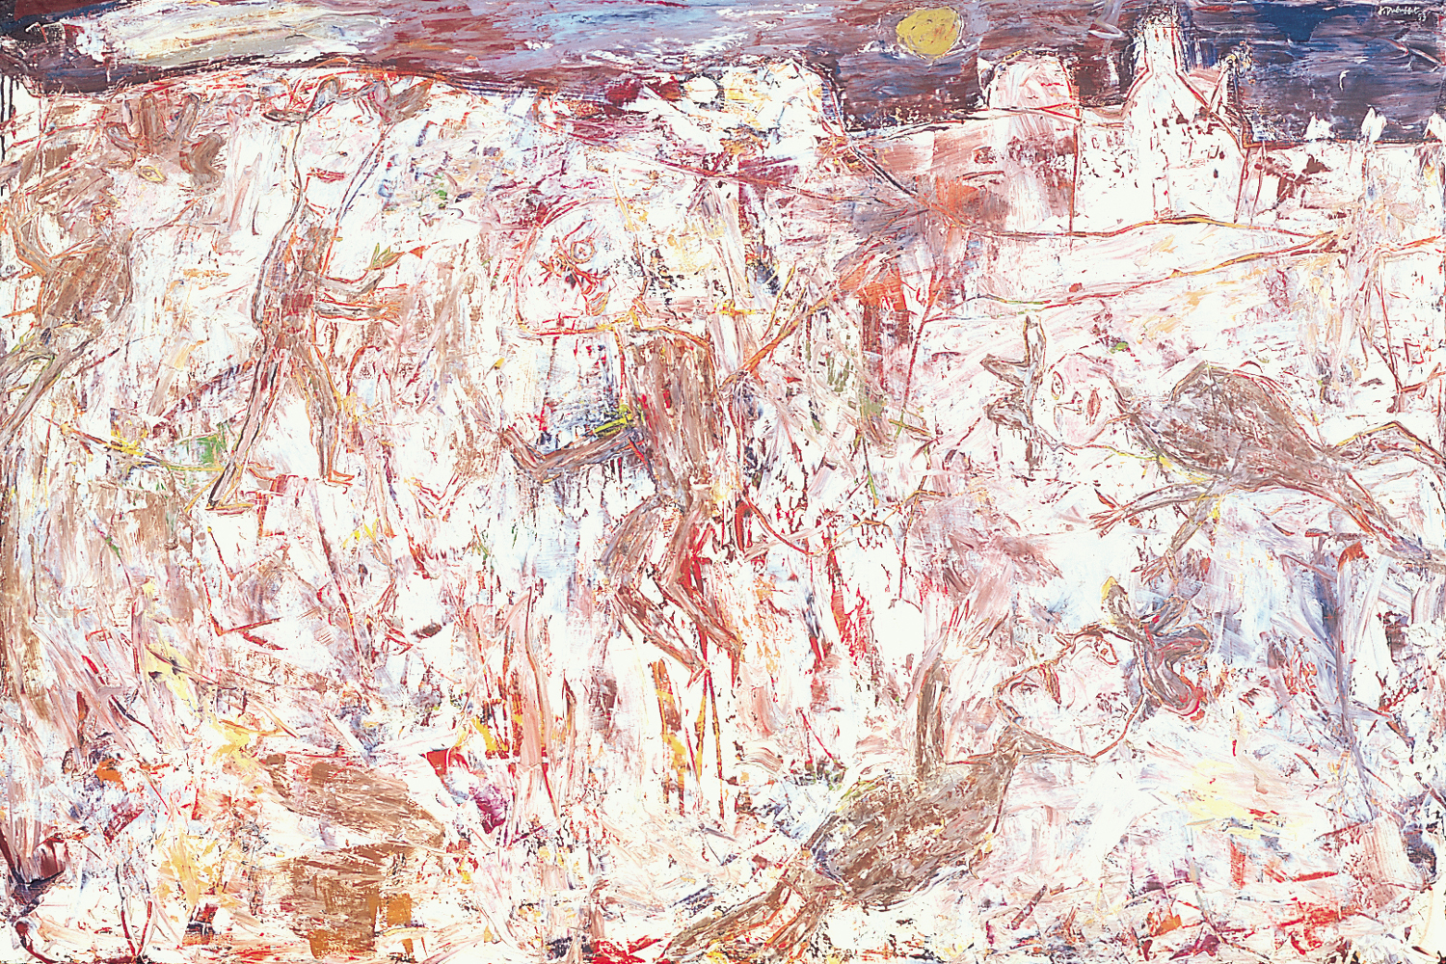
Jean Dubuffet Post War Expressionism

Slide 4
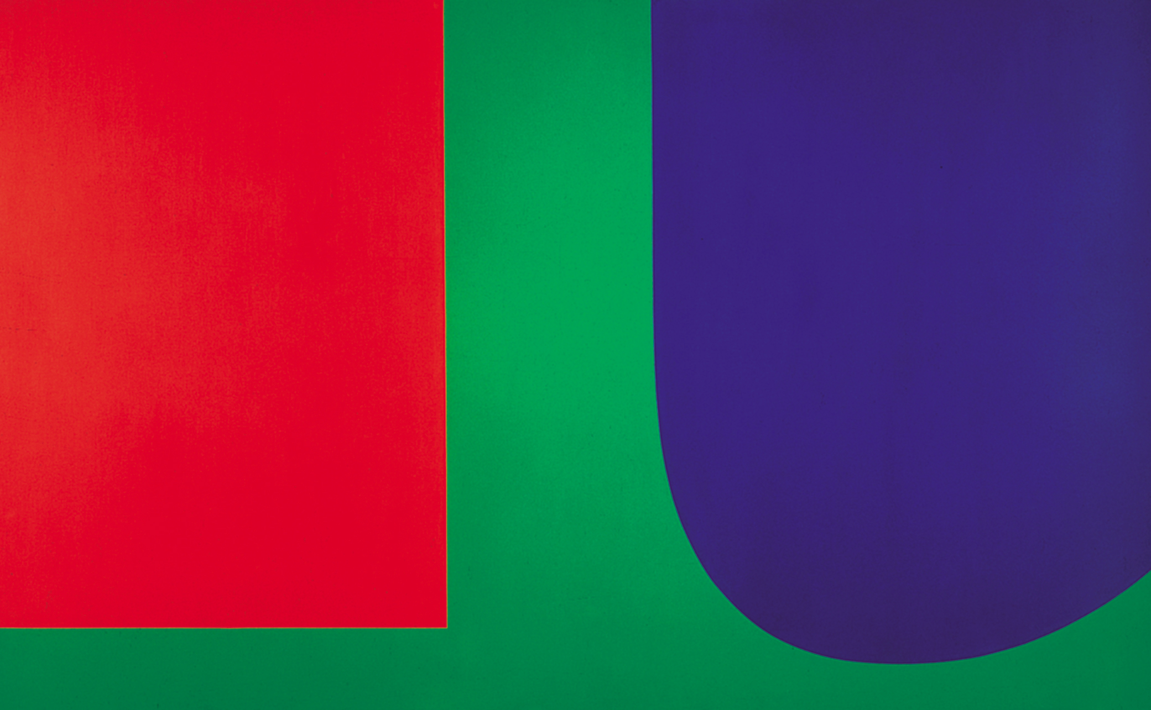
Ellsworth Kelly – Color Field Painting

Slide 5
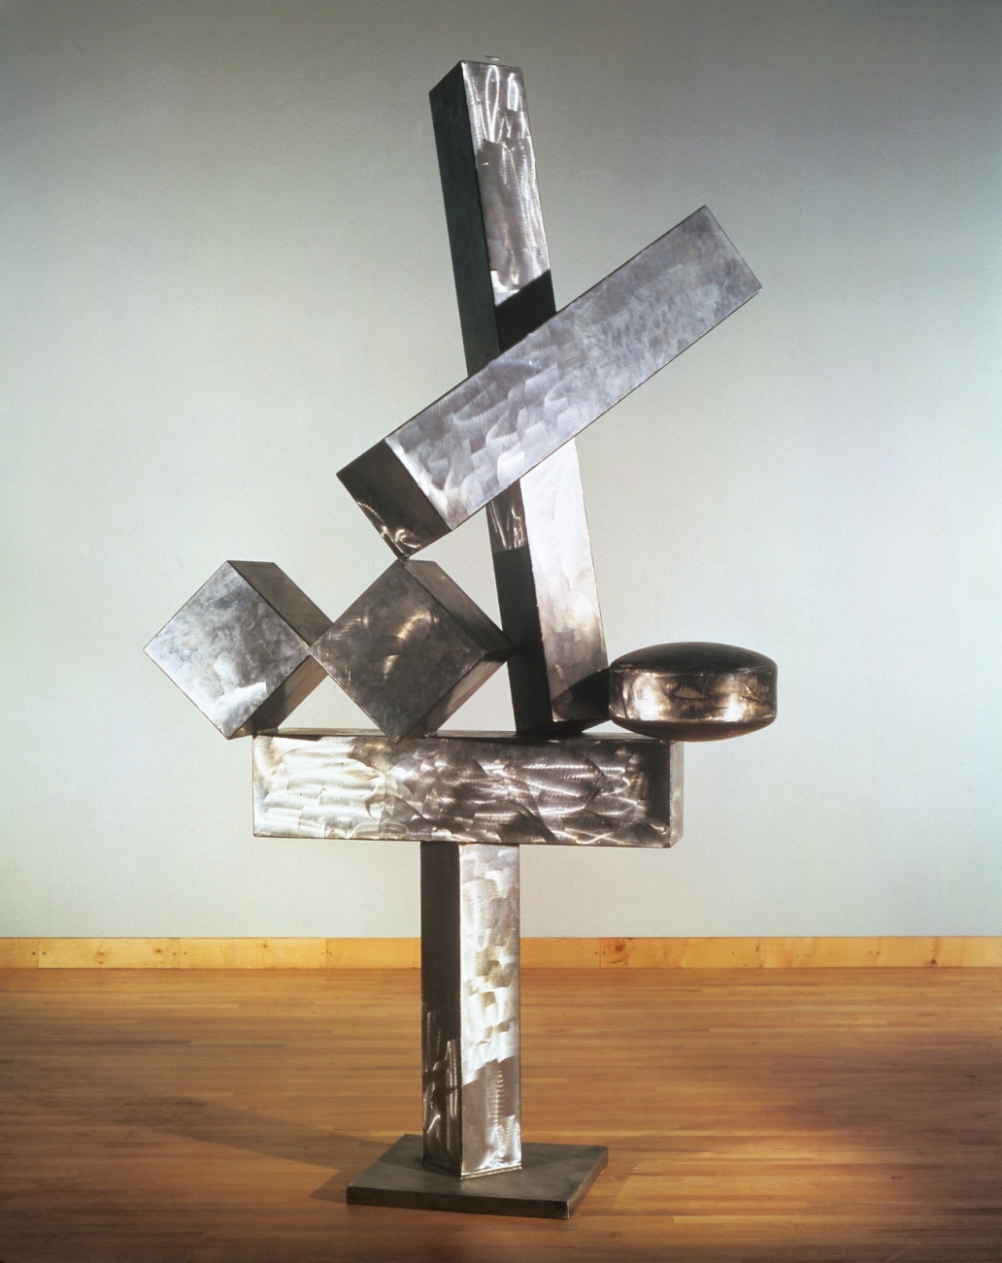
David Smith - Minimalism

Slide 6
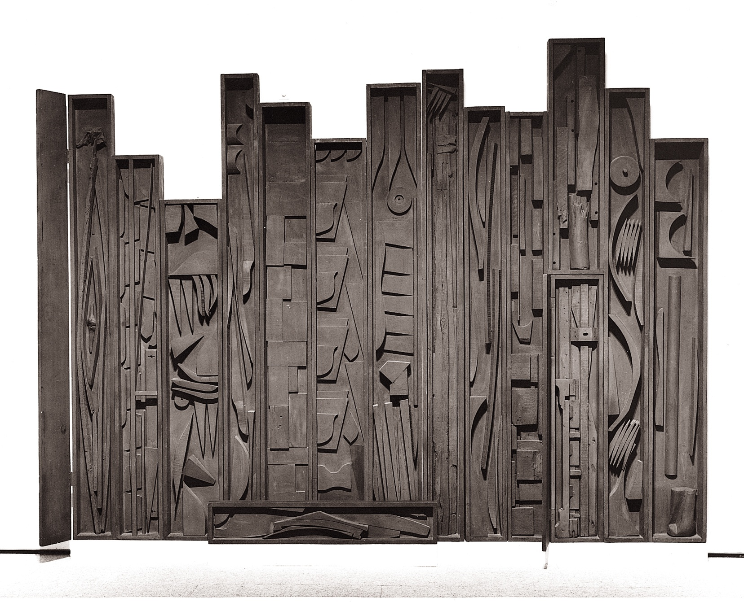
Louise Nevelson- Minimalism

Slide 7
Donald Judd
Minimalism

Slide 8
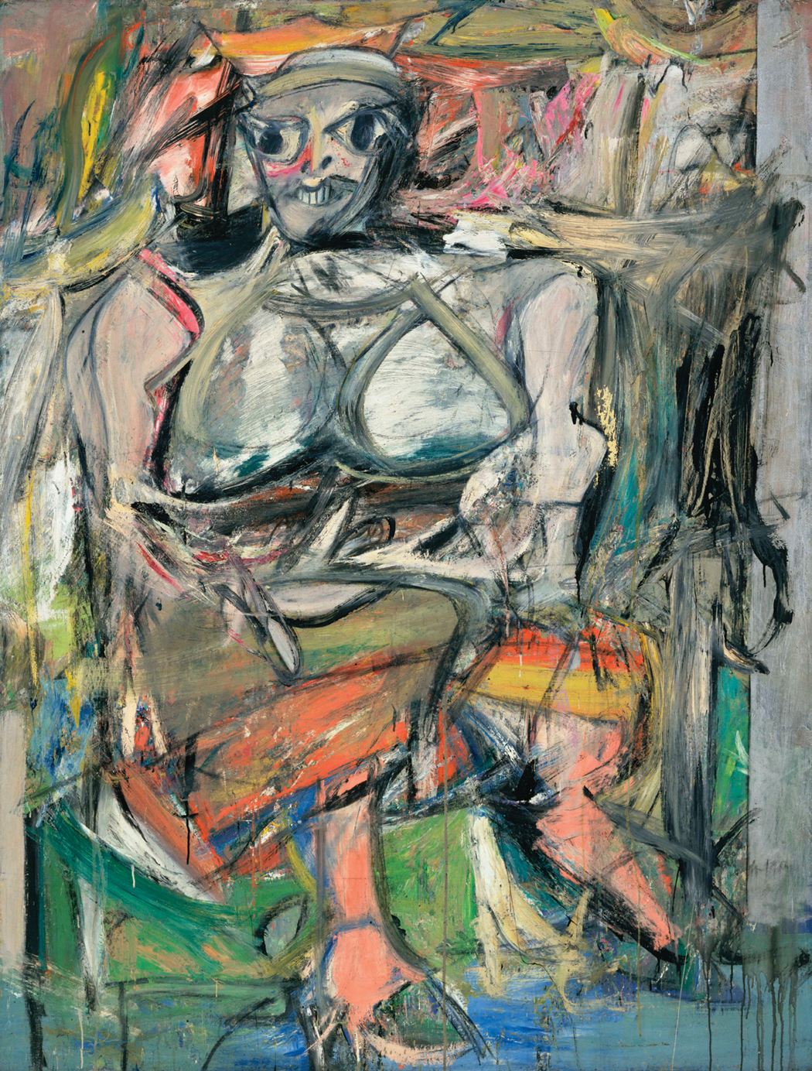
Willem DeKooning
Post War Expressionism

Slide 9
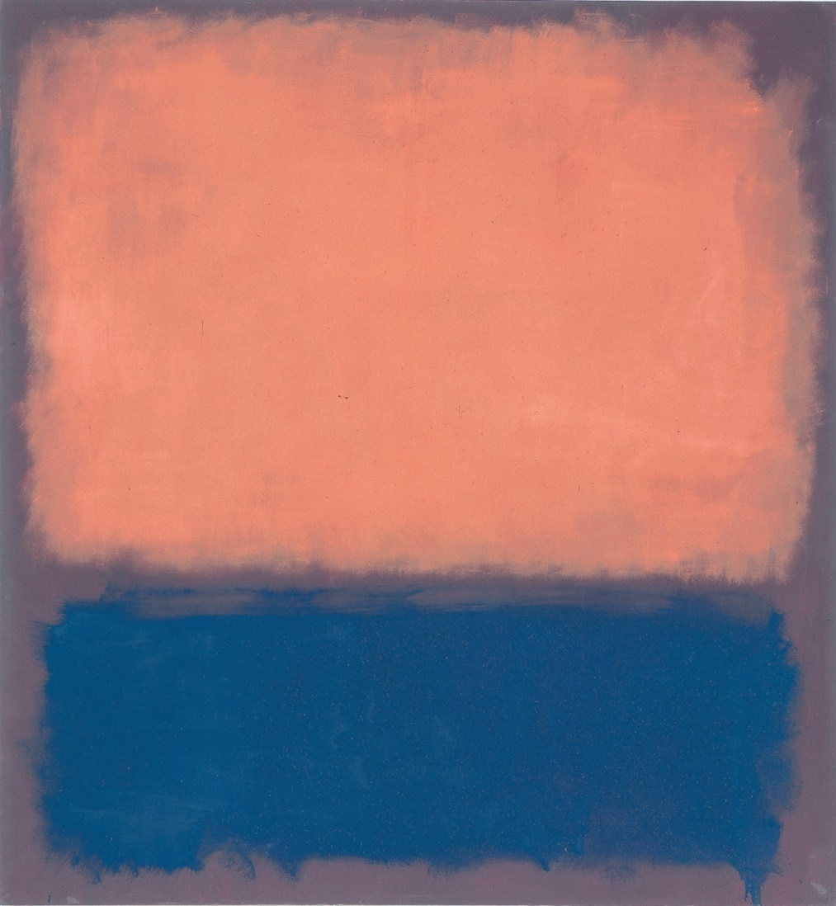
Mark Rothko
Color Field Painting

Slide 10
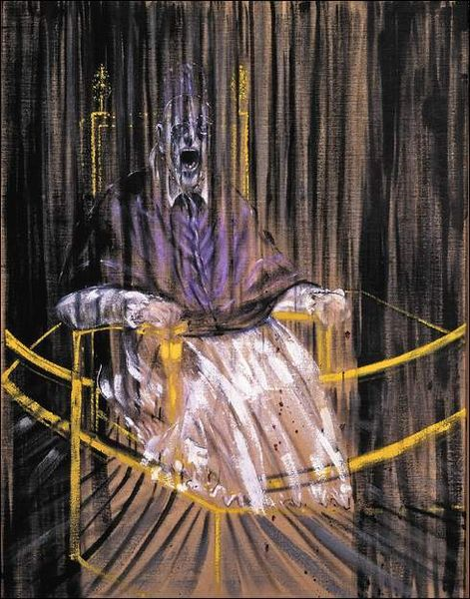
Francis Bacon Post War Expressionism

Slide 11
Barnett Newman – Color Field Painting

Slide 12
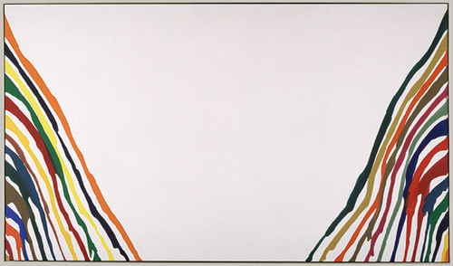
Morris Louis – Post-Painterly Abstraction

Slide 13
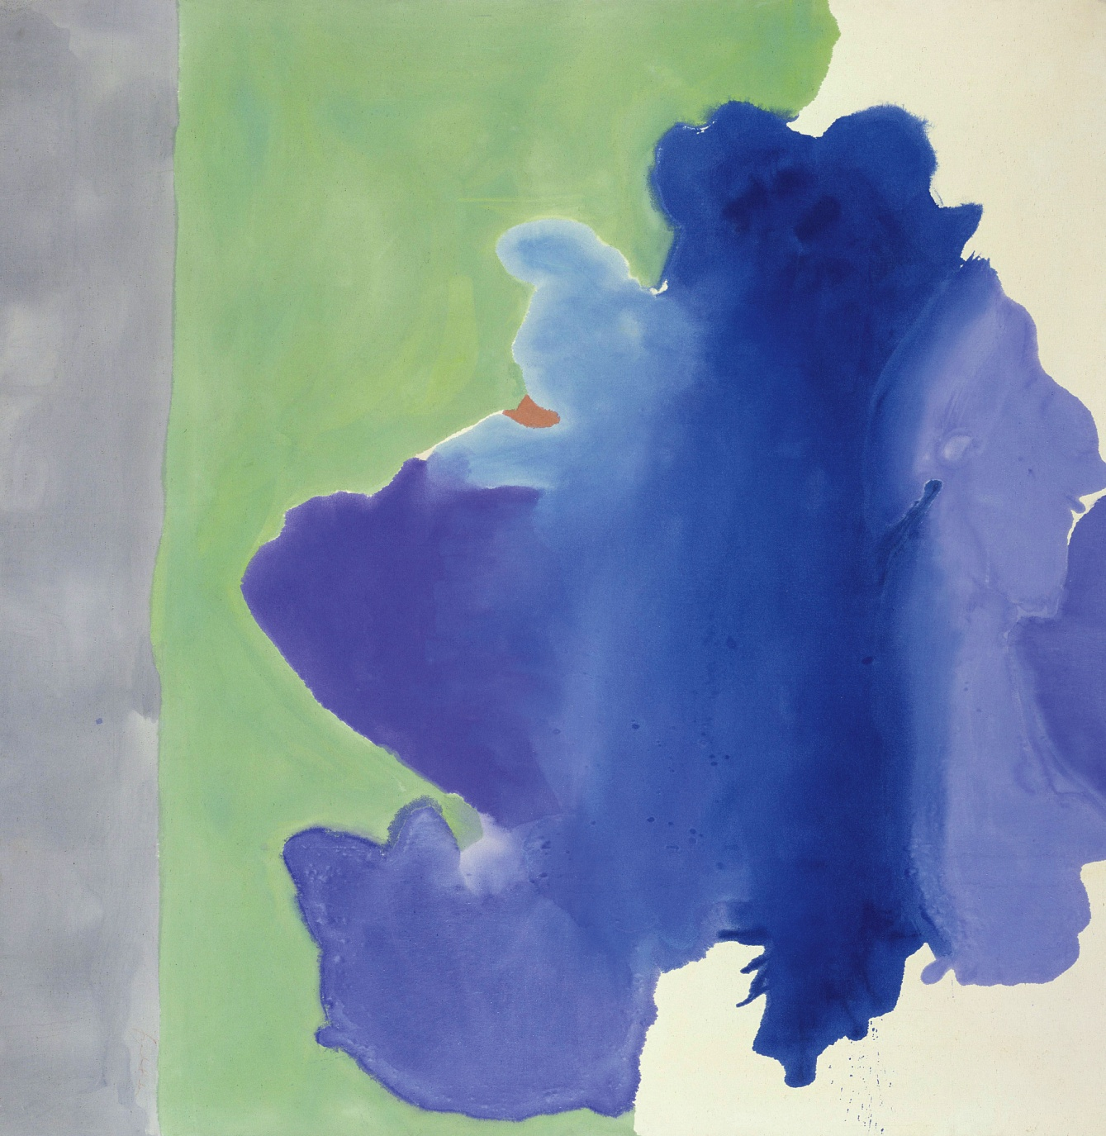
Helen Frankenthaler – Post Painterly Abstraction

Slide 14
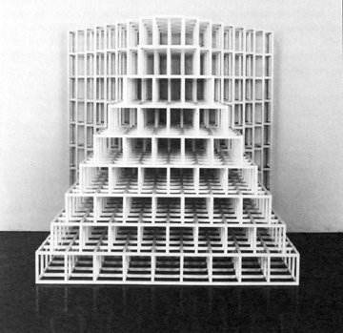
Sol Lewitt - Minimalism

Slide 15
Jean Dubuffet Post War Expressionism

Slide 16
Barnett Newman – Color Field Painting

Slide 17
Sol Lewitt - Minimalism

Slide 18
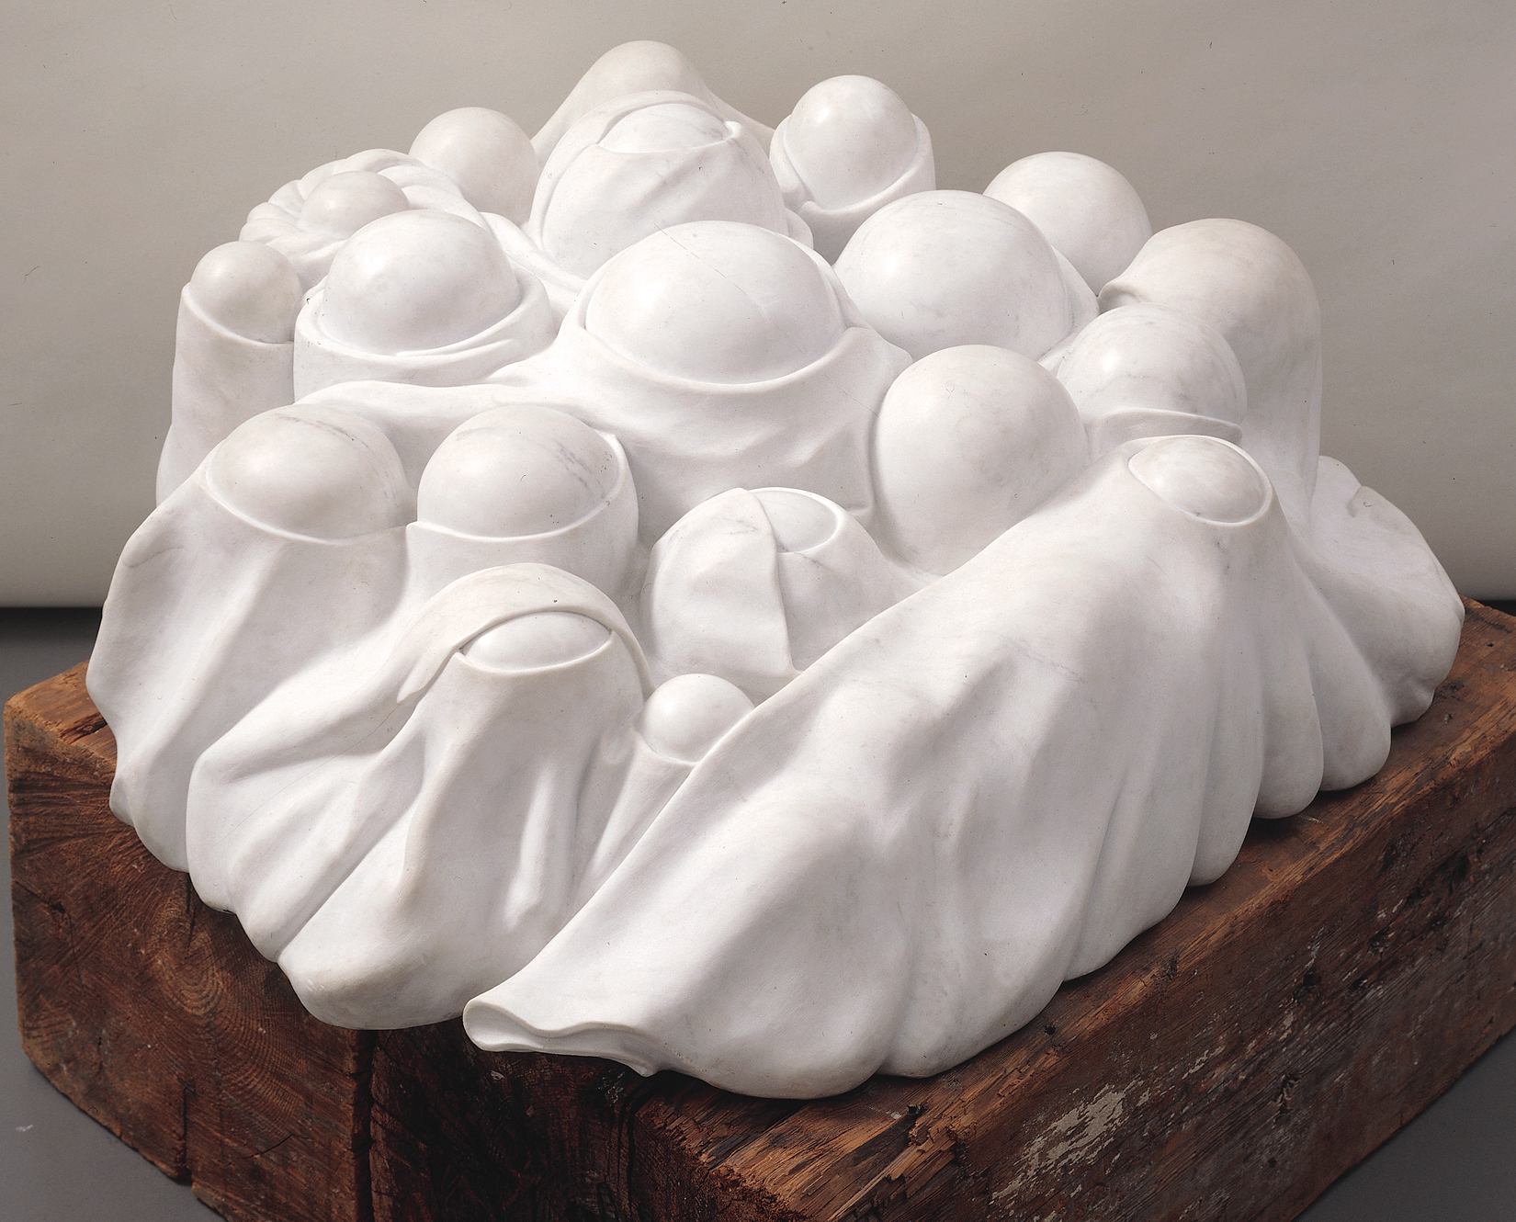
Louise Bourgeois - Minimalism

Slide 19
Morris Louis – Post-Painterly Abstraction

Slide 20
David Smith - Minimalism

Slide 21
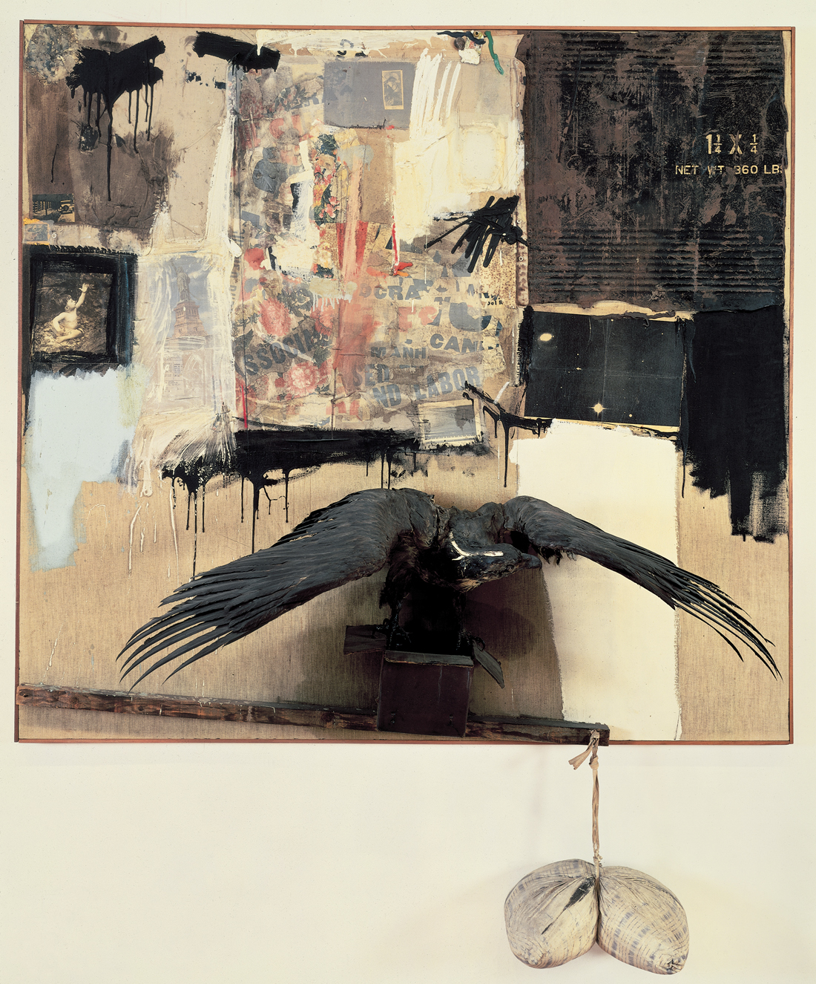
Robert Rauschenberg
Pop Art

Slide 22
Helen Frankenthaler – Post Painterly Abstraction

Slide 23
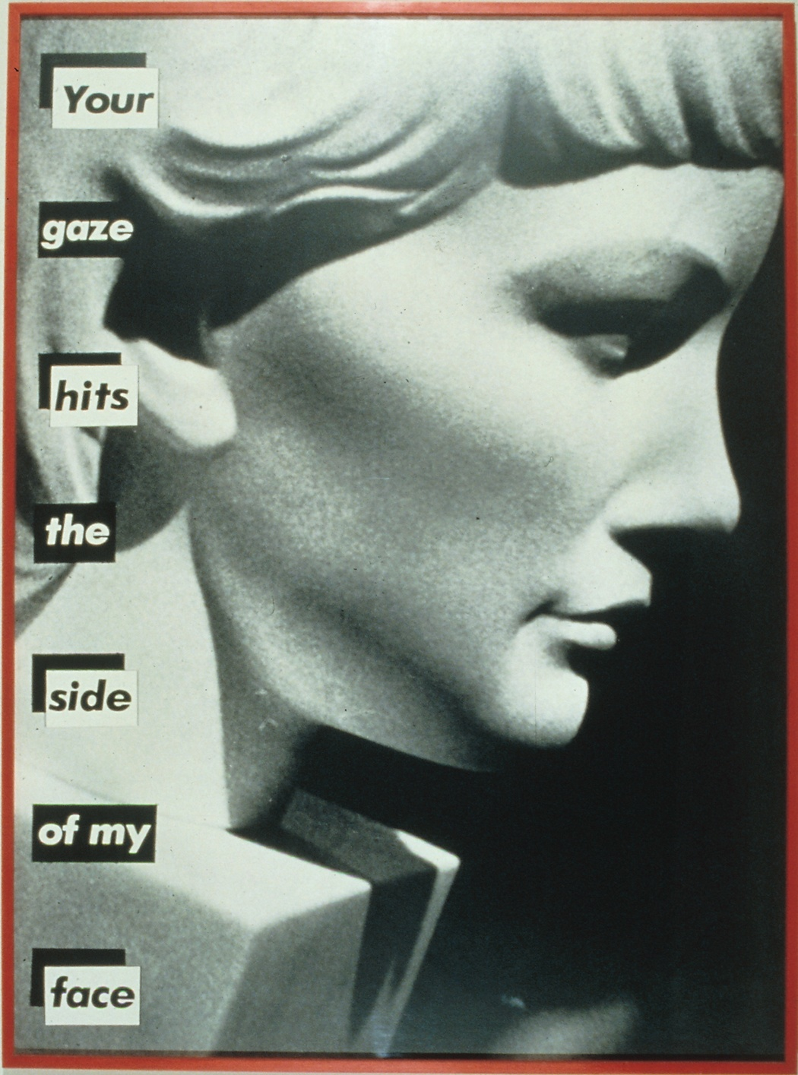
Barbara Kruger
Feminist Art

Slide 24
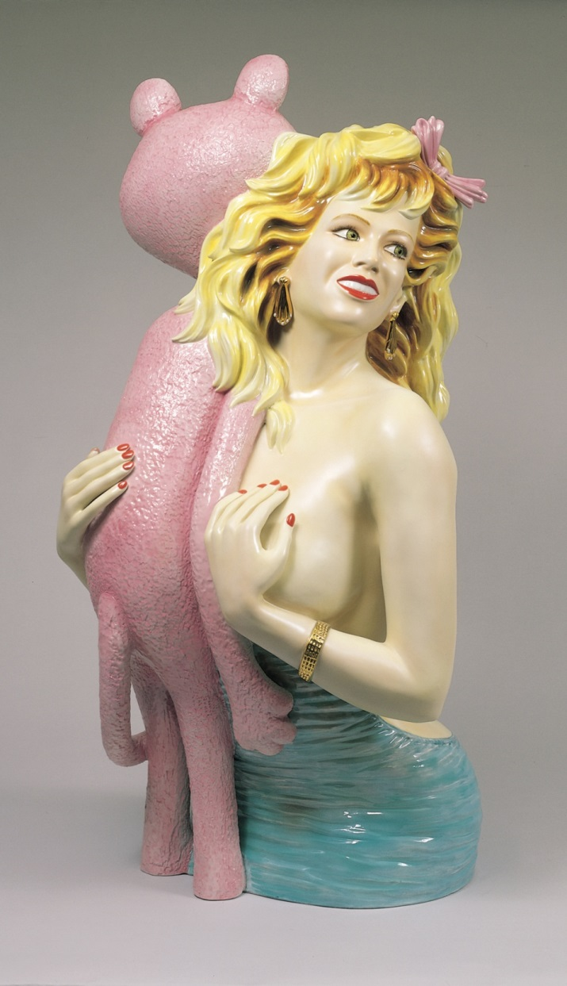
Jeff Koons
Social /Political Art

Slide 25
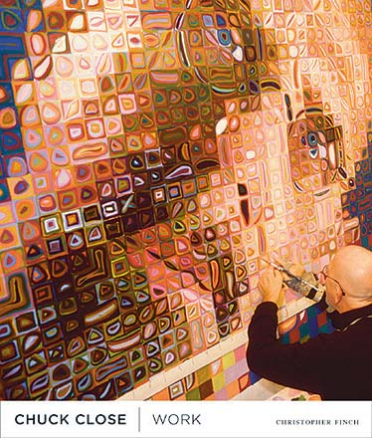
Chuck Close
Photorealism

Slide 26
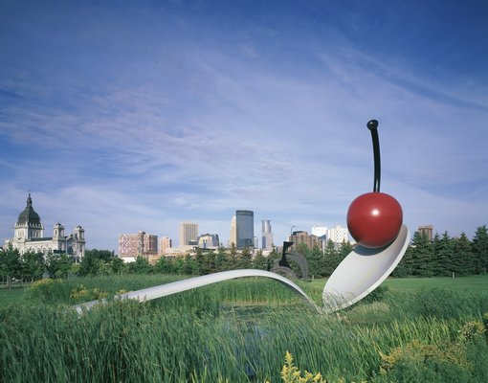
Claes Oldenburg
Pop Art

Slide 27
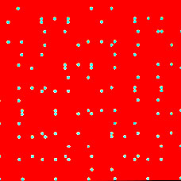
Larry Poons
OP Art

Slide 28
Louise Nevelson- Minimalism

Slide 29
Jackson Pollock - Post War Expressionism

Slide 30
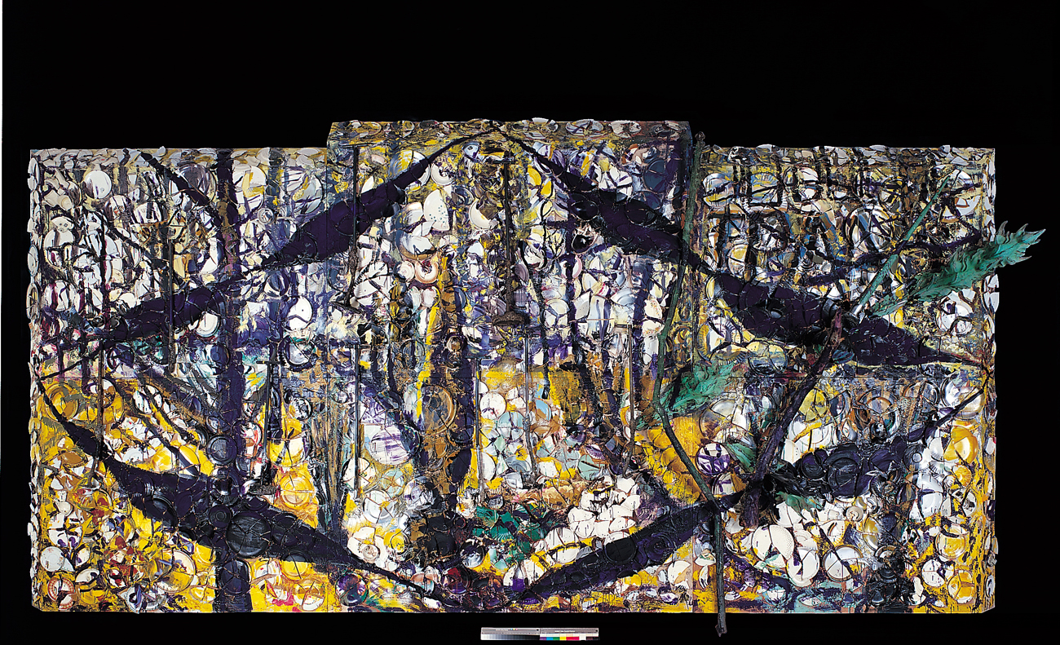
Julian Schnabel – Neo Expressionism

Slide 31
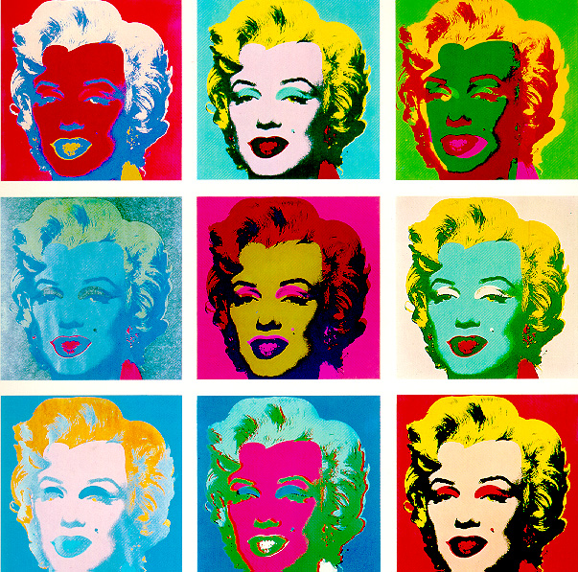
Andy Warhol – Pop Art

Slide 32
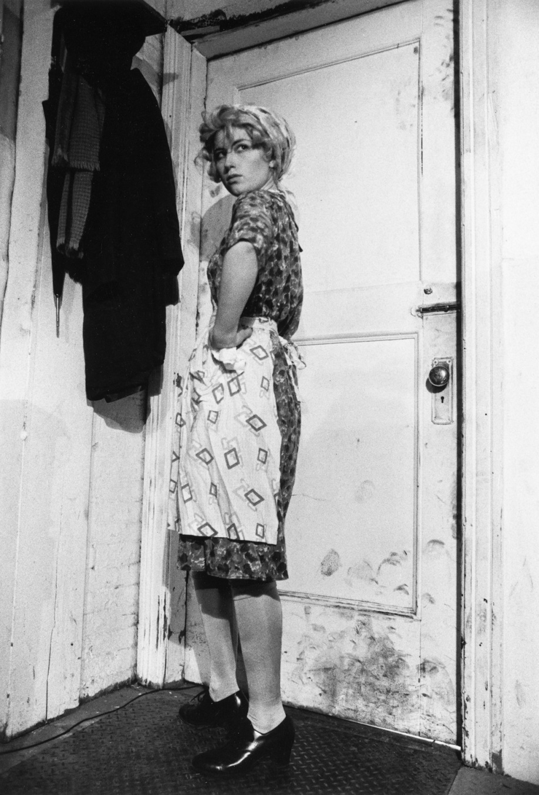
Cindy Sherman
Feminist Art

Slide 33
Duane Hanson
Photorealism

Slide 34
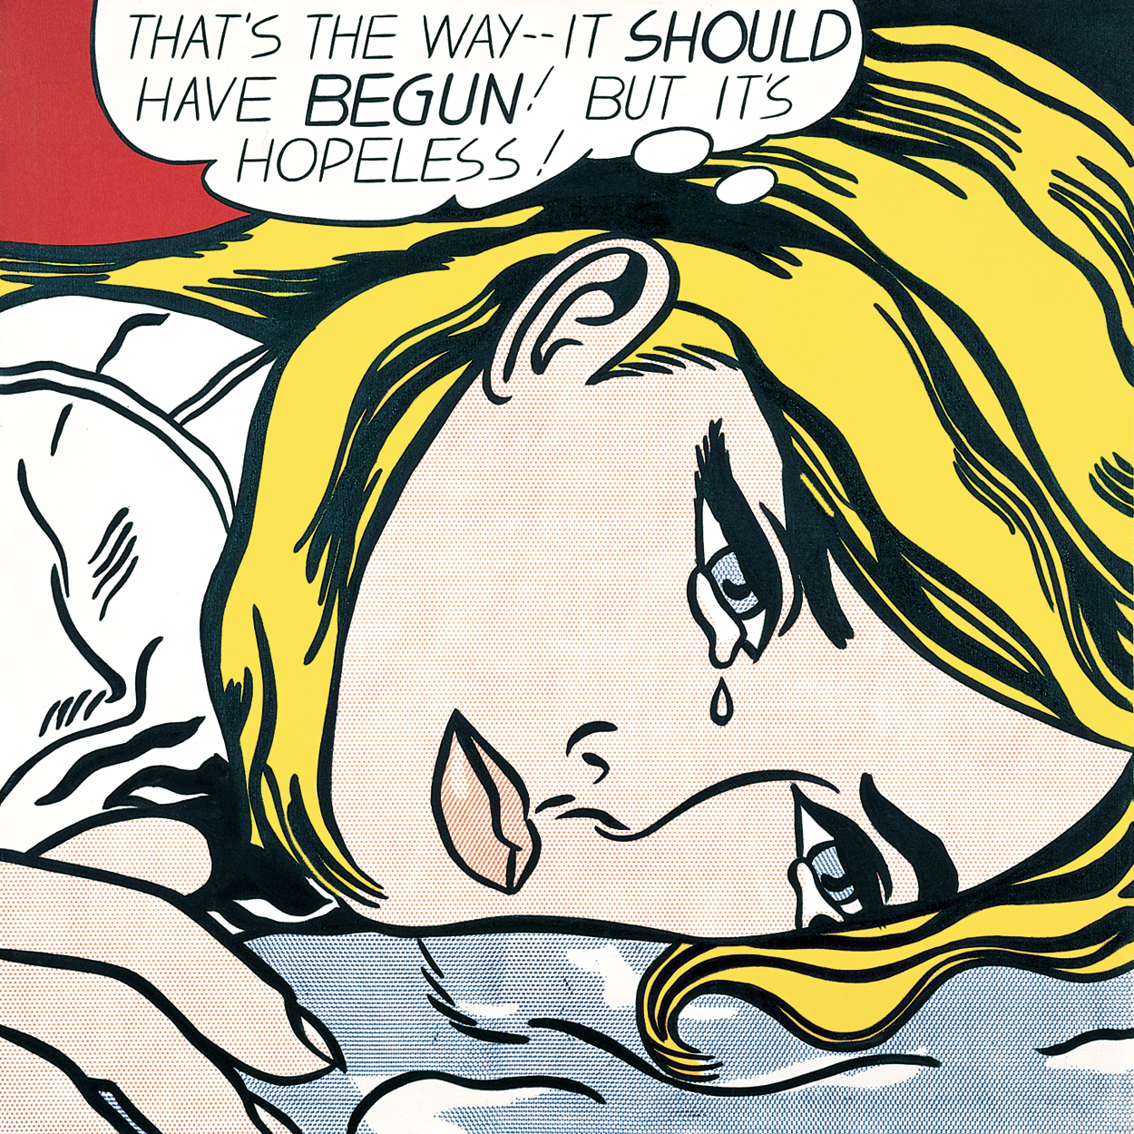
Roy Lichtenstein
Pop Art

Slide 35
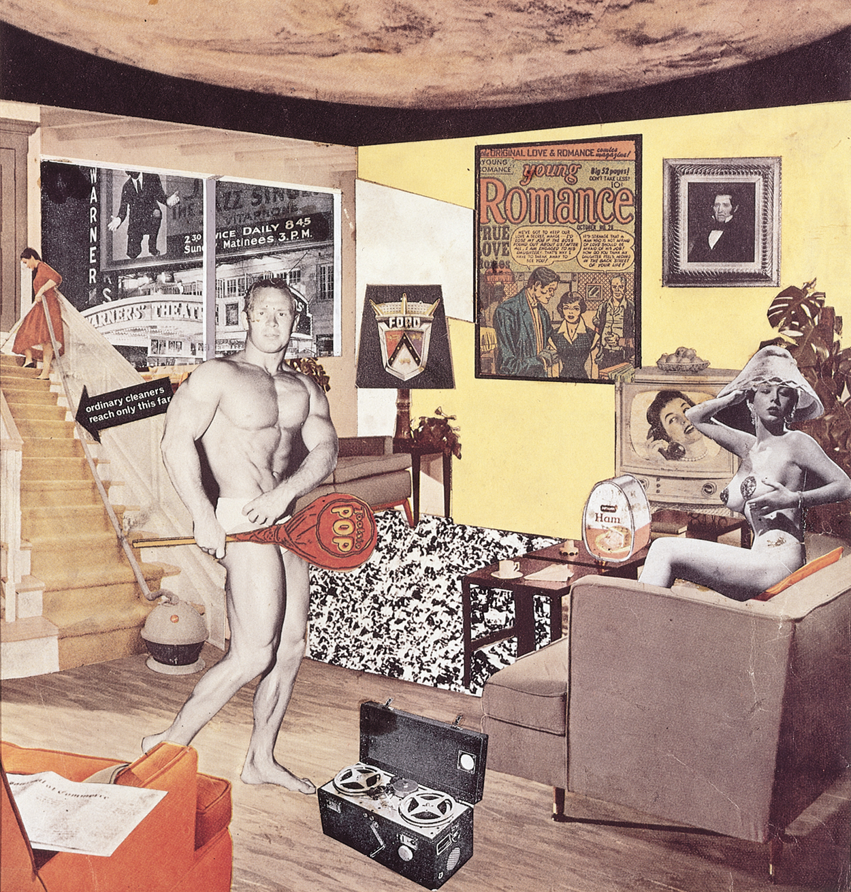
Richard Hamilton – Pop Art

Slide 36
Bridget Riley
OP Art

Slide 37
Mark Rothko
Color Field Painting

Slide 38
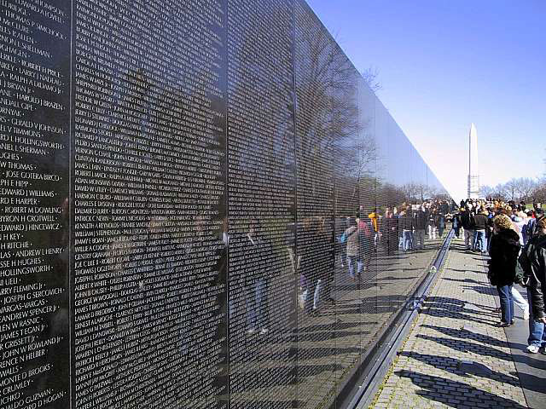
Maya Ying Lin, Vietnam Veterans Memorial
Site Specific Art

Slide 39
Willem DeKooning
Post War Expressionism

Slide 40
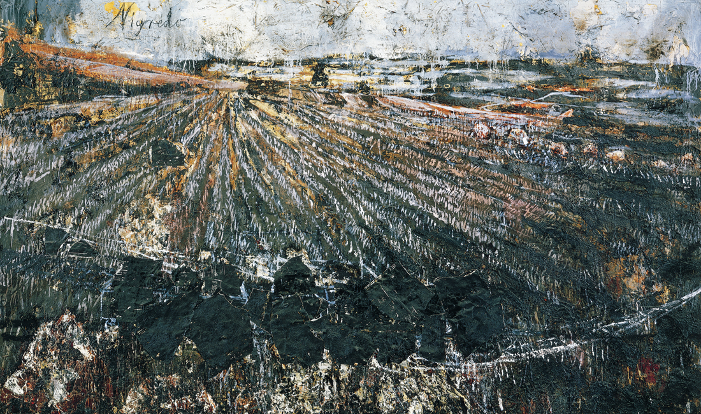
Anselm Keifer – Neo Expressionism

Slide 41
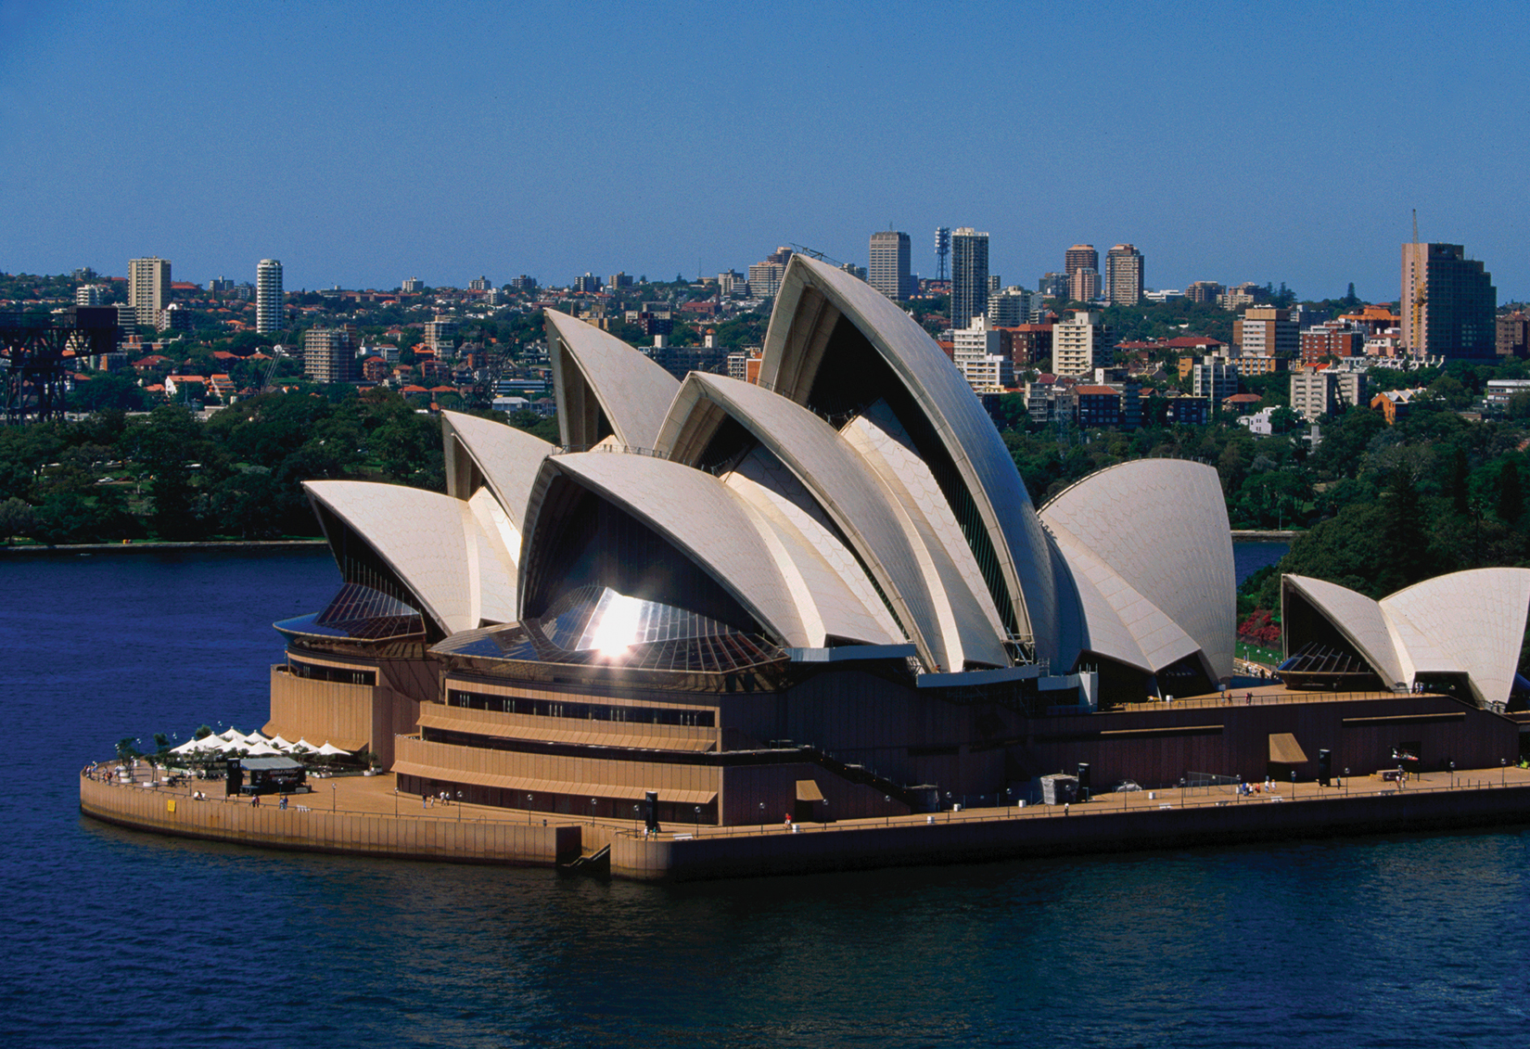
Sydney Opera House - Australia

Slide 42
Richard Hamilton – Pop Art

Slide 43
Donald Judd
Minimalism

Slide 44
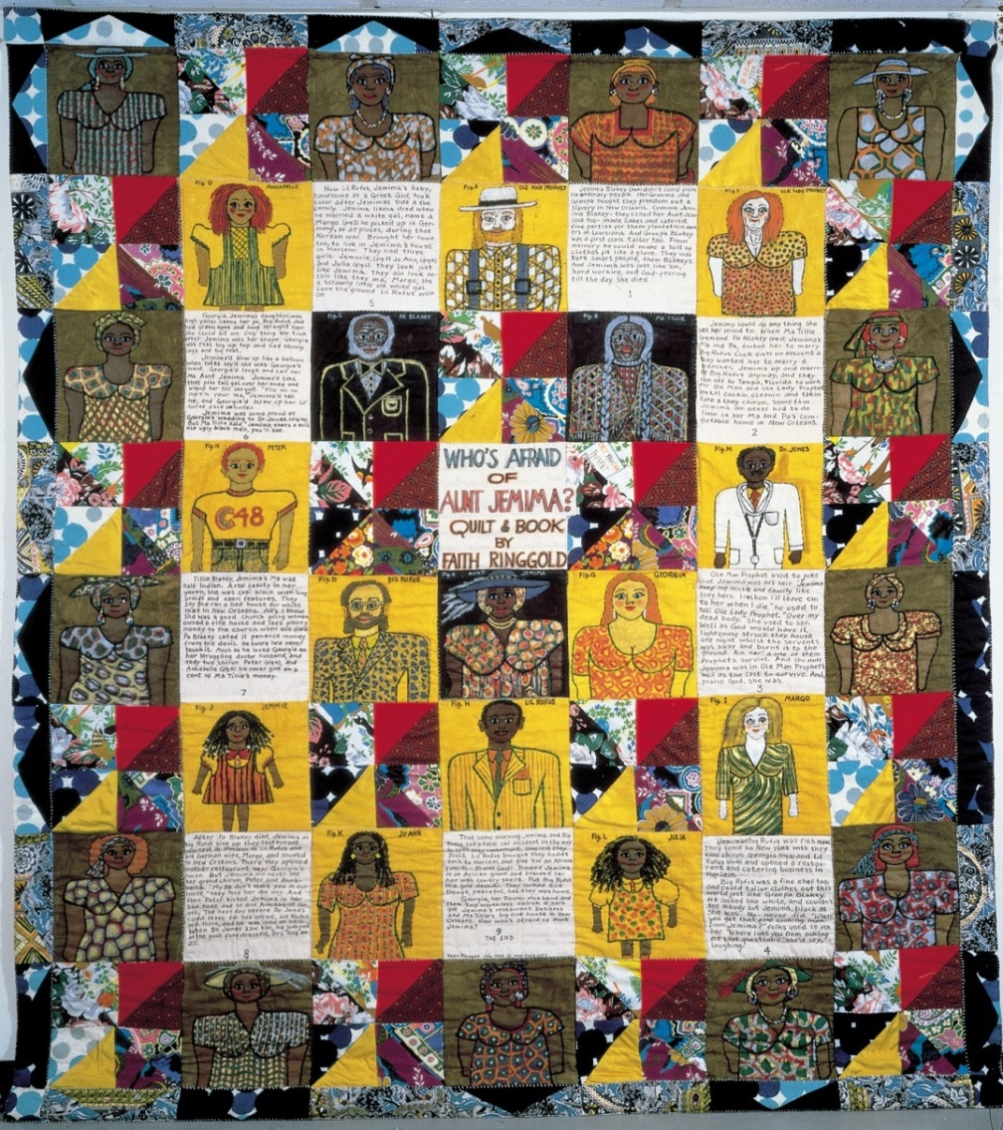
Faith Ringgold
Social Art

Slide 45
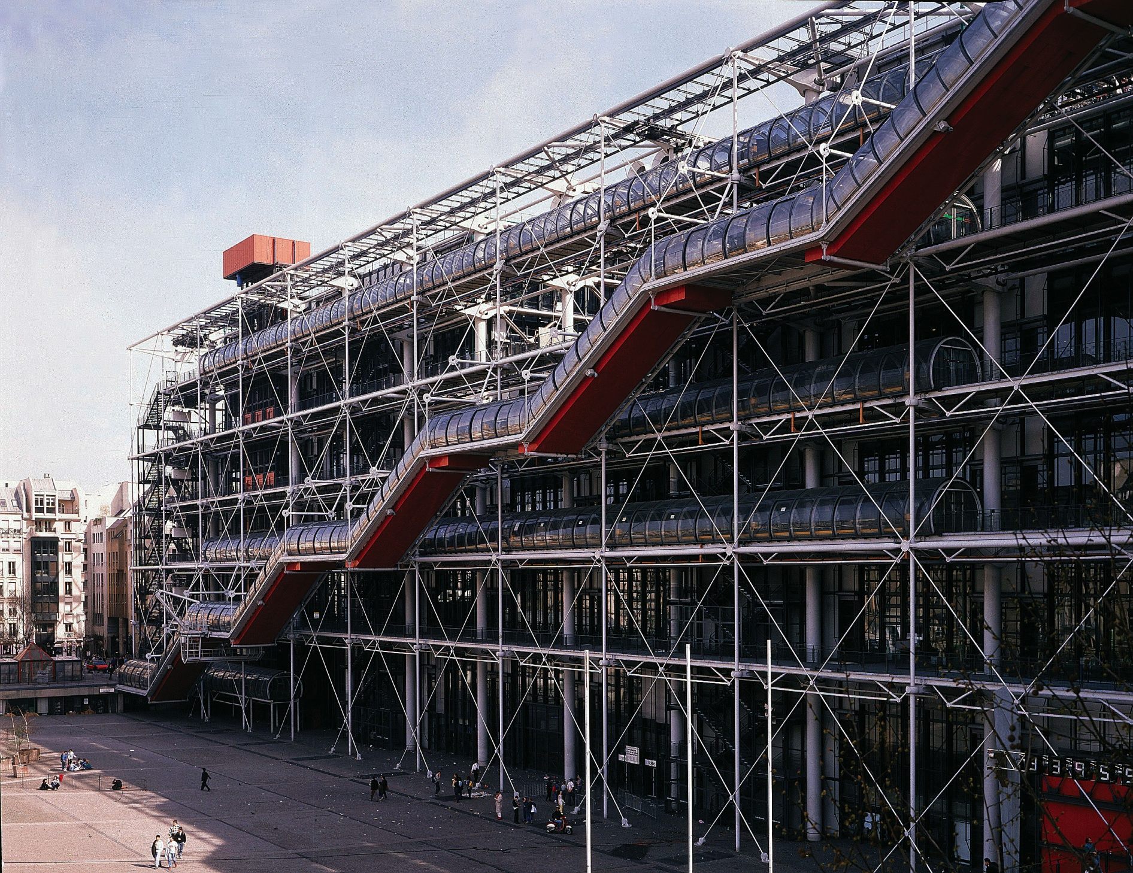
Pompidou Center of Art and Culture, Paris

Slide 46
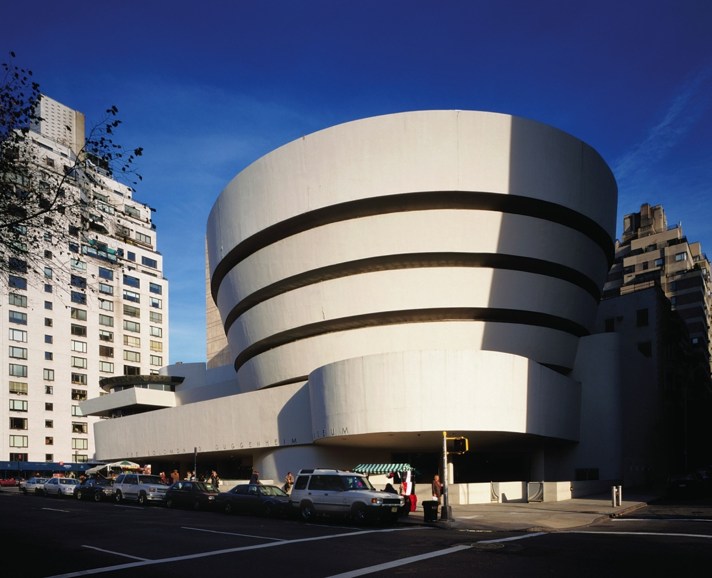
Frank Lloyd Wright - Guggenheim

Slide 47
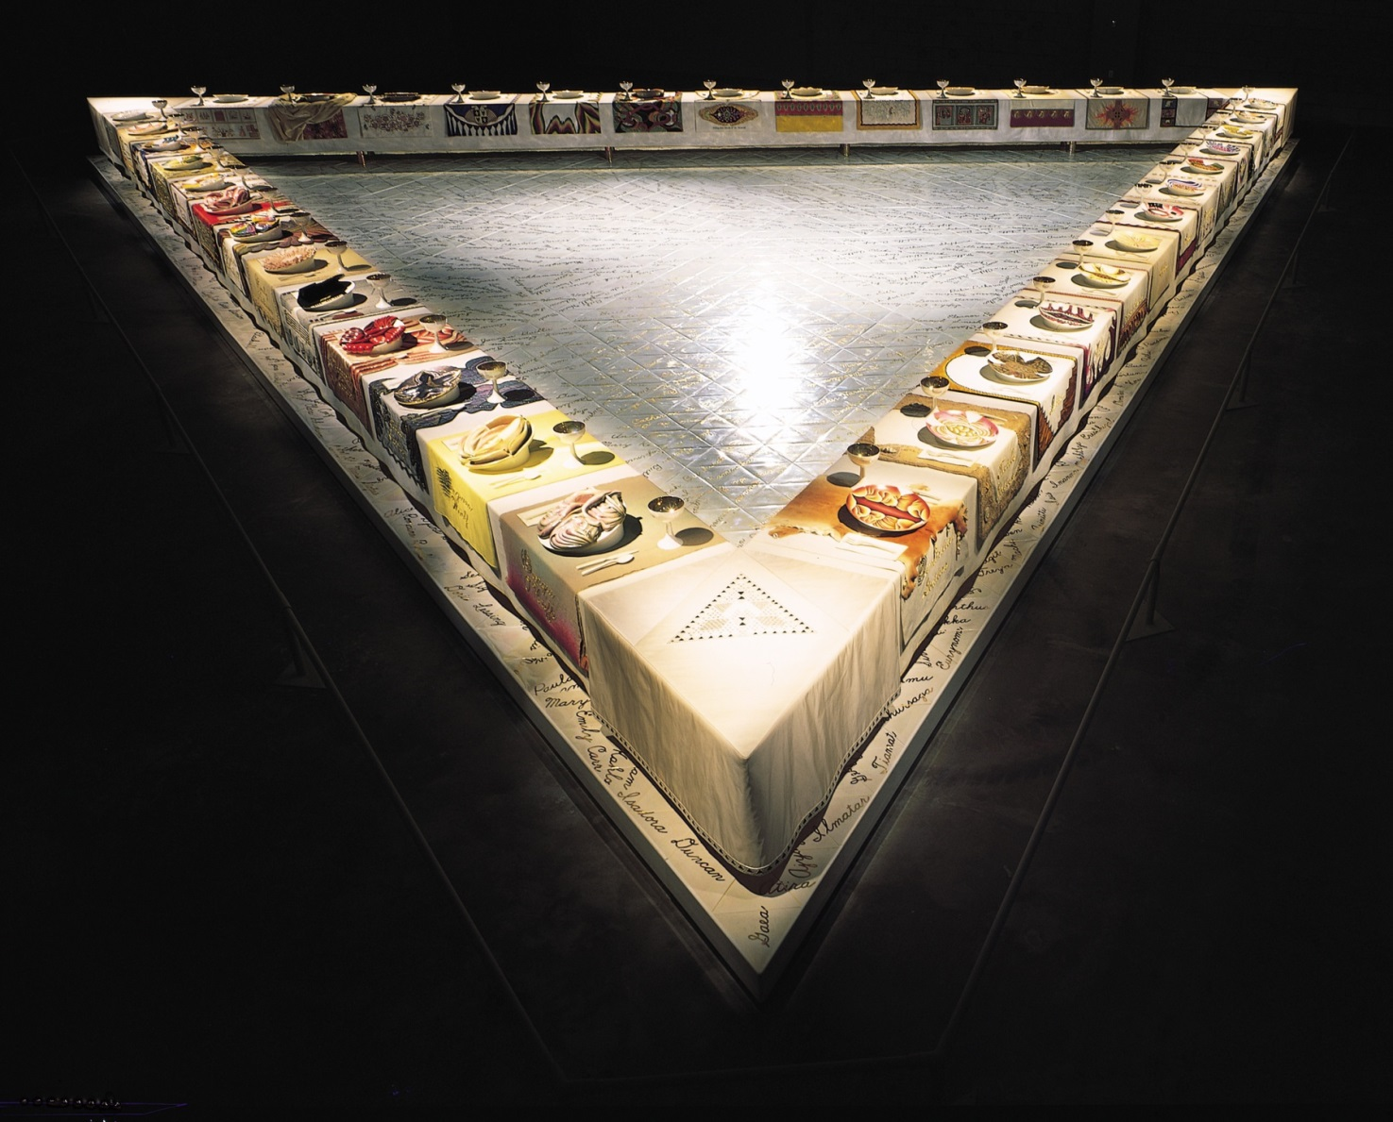
Judy Chicago
Feminist Art

Slide 48
Robert Rauschenberg
Pop Art

Slide 49
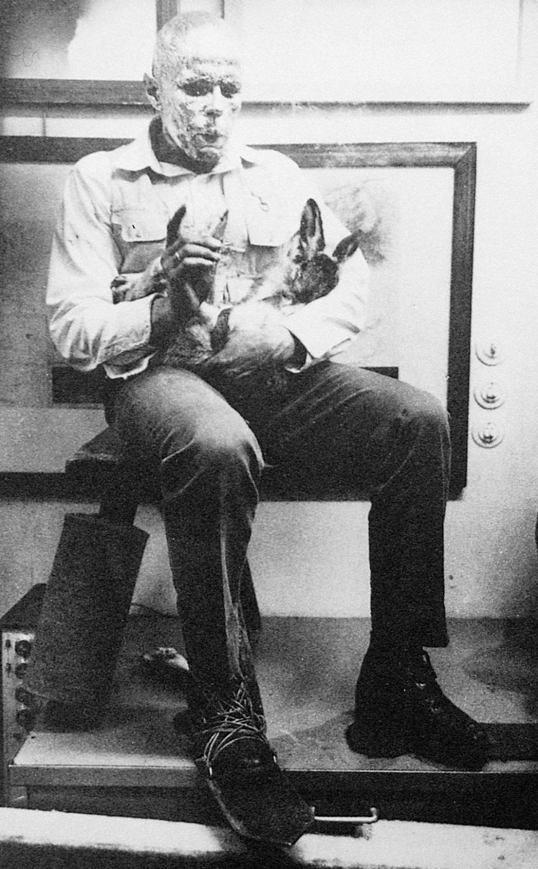
Joseph Beuys:
How to Explain Pictures to a Dead Hare
Performance Art

Slide 50
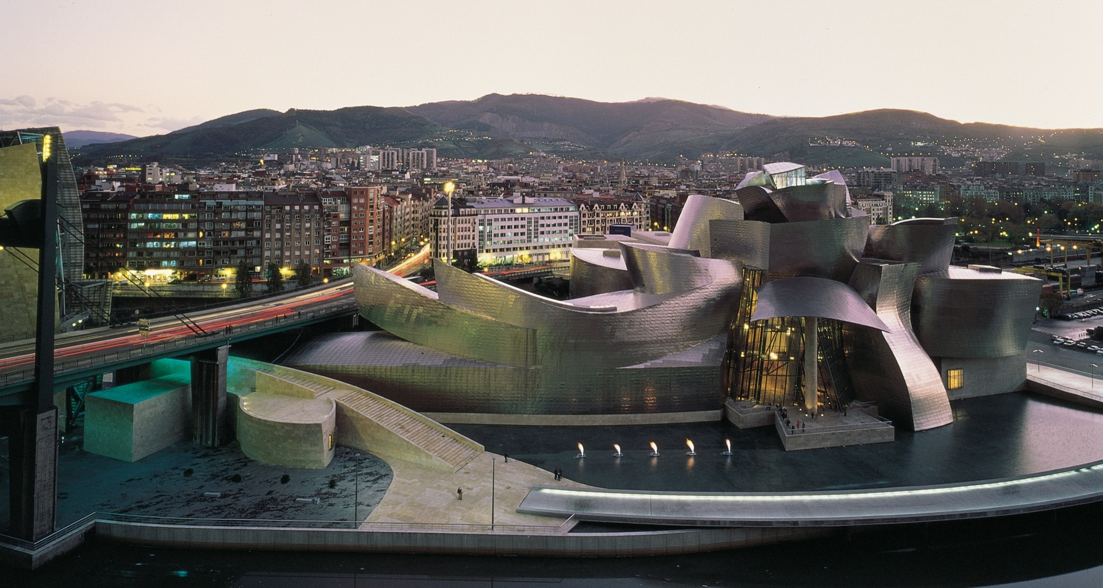
Frank Gehry , Guggenheim, Spain

Slide 51
Louise Bourgeois - Minimalism

Slide 52
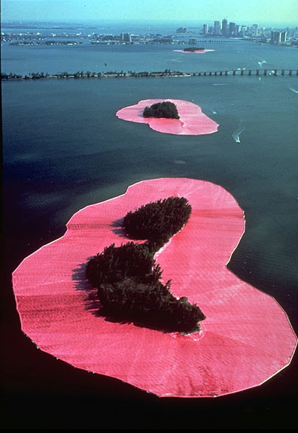
Christo:
Surrounded Islands
Site Specific Art

Slide 53
Roy Lichtenstein
Pop Art

Slide 54
Claes Oldenburg
Pop Art

Slide 55
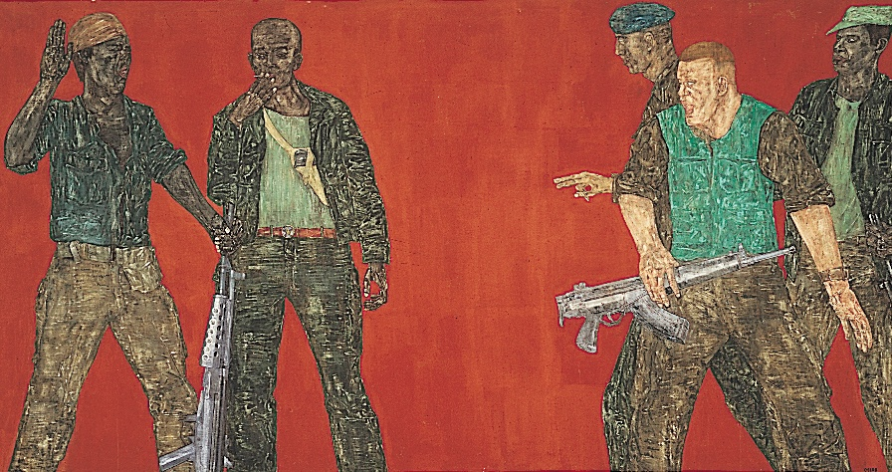
Leon Golub – Political Art

Slide 56
Larry Poons
OP Art

Slide 57
Bridget Riley
OP Art

Slide 58
Chuck Close
Photorealism

Slide 59
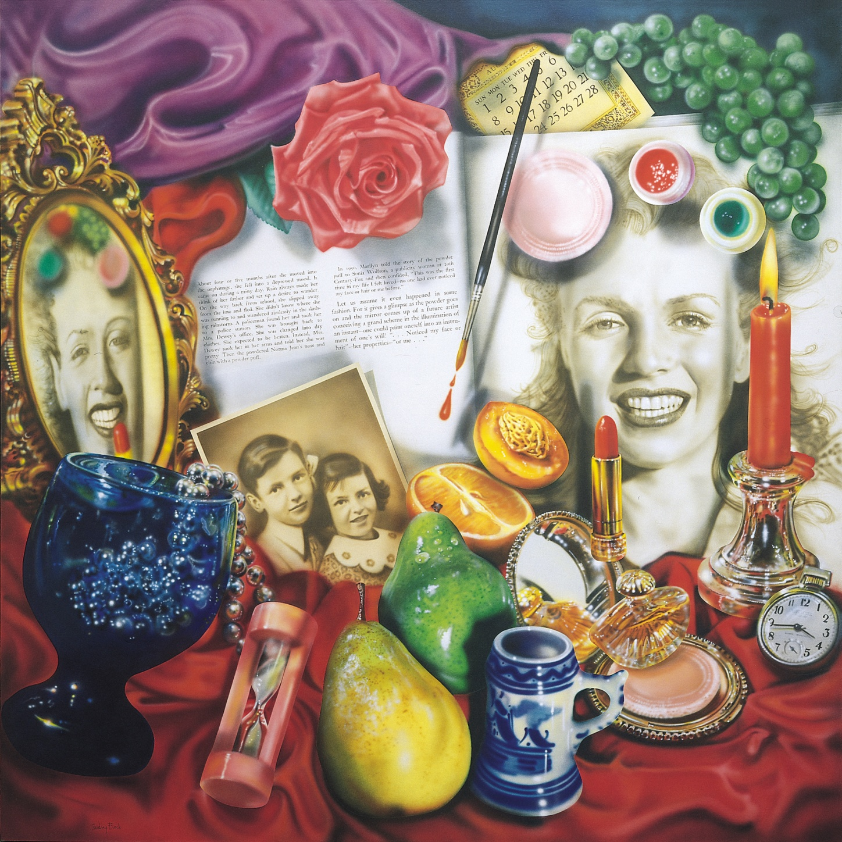
Audrey Flack
Photorealism

Slide 60
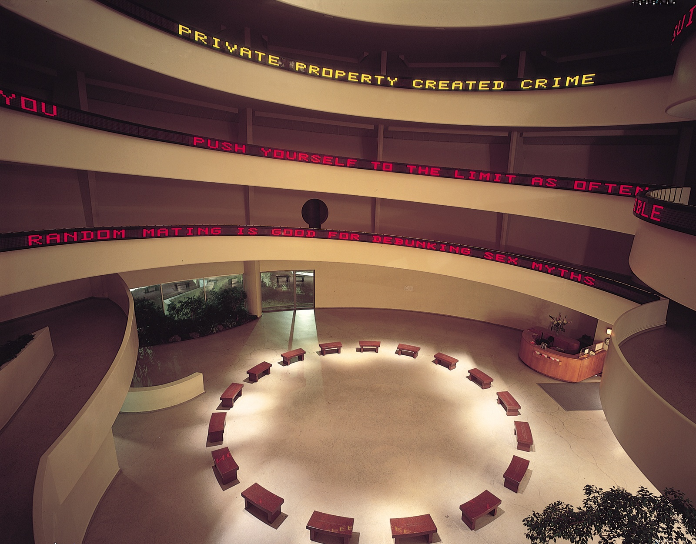
Jenny Holzer – Truisms
Site Specific Art

Slide 61
Duane Hanson
Photorealism

Slide 62
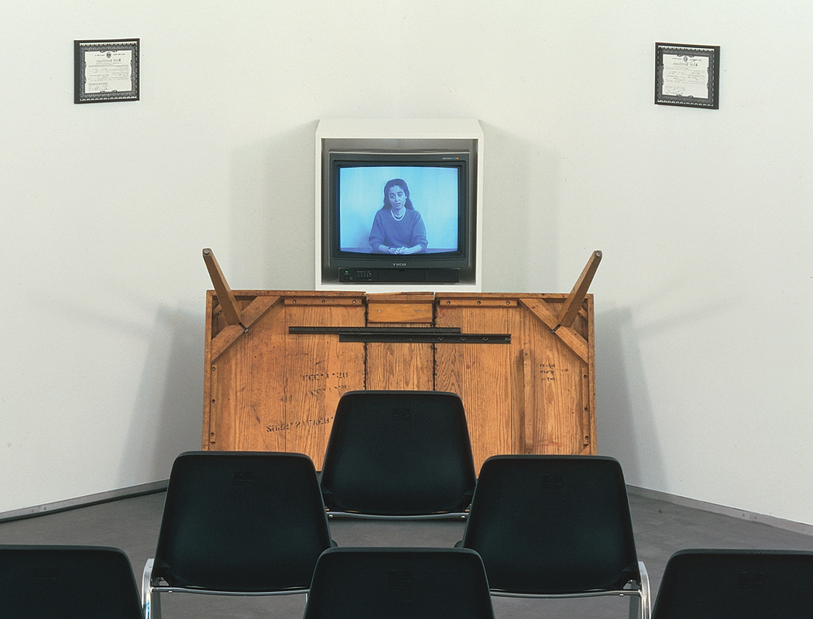
Adrian Piper : Cornered
Performance Art

Slide 63
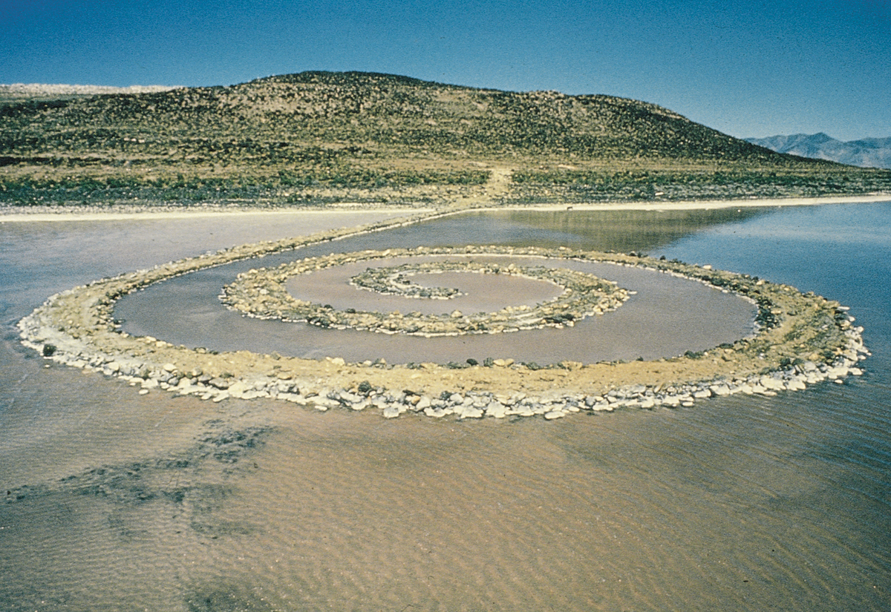
Robert Smithson, Spiral Jetty
Environmental Art

Slide 64
Julian Schnabel – Neo Expressionism

Slide 65
Anselm Keifer – Neo Expressionism

Slide 66
Audrey Flack
Photorealism

Slide 67
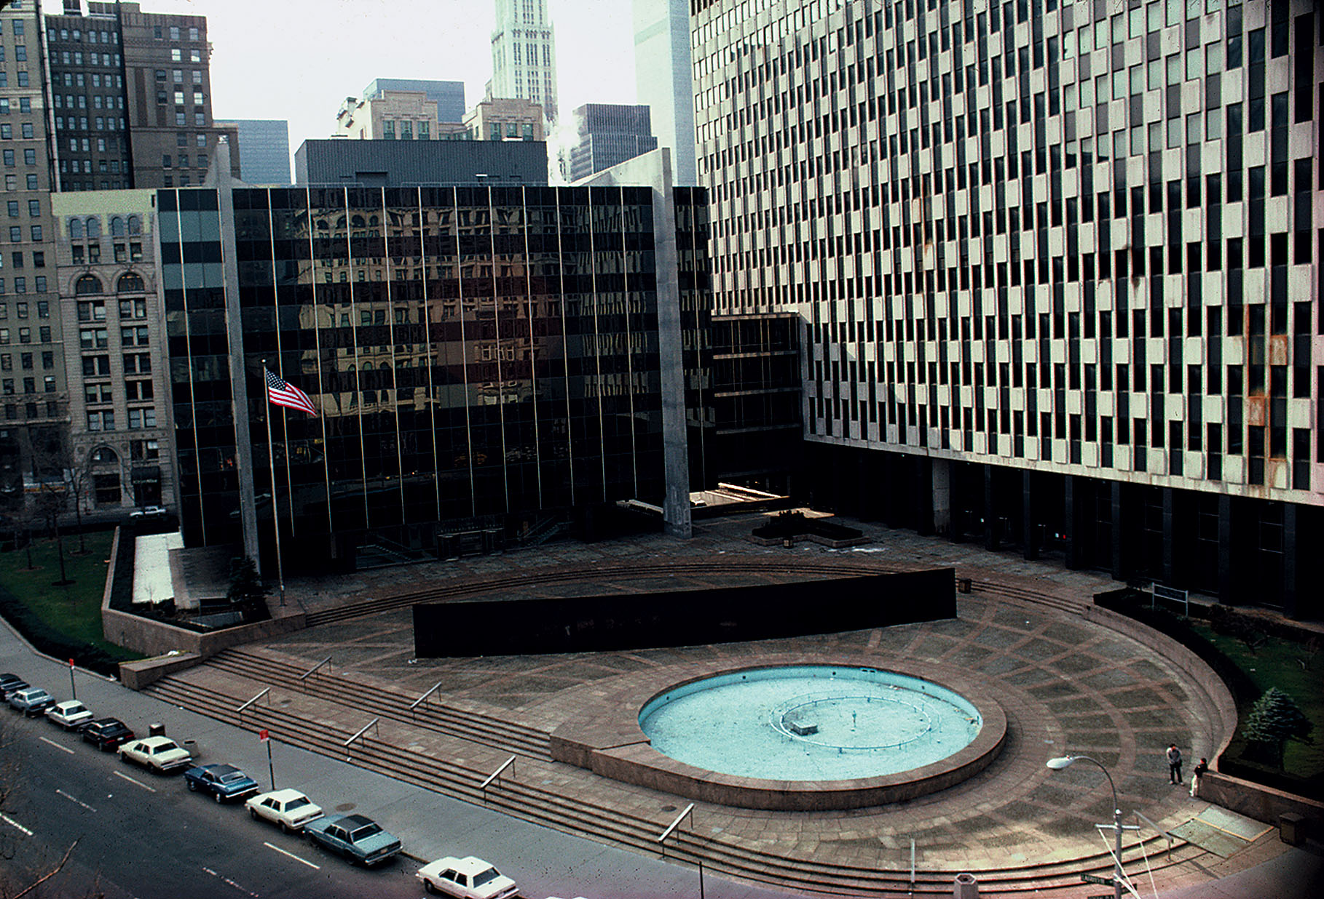
Richard Serra, Tilted Arc
Site Specific Art

Slide 68
Cindy Sherman
Feminist Art

Slide 69
Judy Chicago
Feminist Art

Slide 70
Barbara Kruger
Feminist Art

Slide 71
Maya Ying Lin, Vietnam Veterans Memorial
Site Specific Art

Slide 72
Francis Bacon Post War Expressionism

Slide 73
Faith Ringgold
Social Art

Slide 74
Jeff Koons
Social /Political Art

Slide 75
Frank Lloyd Wright - Guggenheim

Slide 76
Sydney Opera House - Australia

Slide 77
Pompidou Center of Art and Culture, Paris

Slide 78
Frank Gehry , Guggenheim, Spain

Slide 79
Leon Golub – Political Art

Slide 80
Christo:
Surrounded Islands
Site Specific Art

Slide 81
Robert Smithson, Spiral Jetty
Environmental Art

Slide 82
Richard Serra, Tilted Arc
Site Specific Art

Slide 83
Joseph Beuys:
How to Explain Pictures to a Dead Hare
Performance Art

Slide 84
Adrian Piper : Cornered
Performance Art

Slide 85
Jenny Holzer – Truisms
Site Specific Art

Slide 86
Ellsworth Kelly – Color Field Painting

Slide 87
Andy Warhol – Pop Art

