Slide 1
Late Antiquity - Byzantine Art
Late Antiquity: 200 – 500 CE
Byzantine: 500 - 1453

Slide 2
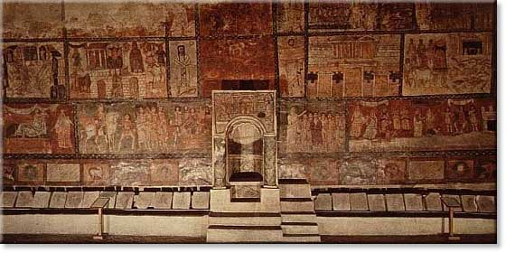
Fresco. Dura Europos Synagogue, Syria 245-256

Slide 3
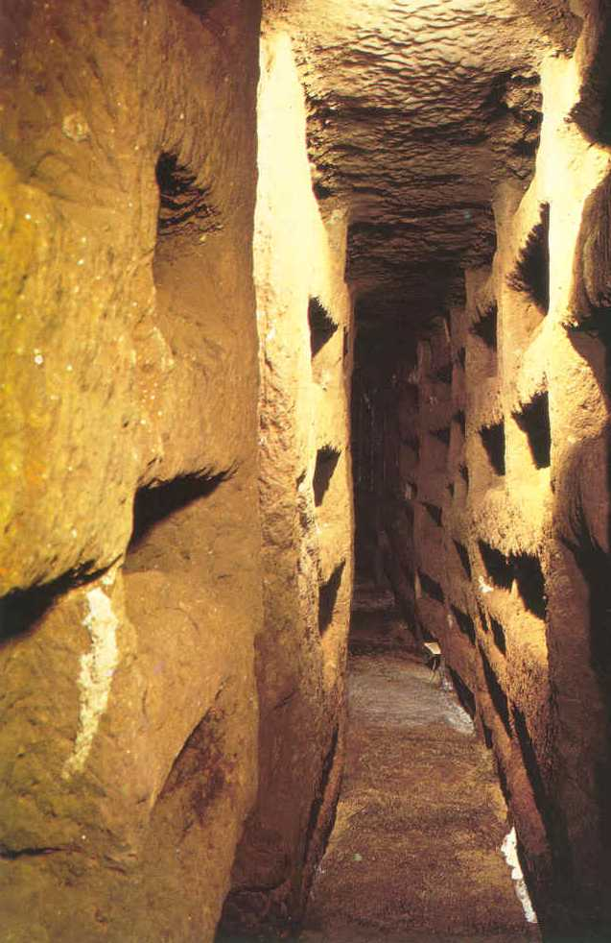
loculi

Slide 4
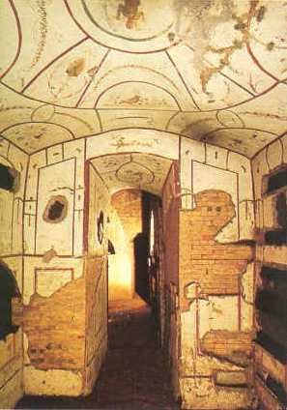
Painted cubiculum in the Catacomb
Rome, Italy
Ca. Early 4th Century
Catacombs were often painted with Christian symbols and motifs, praying figures (orants), and biblical scenes suitable to a funerary context.

Slide 5
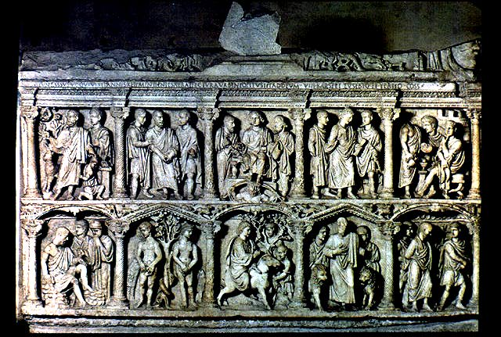
Sarcophagus of Junius Bassus
Ca. 359 - marble
Rome, Italy
Notes:
This Early Christian sculpture is the sarcophagus of Junius Bassus. It draws many influences from Christian and Roman styles. On the front it depicts ten biblical scenes. For example one scene portrays Jesus as a teacher. In the frame in the top center, Jesus is depicted as standing on the Roman sun god in order to show his power over the universe. Other Christian influence included the scene of Adam and Eve. Also, the sculpture is only engraved on three sides as opposed to the Roman four. Roman influences also include the 12 columns and few arches that separate the sciences. The people are also carved in a very Roman style.

Slide 6
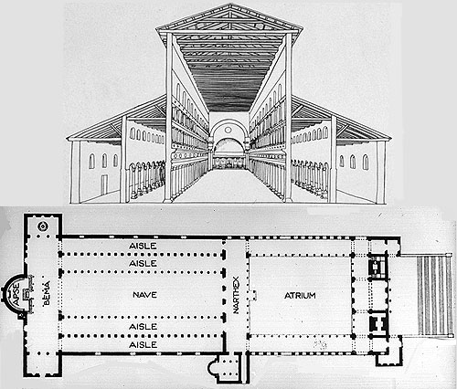
Plan and Section: Old St. Peter's, c. 320-27 CE

Slide 7
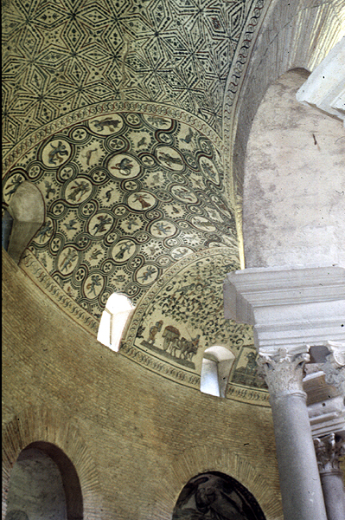
Interior of Santa Costanza, Rome, Italy, ca. 337–351.
The church of Santa Costanza in Rome was a mausoleum built for Constantine's daughter, Constantina.
Notes:
Interior of Santa Costanza, Rome, Italy, ca. 337–351

Slide 8
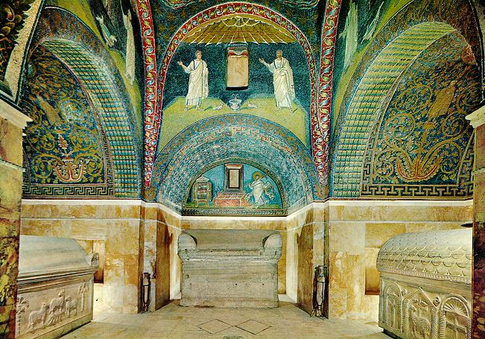
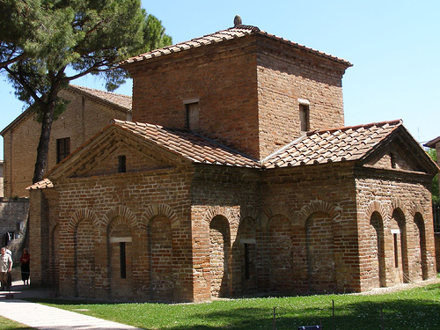
Mausoleum of Galla Placidia, Ravenna, Italy, ca. 425.
Notes:
It was built within the first half of the 5th century by Galla Placidia. It is the oldest and the richest of mosaics monument of Ravenna.
The plan is of a Latin cross and the construction is all of brickwork.
Inside the mosaic covering staarts off from the bottom of the barrel-vaults of the four limbs and cover all the high part of the building.

Slide 9
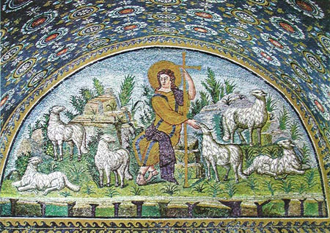
Christ as the Good Shephard 425 CE Mosaic Mausoleum of Galla Placidia, Ravenna, Italy
Notes:
From the early part of the fifth century the "capital" of the Roman Empire in the West was not at Rome, but at Ravenna in northeastern Italy. The emperor Honorius moved his court from Rome to Ravenna in AD 410 in order to escape the siege of Alaric and the Visigoths. Galla Placidia (388-450), the sister of Honorius, was abducted by the Visigothic king, whom she married. After his death she married a Roman nobleman and their son was the emperor Valentinian III. She played a leading role in the political maneuvering of the day.

Slide 10
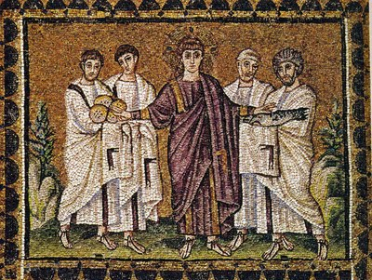
Miracle of the loaves and fishes,
mosaic from Sant’ Apollinare Nuovo
Notes:
Miracle of the loaves and fishes, mosaic from top register of nave wall (above clerestory windows) of Sant'Apollinare Nuovo, Ravenna, Italy, ca. 504.
Note purple & gold robes, cross- inscribed nimbus (halo), beardless Jesus
The central figure of the mosaic is Justinian the Byzantine emperor. This mosaic utilizes many devices that portray Justinian as a majestic figure. First, Justinian is portrayed with gold and purple robes and has a halo around him. He also has a young, youthful face like Christ. These are features that we normally associate with Christ so the artist is trying to render him as almost a Christ figure. There is also a hierarchy of layers in this piece as Justinian is the top most layer in the mosaic. The next layer is made up of clergy men and then Justinian’s guard. Justinian is also ornamented with jewelry and crown which denote that he is a political leader as well. The artist is using these techniques to show that Justinian is a majestic ruler because they are portraying a Christ figure and a political figure, suggesting that Justinian is both the religious and political head of state.

Slide 11
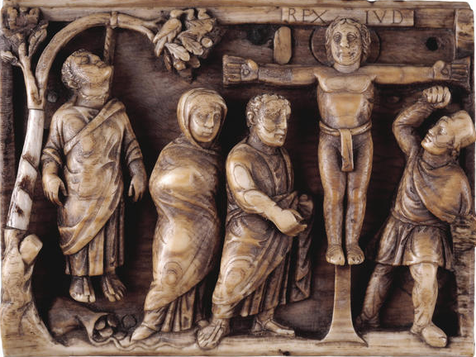
Suicide of Judas and Crucifixion of Christ ca. 420, Ivory
Notes:
This plaque is one of four, which though now separated, must originally have been mounted on the four sides of a small square casket. Each is carved with scenes from Christ's Passion. The other panels depict the Christ carrying the Cross, the empty Sepulchre and Doubting Thomas.
This is the earliest known narrative portrayal of the Crucifixion. It is combined with another scene of death, the hanging of Judas. The stiff, clothed body of Judas pulls down the branch of a tree and a spilled sack of coins lies at his feet. In contrast the exposed limbs of Christ appear still vigorous, and He gazes at the viewer, triumphant in death. A plaque over Christ's head is inscribed REX IUD[AEORUM] ('King of the Jews'). Mary and John stand in similar poses to the left of the cross, while on the right Longinus steps from beneath the arm of the cross across the frame into the viewer's space. In the branch of the tree which bends towards Christ, a bird feeds her chicks - a symbol of the life-giving power of His death.
The depth of the carving - almost three-dimensional - and sense of movement in this particular plaque are typical of the continuation of the classical tradition of ivory carving in Rome.
Height: 7.5 cm Width: 9.8 cm
M&ME 1856,6-23,5
Room 41, Sutton Hoo and early Medieval, case 5
K. Weitzmann (ed.), Age of spirituality: Late Antique and early Christian art, third to seventh century (New York, 1979), pp. 502-4, no. 452
Text Only Home Search Tours Help Back to top
© 2000 The British Museum

Slide 12
Byzantine Art: 500-1453 CE
Early: 500-726
Iconoclastic: 726-843
Middle/High Byzantine: 843-1200
Late Byzantine: 1204 - 1453

Slide 13
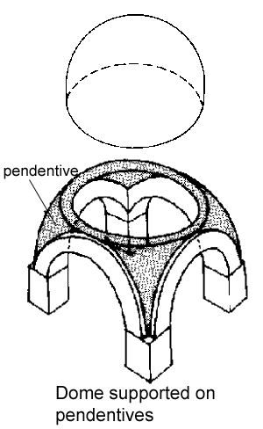
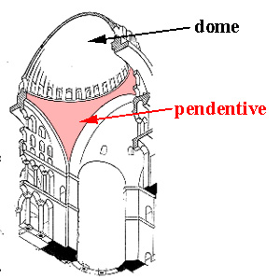
Pendentive
Interior View
Exterior View

Slide 14
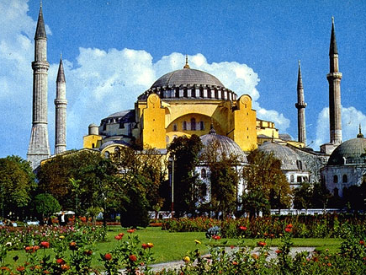
Hagia Sophia Constantinople (Istanbul), Turkey, 532–537.
The building was the first domed building to have a circular dome on top of a square base. The architects achieved this with the innovation of pendentive construction, in which triangular pieces were used to create a complete ring at the bottom of the dome’s base. It also took the use of light to a new level with the ring of windows around the base of the central dome, making it appears as if it were support by light which is a symbol for god. This building is also one of the first examples of the combination of a central and basilica plan church as the central dome is surrounded by four equal wings form the Greek cross.

Slide 15
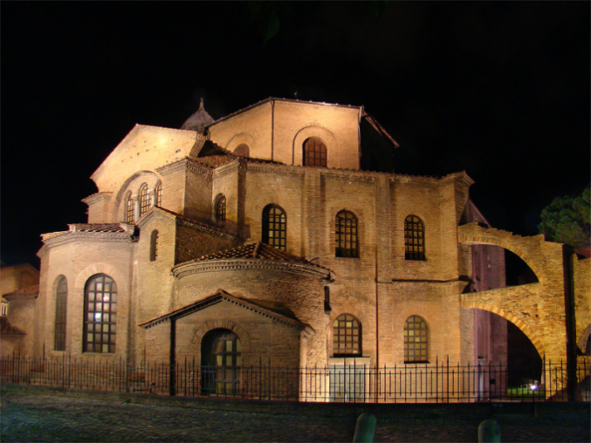
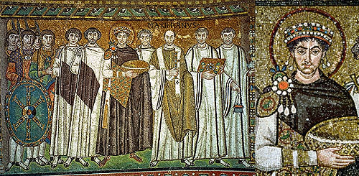
Detail of Justinian and Attendants San Vitale

Slide 16
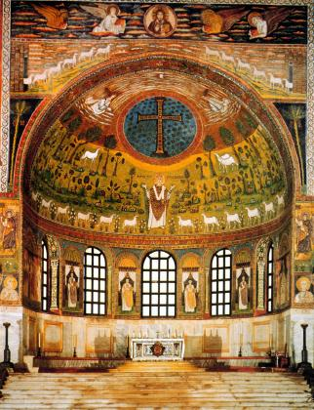
Saint Apollinaris amid sheep, apse mosaic, Sant'Apollinare in Classe, Ravenna, Italy, ca. 533–549.
Christ as the Good Shepard - 425 CE Mosaic Mausoleum of Galla Placidia, Ravenna,Italy

Slide 17
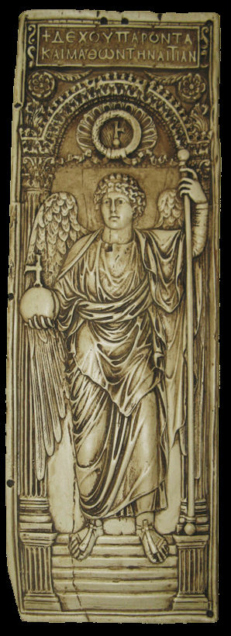
Saint Michael the Archangel,
Right leaf of a diptych, early sixth century, Ivory

Slide 18
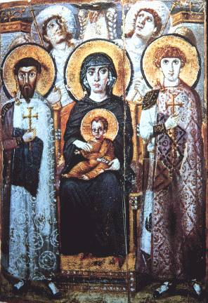
Virgin (Theotokos) and Child between Saints Theodore and George, icon, sixth or early seventh century. Encaustic on wood, 2' 3" x 1' 7 3/8". Monastery of Saint Catherine, Mount Sinai, Egypt

Slide 19
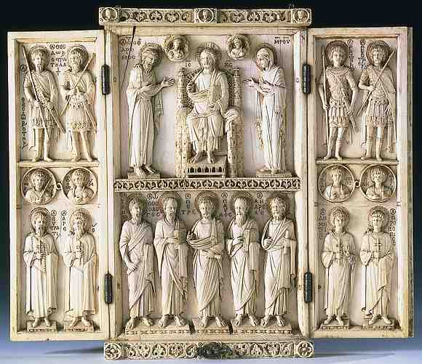
Harbaville Triptych: Deisis and Saints Constantinople Mid10th century lvory with traces of goldleaf
Notes:
The triptych is organized around the depiction of the deisis; the Virgin and St. John the Baptist intercede with Christ Enthroned, on behalf of humanity. On the section beneath, and on the two side panels, apostles, martyrs, bishop and soldier-saints join in this prayer. This masterpiece of Byzantine classicism is the most elegant of the ivories from the imperial workshop known as "Romanos" (based on the plaque in the Cabinet des Médailles at the Bibliothèque Nationale in Paris in which Christ is crowning Emperor Romanos II (945-949) and his wife Eudoxia). It is an important example of the rebirth of the ornamental arts in Byzantium under the Macedonian Emperors.

Slide 20
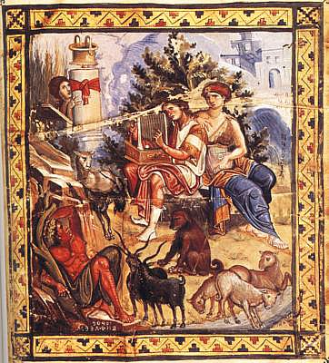
David composing the psalms, folio 1 verso of the Paris Psalter, ca. 950-970. Tempera on vellum, 1' 2 1/8" x 10 1/4".

Slide 21
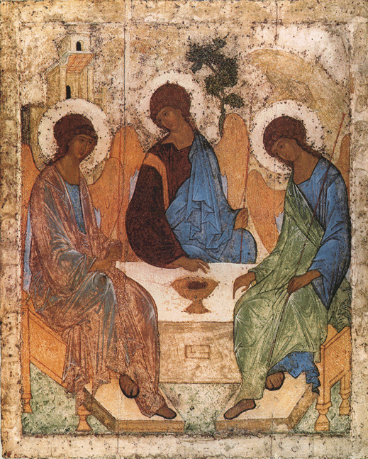
ANDREI RUBLYEV, Three angels (Old Testament Trinity), ca. 1410. Tempera on wood, 4' 8" x 3' 9". Tretyakov Gallery, Moscow.
Russian paintings usually had strong patterns, firm lines, and intense contrasting colors.

Slide 22
EARLY MEDIEVAL – GOTHIC Art
Early medieval: 450 – 1050
Romanesque: 1050-1200
Gothic: 11-40-1400

Slide 23
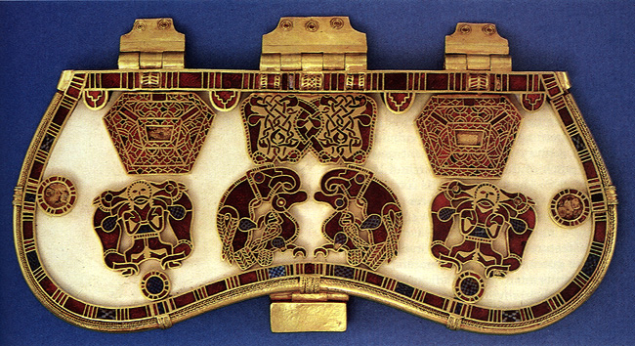
Hiberno-Saxon: 500-700 CE
Purse Cover – 600 CE

Slide 24
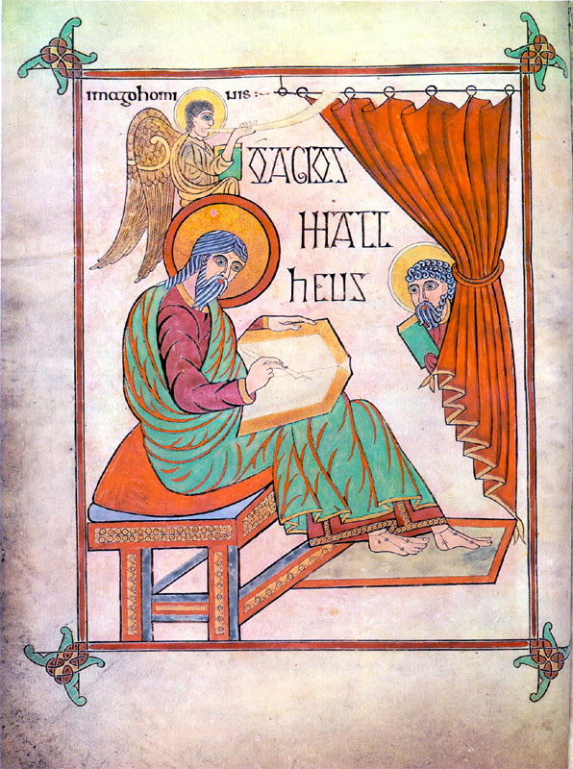
Saint Mathew- Book of Lindisfarne – 700 CE

Slide 25
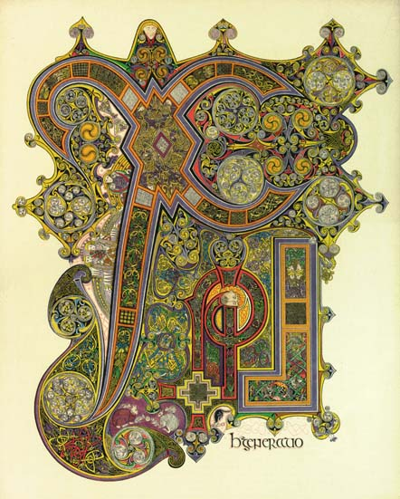
Book of Kells – 800 CE

Slide 26
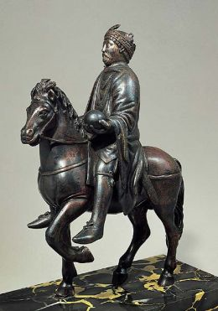
Carolingian Ruler – 800 CE

Slide 27
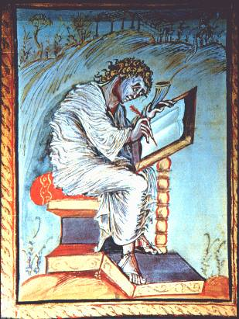
Carolingian – Ebbo Gospels- St. Mathew

Slide 28
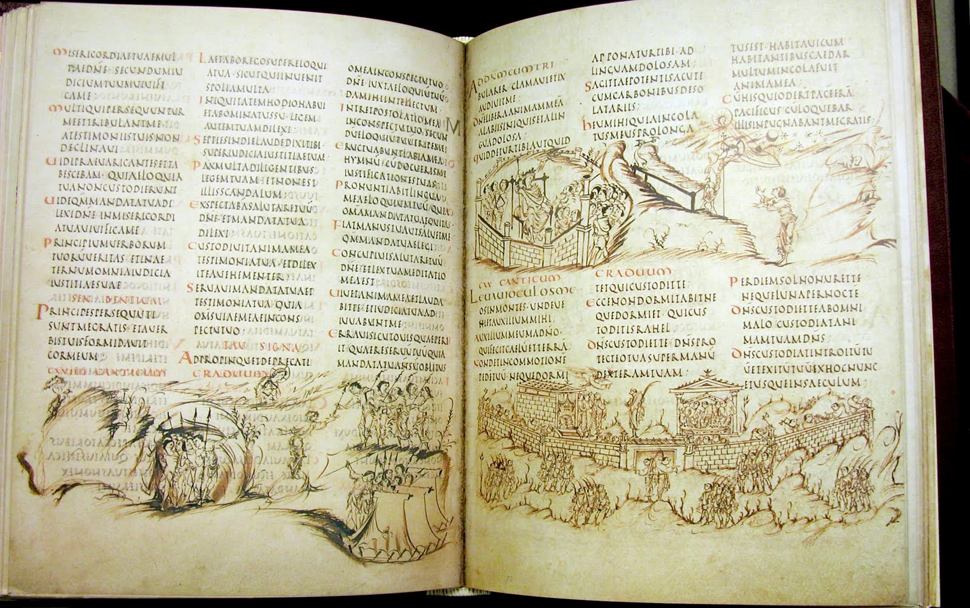
Utrecht Psalter – 830 CE

Slide 29
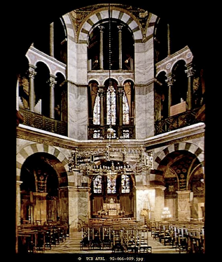
Palace of Charlemagne – 800 CE

Slide 30
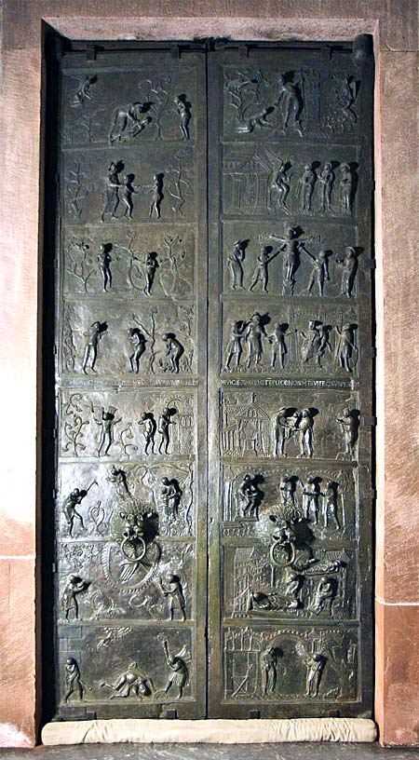
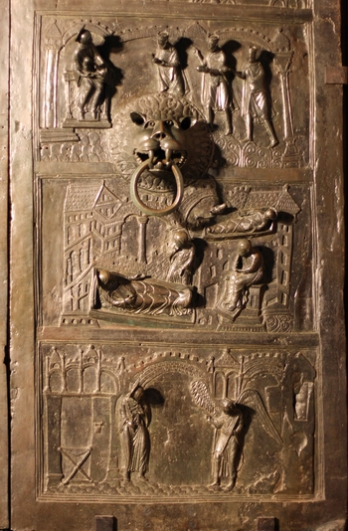
Ottonian Art – Bernward Doors – 1015 CE

Slide 31
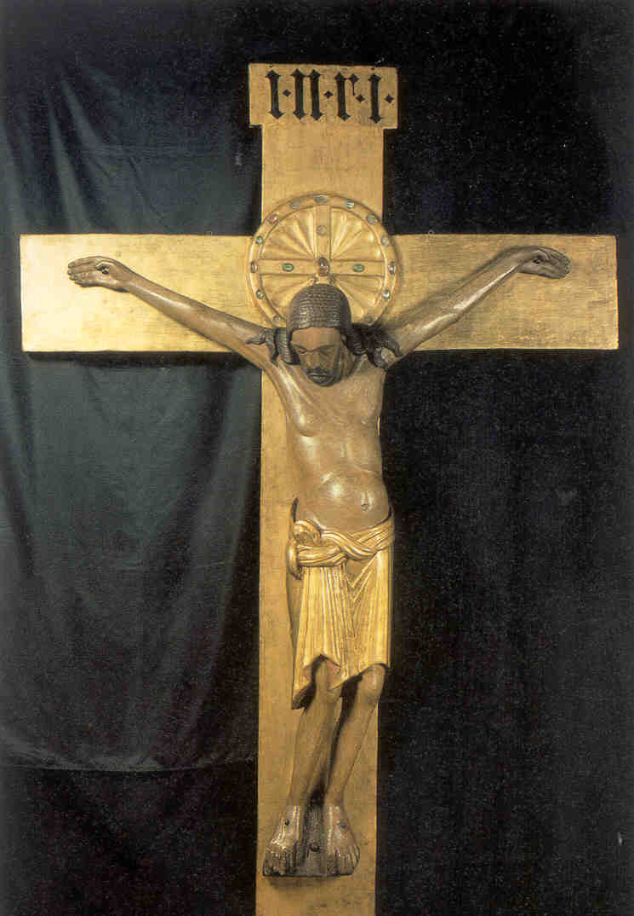
Gero Crucifix – 970 CE

Slide 32
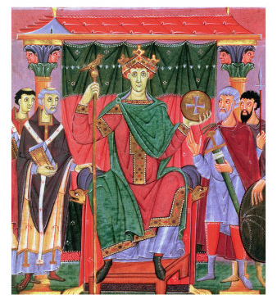
Otto III enthroned – 1000 CE

