Slide 1
Ancient Near East
Sumerian Art – 3500 – 2300 BCE
Akkadian, Neo-Sumerian, Babylonian, Hittite Art - 2250 – 860 BCE
Neo-Babylonian / Persian Art – 575 – 465 BCE
Sasanian Art - 250 CE

Slide 2
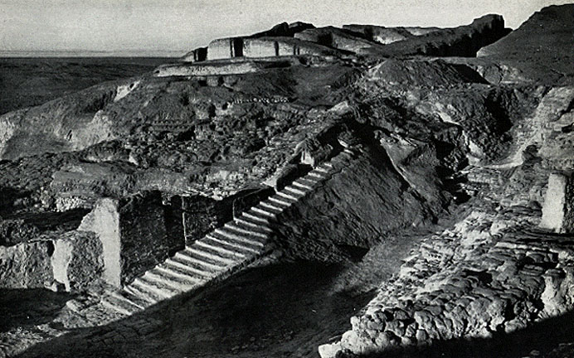
White Temple, Uruk 3200 BCE Sumerian

Slide 3
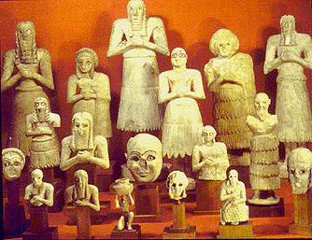
Statuettes from Eshnunna – 2700 BCE Sumerian

Slide 4
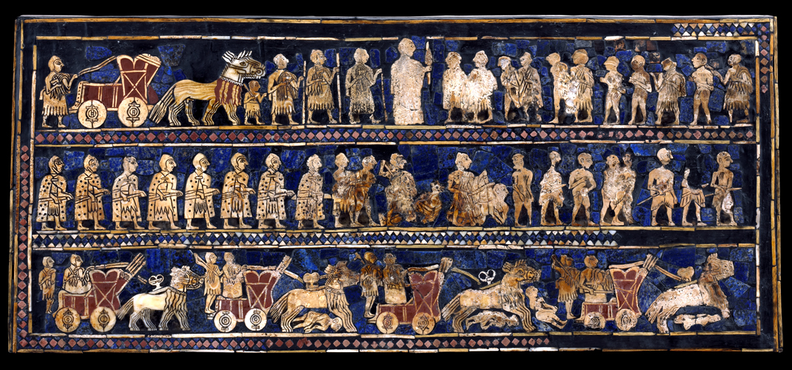
Standard of Ur – 2600 BCE Sumerian

Slide 5
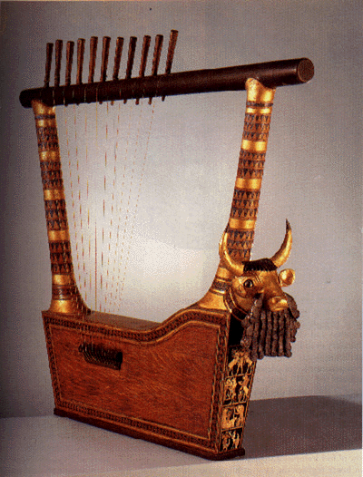
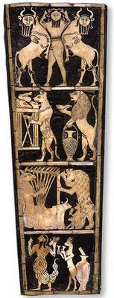
Bull Headed Lyre – 2600 BCE Sumerian

Slide 6
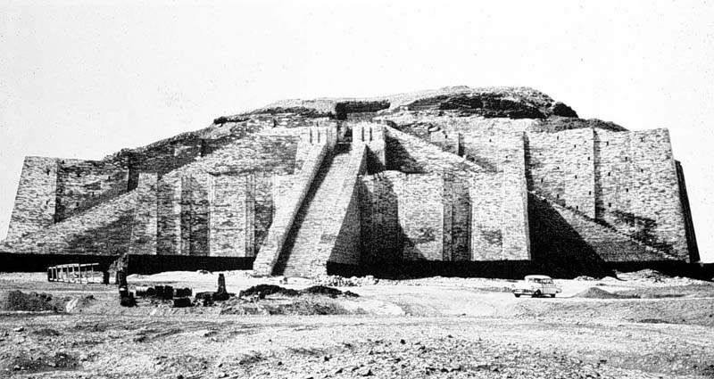
Ziggurat – 2100 BCE Akkadian

Slide 7
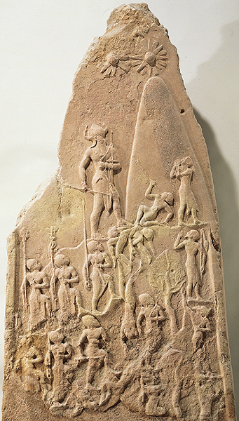
Victory Stele of Naram-sim – 2250-BCE Akkadian

Slide 8
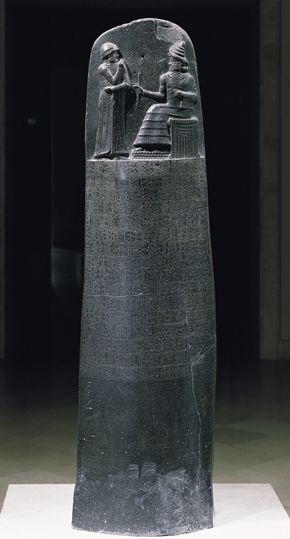
Stele – Law code of Hammurabi – 1780 BCE Babylonian

Slide 9
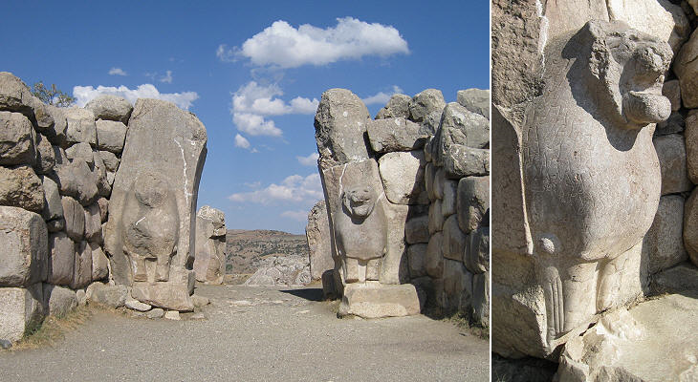
Lion Gate – Turkey – 1400 BCE Hittite

Slide 10
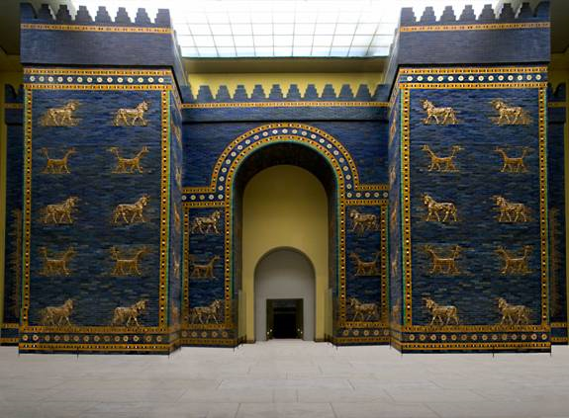
Ishtar Gate - 575 BCE Babylonian

Slide 11
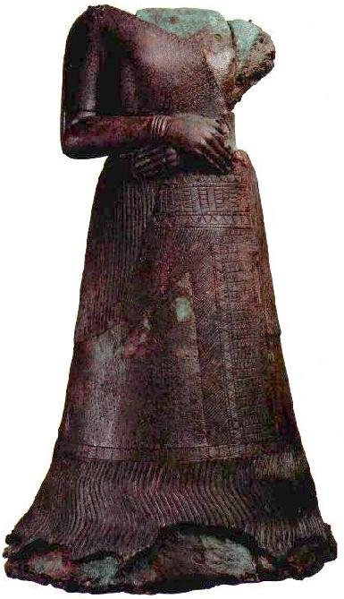
Queen Napirasu – 1350 BCE Assyrian

Slide 12
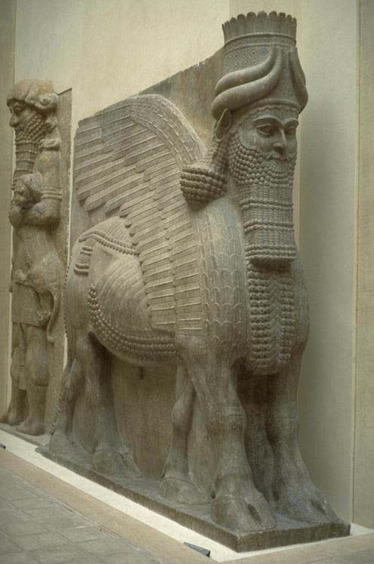
Lamassu – 720 BCE Assyrian

Slide 13
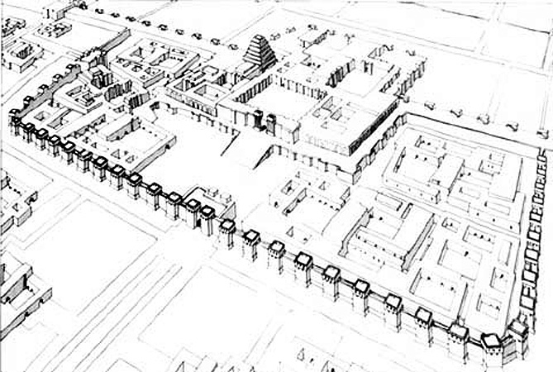
Palace of Sargon – 720 BCE Assyrian

Slide 14
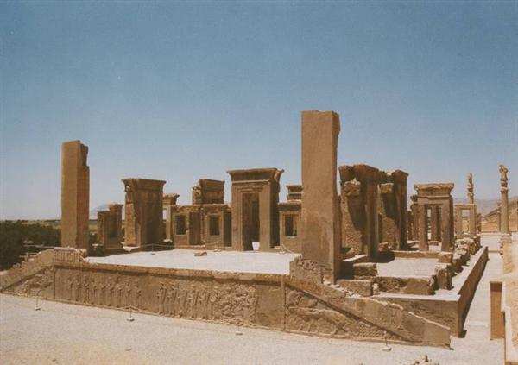
Palace of Persepolis – 500 BCE Persian

Slide 15
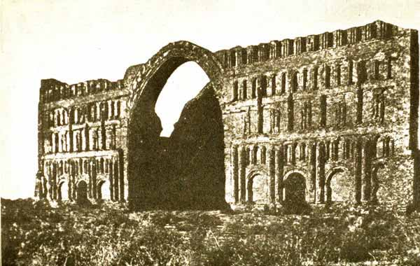
Palace of Shapur I– 250 BCE Persian

Slide 16
Egyptian Art Old Kingdom: 2575-2134 BCE Middle Kingdom: 2040 – 1640 BCE New Kingdom: 1550 – 1070 BCE

Slide 17
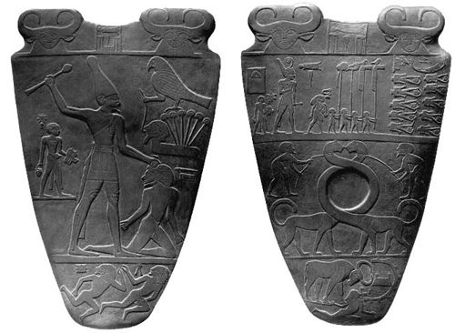
Palette of King Narmer – 300 BCE Old Kingdom

Slide 18
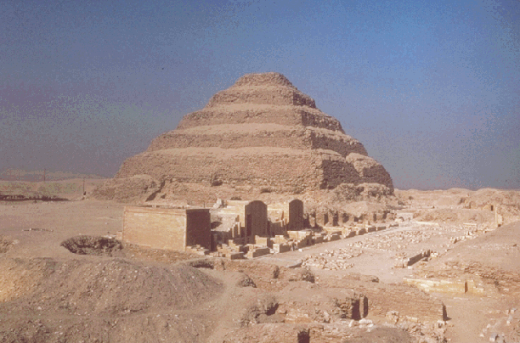
Imhotep stepped pyramid – 2600 BCE Old Kingdom

Slide 19
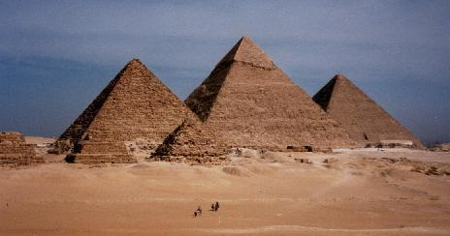
Great Pyramids, Gizeh – 2500 BCE Old Kingdom

Slide 20
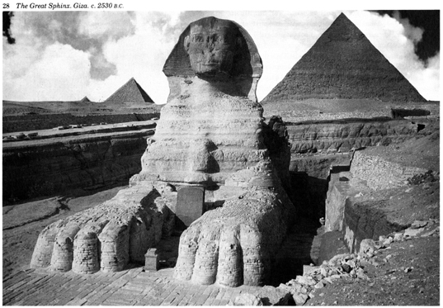
Great Sphinx – 2500 BCE Old Kingdom

Slide 21
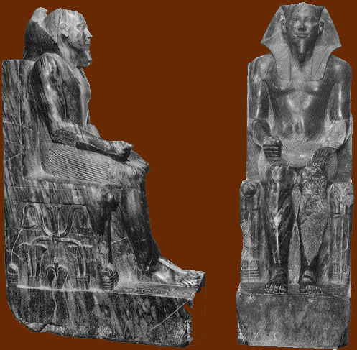
Khafre – Dynasty IV – 2500 BCE Old Kingdom

Slide 22
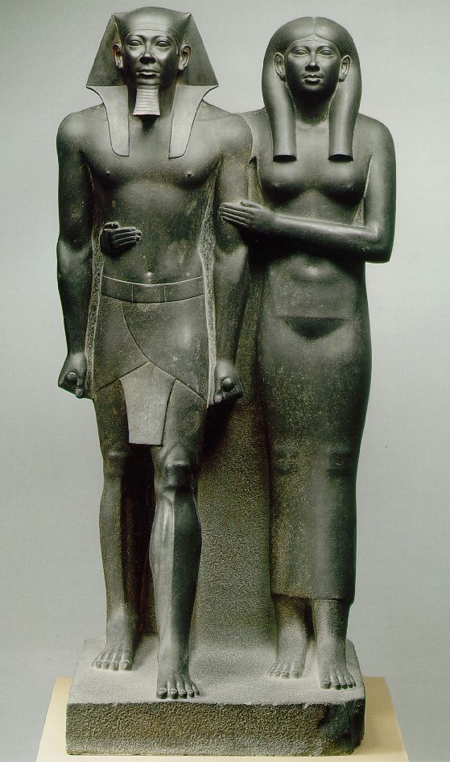
Menkaure and Queen – 2500 BCE Old Kingdom

Slide 23
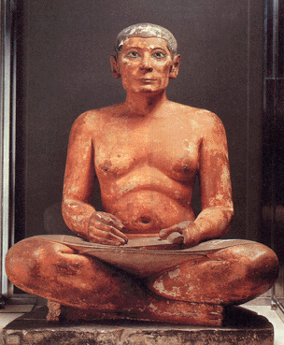
Seated Scribe – 2500 BCE Old Kingdom

Slide 24
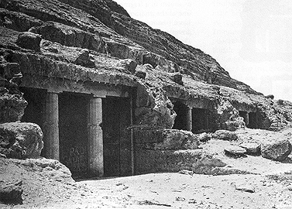
Rock Cut Tombs – Beni hasan – 1900 BCE Middle Kingdom

Slide 25
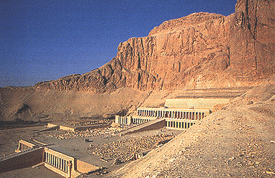
Temple of Hatshepsut – 1470 BCE New Kingdom

Slide 26
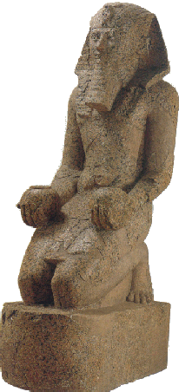
Hatshepsut – 1470 BCE New Kingdom

Slide 27
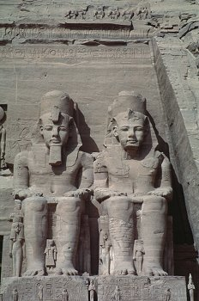
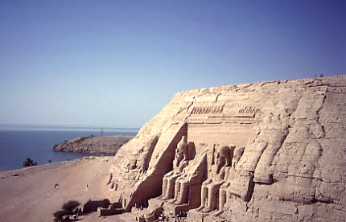
Tomb of Ramses II – 1290 BCE New Kingdom

Slide 28
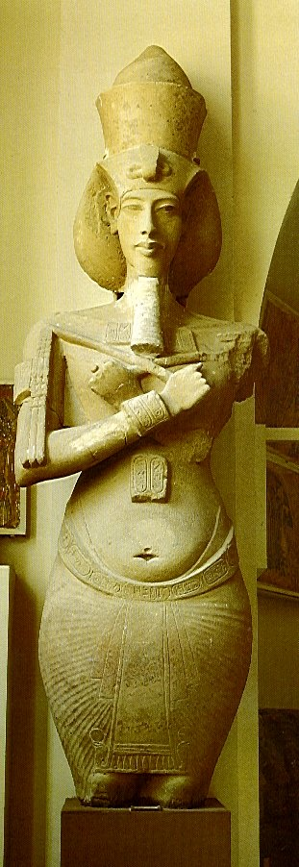
Akhenaton – 1350 BCE – Armana New Kingdom

Slide 29
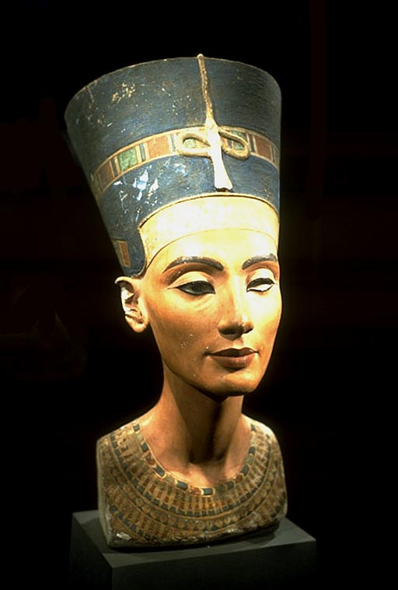
Nefertiti – 1350 BCE New Kingdom

Slide 30
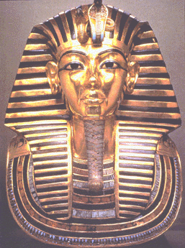
Tutankhamen – 1320 BCE New Kingdom

Slide 31
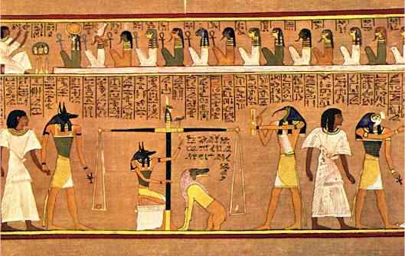
Last Judgment of Hu-Nefer - 1290 BCE New Kingdom

Slide 32
Aegean Art Cycladic: 3000– 1600 BCE Minoan: 1900 – 1375 BCE Mycenaean: 1600 – 1100 BCE

Slide 33
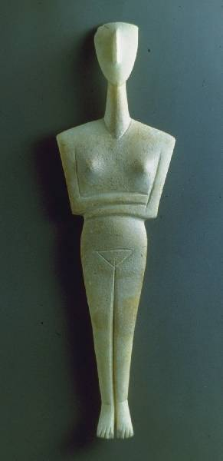
Woman figurine – 2500 BCE Cycladic

Slide 34
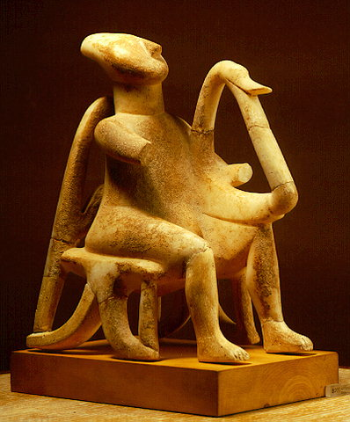
Male Lyre player – 2700 BCE Cycladic

Slide 35
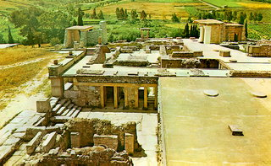
Palace at Knossos – 1600 BCE Minoan

Slide 36
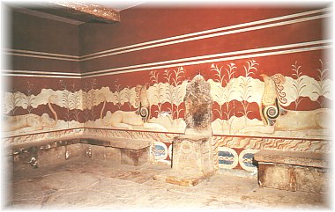
Alabaster Throne at Minos

Slide 37
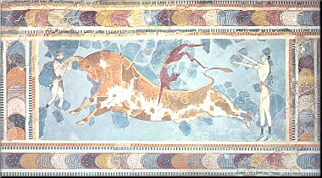
Toreador Fresco – 1400 BCE Minoan

Slide 38
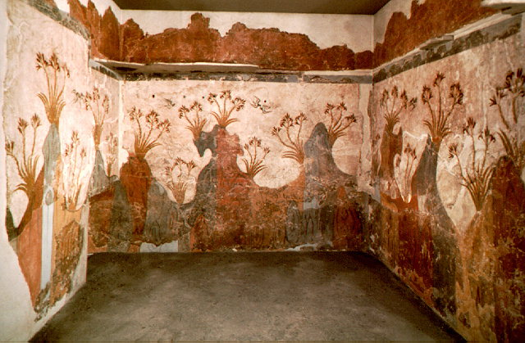
Landscape with Swallows – 1650 BCE Minoan

Slide 39
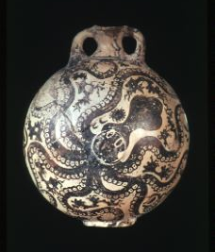
Octopus Jar – 1500 BCE Minoan

Slide 40
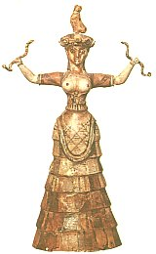
Snake Goddess – 1600 BCE Minoan

Slide 41
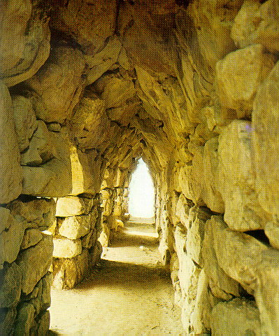
Corbelled gallery – 1300 BCE Mycenaean

Slide 42
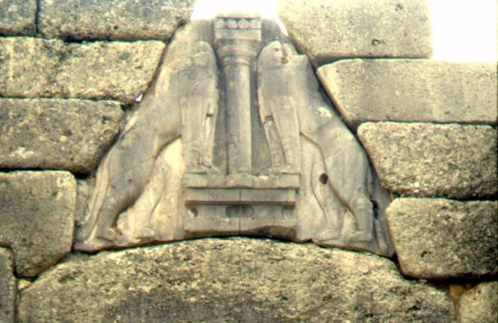
Lion Gate – 1300 BCE Mycenaean

Slide 43
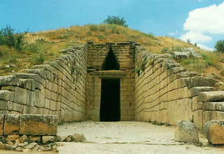
Treasury at Atreus – 1300 BCE Mycenaean

Slide 44
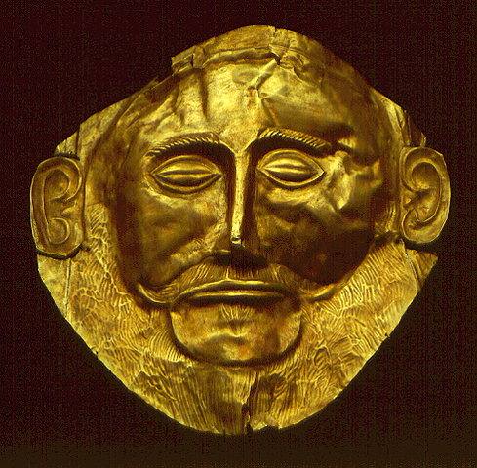
Funerary mask – 1600 BCE Mycenaean

