Slide 1
Greek Art Geometric: 900-700 BCE Orientalizing: 700-600 BCE Archaic: 600-480 BCE Classical: 480-400 BCE Late Classical: 400 – 323 BCE Hellenistic: 323-30 BCE

Slide 2
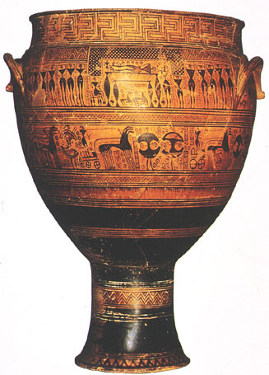
Diplyon Krater – 740 BCE Geometric

Slide 3
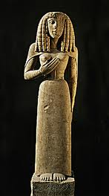
Lady of Auxerre – 650 BCE Orientalizing

Slide 4
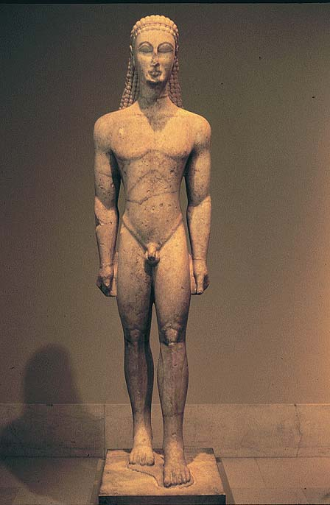
Kouros – 600 BCE Archaic

Slide 5
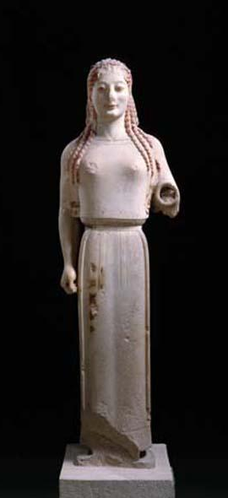
Kore – 530 BCE Archaic

Slide 6
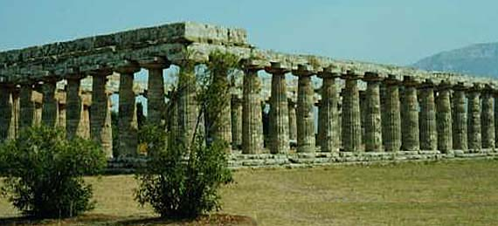
Temple of Hera I – 550 BCE

Slide 7
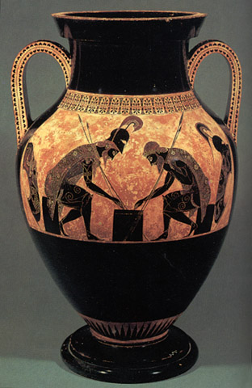
Achilles and Ajax – 540 BCE

Slide 8
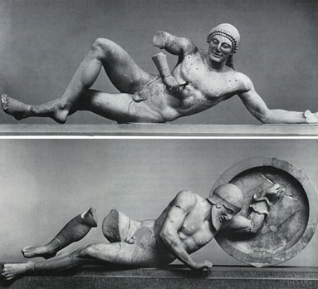
Dying Warrior – Temple of Aphai – 490 BCE

Slide 9
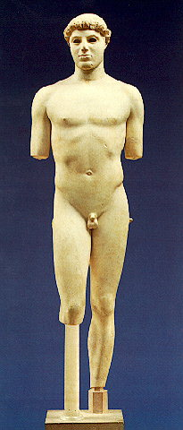
Kritios Boy – 480 BCE Classical

Slide 10
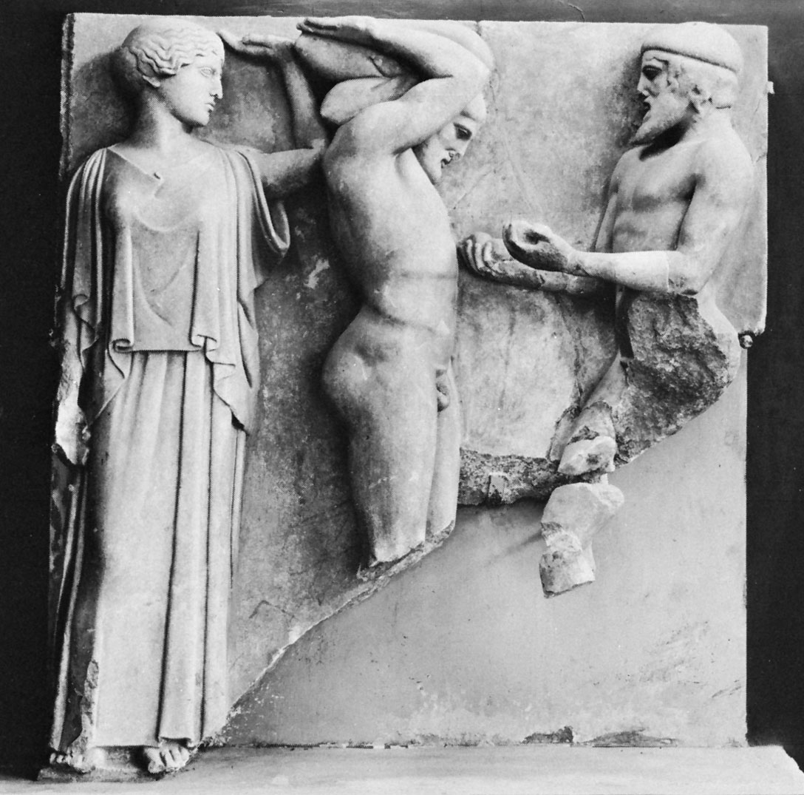
Herakles and Atlas- 470 BCE Classical

Slide 11
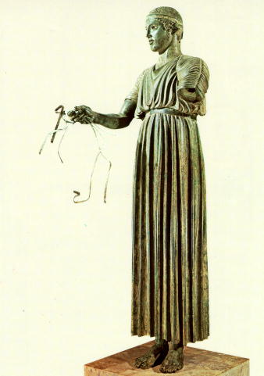
Charioteer – 470 BCE Classical

Slide 12
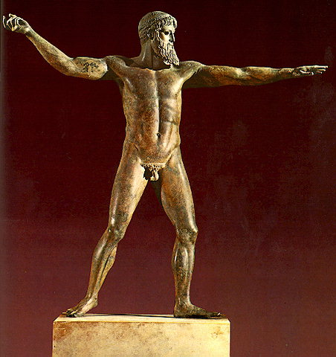
Zeus – 450 BCE Classical

Slide 13
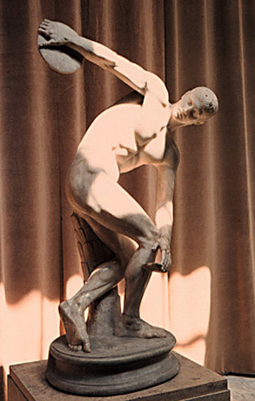
Discus Thrower – 450 BCE Classical

Slide 14
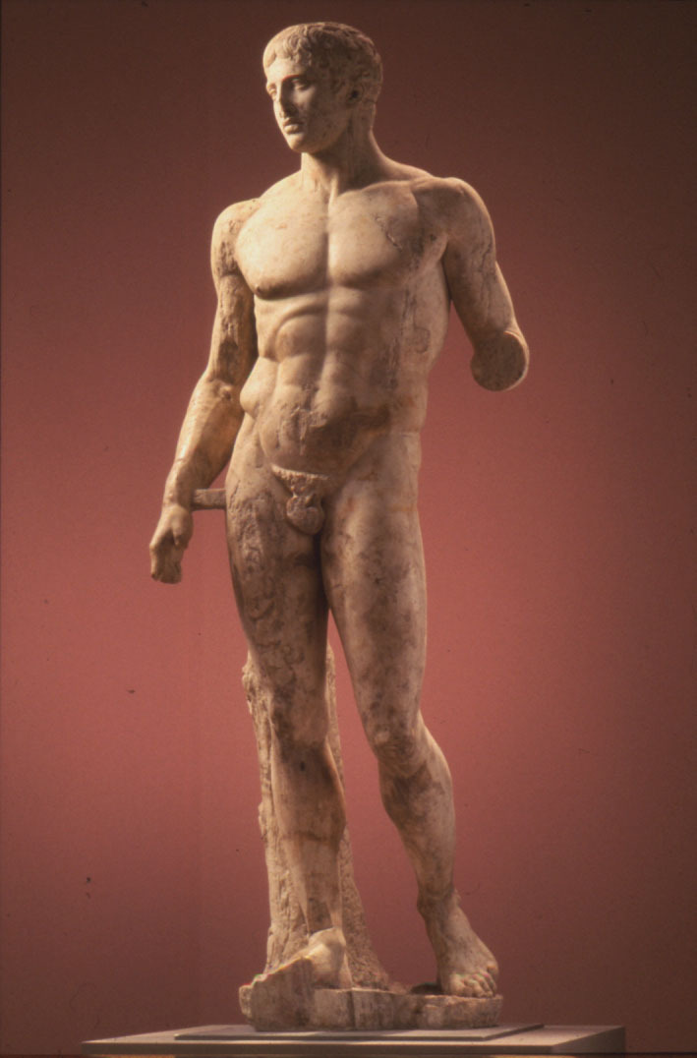
Polykleitos – Spear Bearer – 450 BCE

Slide 15
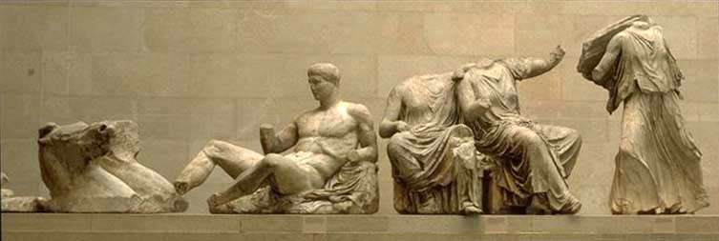
Helios and his horses – 430 BCE High Classical - Parthenon

Slide 16
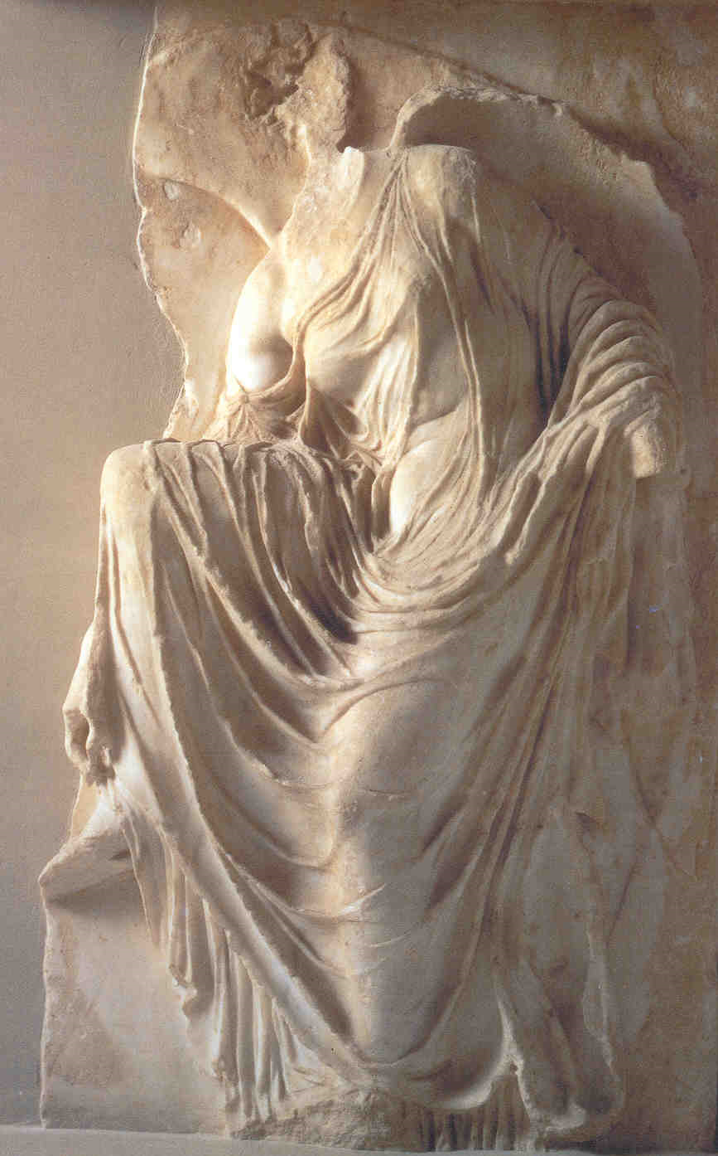
Athena Nike – 410 BCE High Classical

Slide 17
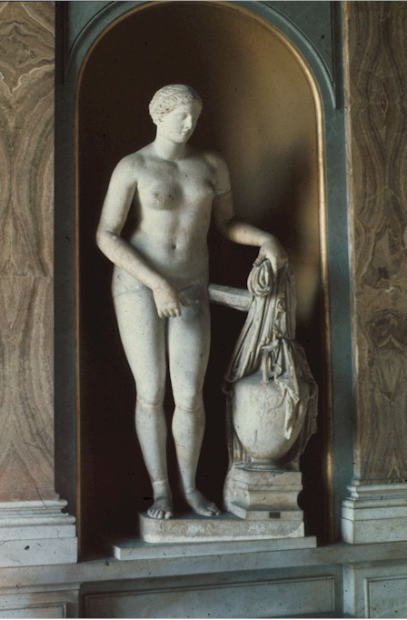
Aphrodite – Praxiteles – 340 BCE Late Classical

Slide 18
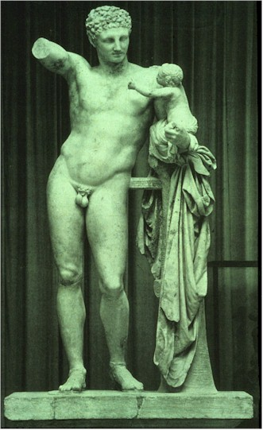
Hermes with Infant: Praxiteles – 330 BCE Late Classical

Slide 19
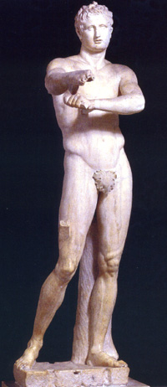
Lysippos – 330 BCE Late Classical

Slide 20
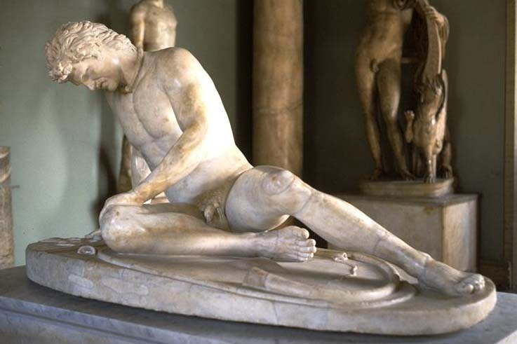
Dying Gaul – 230 BCE Hellenistic

Slide 21
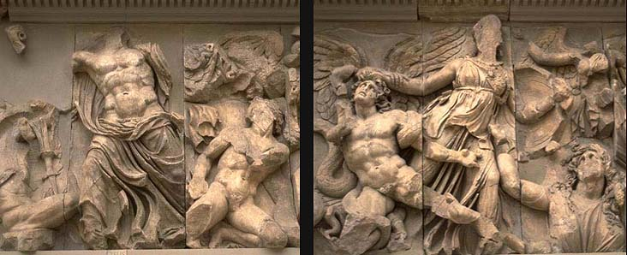
Frieze from Pergamon – 175 BCE Hellenistic

Slide 22
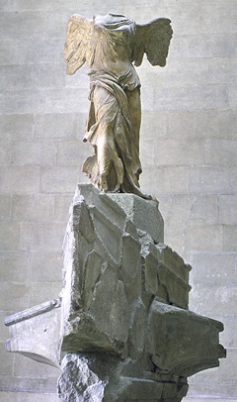
Nike – 190 BCE Hellenistic

Slide 23
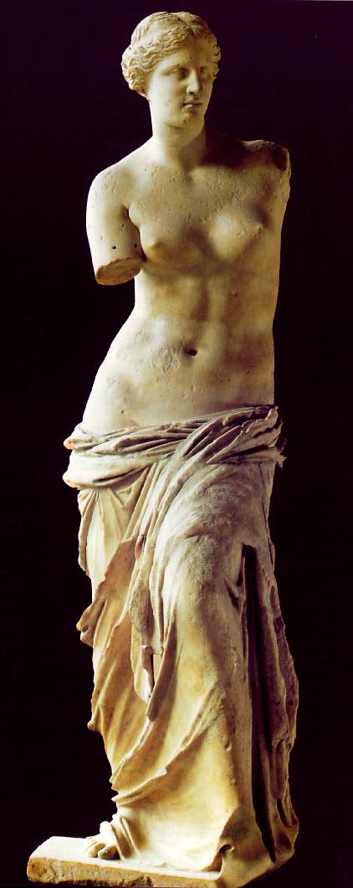
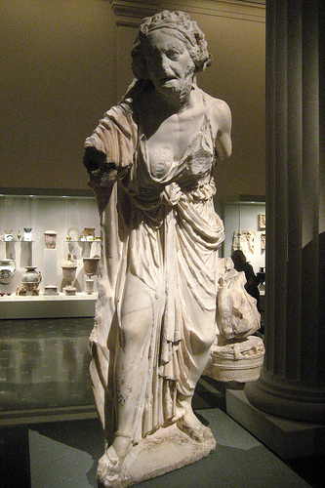
Aphrodite – 150 BCE Hellenistic

Slide 24
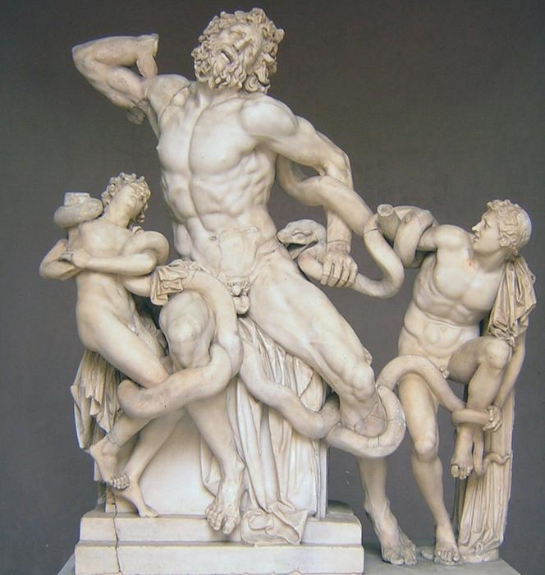
Lacoon and his Sons – 1 CE

Slide 25
Doric Order:
The frieze is divided into triglyphs and metopes.
Massive in appearance, its columns firmly planted on the stylobate.
It is severely plain.
Decorative sculpture only appears in the metope and pediment “voids.”

Slide 26
Greek Architectural terms

Slide 27
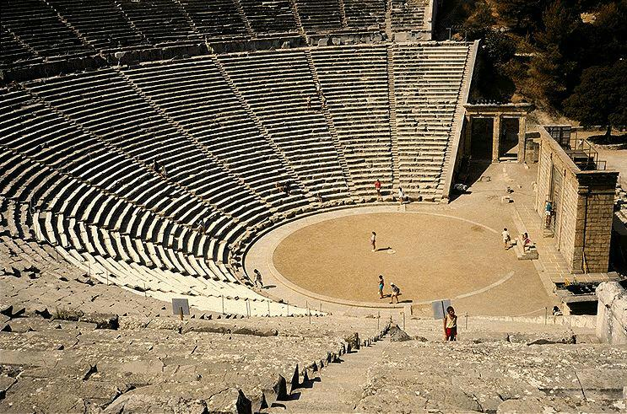
Theatre – Polykleitos – 350 BCE

Slide 28
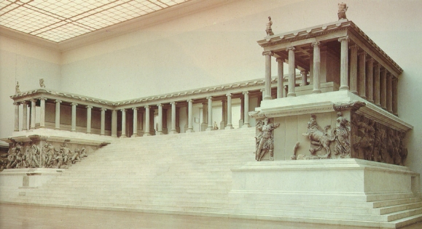
Pergamon Alter – 175 BCE

Slide 29
Etruscan Art 700 – 480 BCE

Slide 30
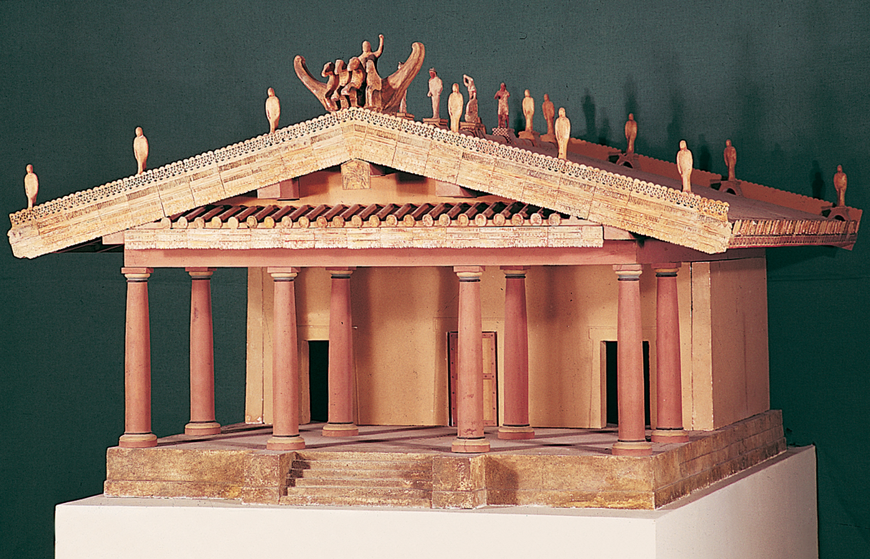
Etruscan Temple – 1 CE

Slide 31
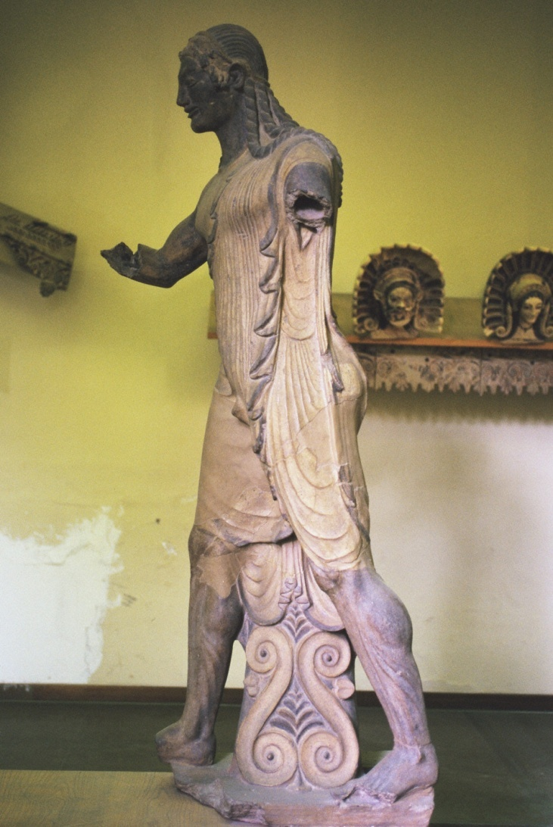
Apollo – 510 BCE

Slide 32
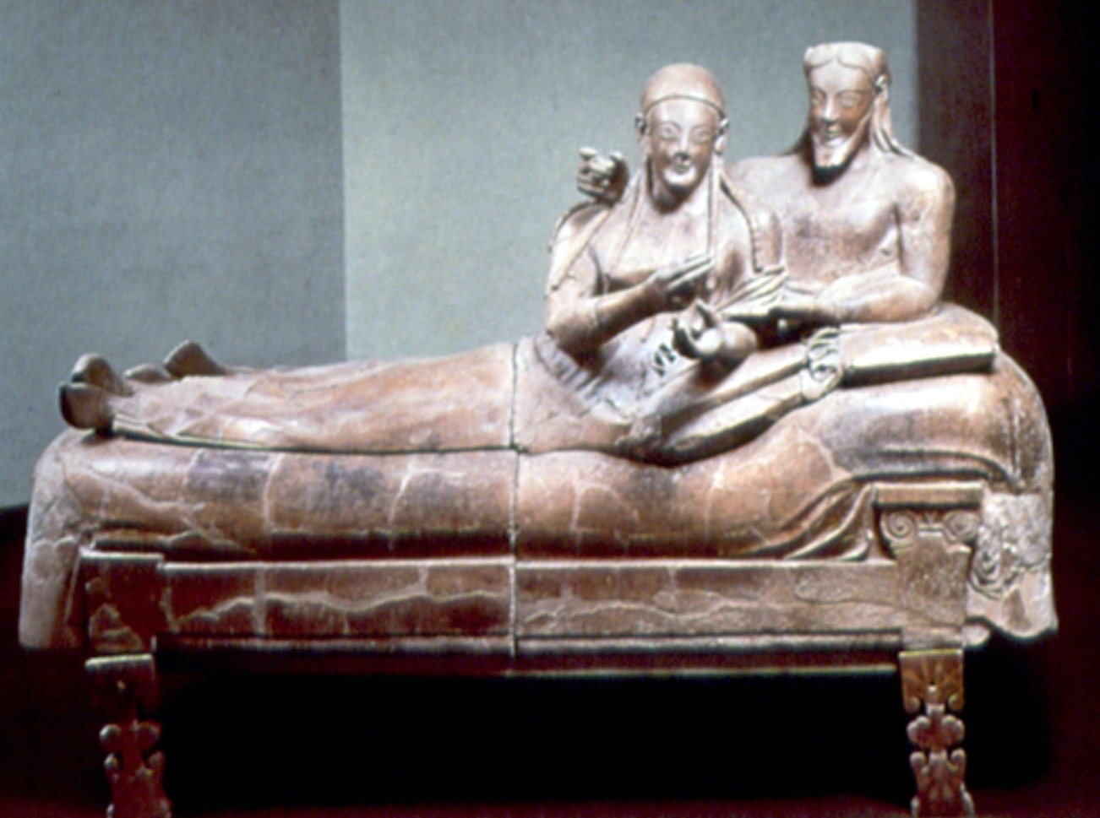
Reclining Couple – 520 BCE
Notes:
Slide concept by William V. Ganis, PhD FOR EDUCATIONAL USE ONLY For publication, reproduction or transmission of images, please contact individual artists, estates, photographers and exhibiting institutions for permissions and rights.

Slide 33
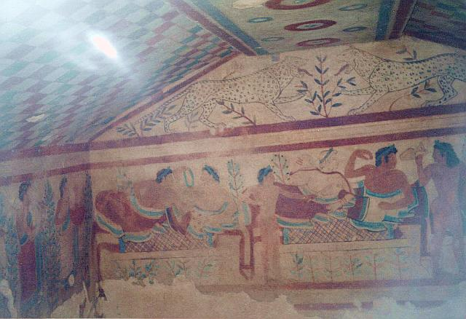
Tomb of the Leopards – 480 BCE

Slide 34
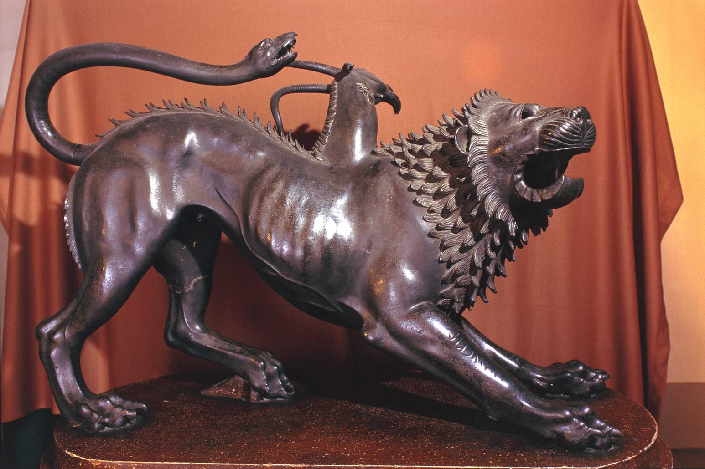
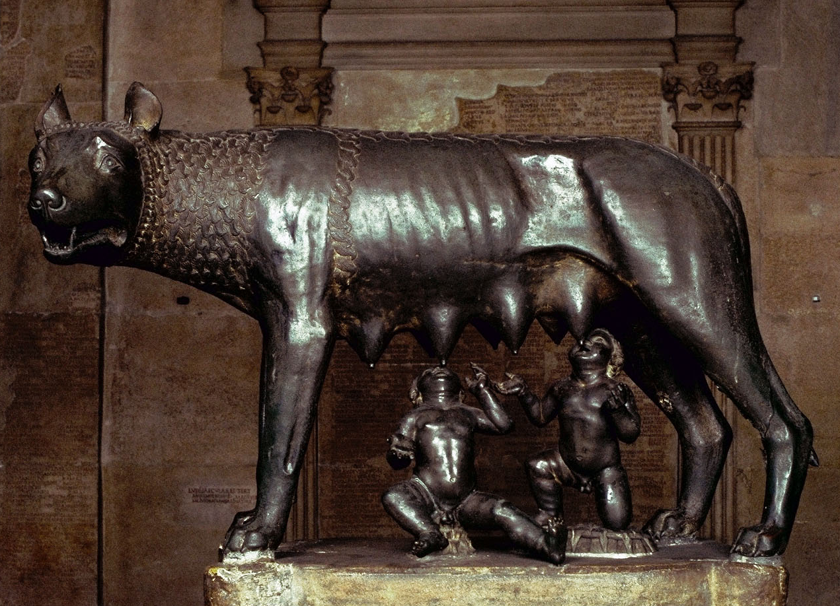
Capitoline Wolf – 500 BCE Chimera of Arezzo – 400 BCE

Slide 35
Roman Art Roman Republic: 509 – 27 BCE Early/High Roman Emp: 27 BCE – 192 CE Late Roman Empire: 192 CE – 410 CE

Slide 36
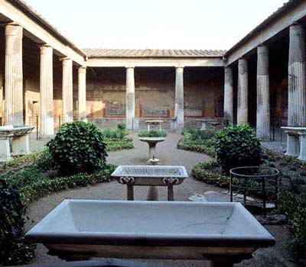
Roman Architecture
House of Vettii
Pompeii, Italy
Ca. 2nd Century BC

Slide 37
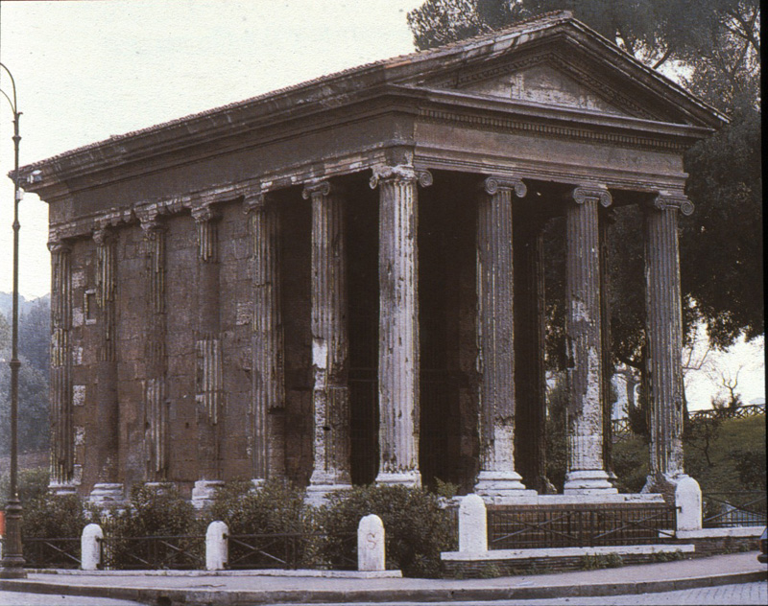
Temple of Fortuna Virilis: 75 BCE

Slide 38
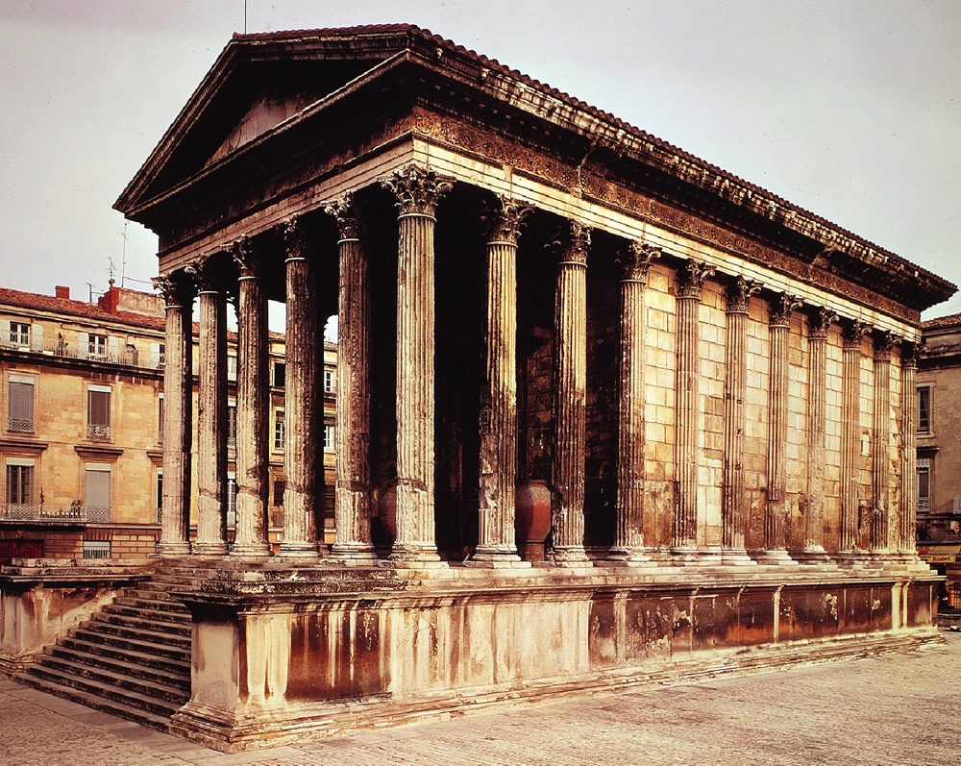
Maison Caree – France – 1 CE

Slide 39
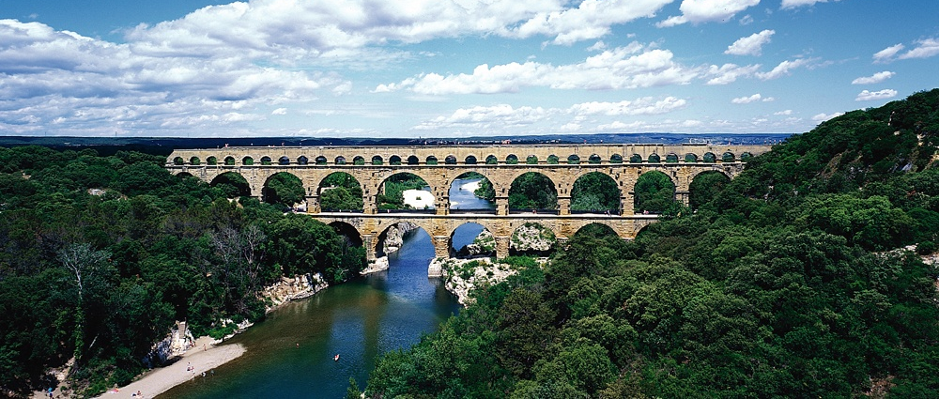
Pont – du – Gard: 16 BCE

Slide 40
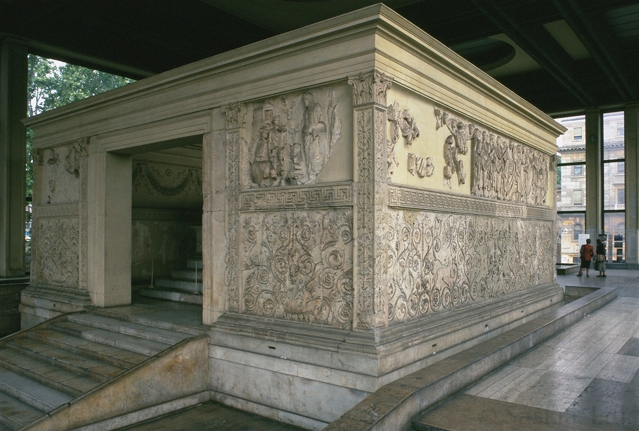
Ara Pacis (peace) – 13 BCE

Slide 41
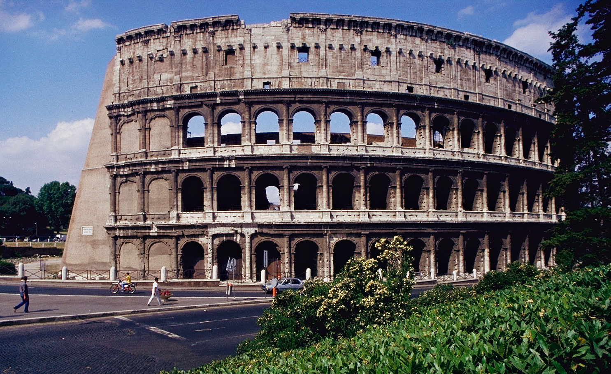
Colosseum – 72 CE

Slide 42
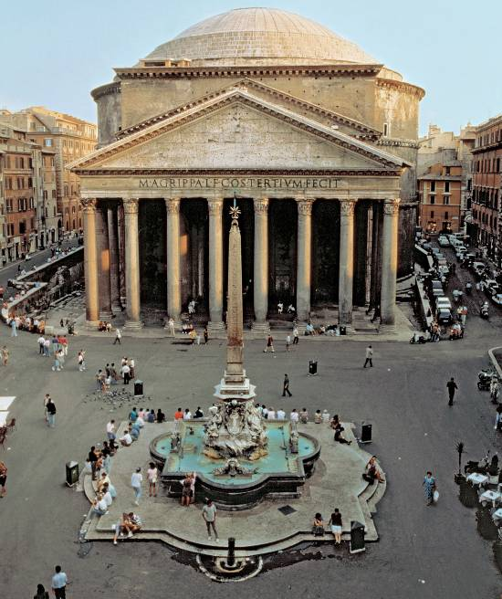
Pantheon – 120 CE

Slide 43
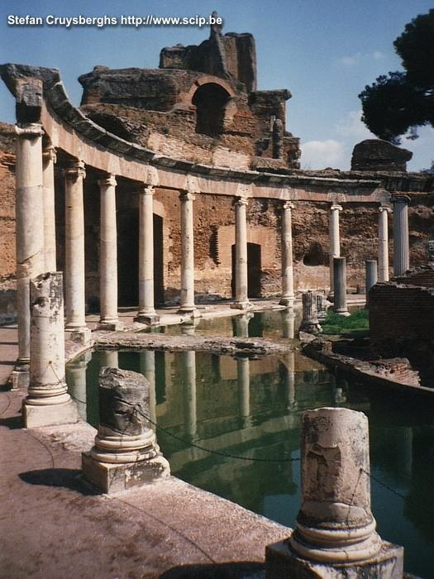
Hadrian’s Villa – 125 CE

Slide 44
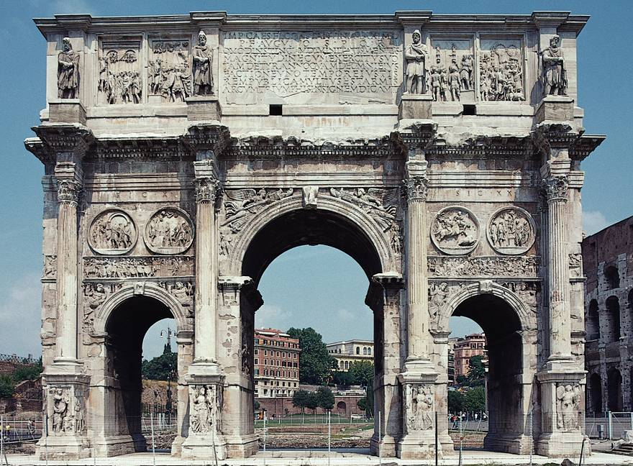
Arch of Constantine – 312 CE

Slide 45
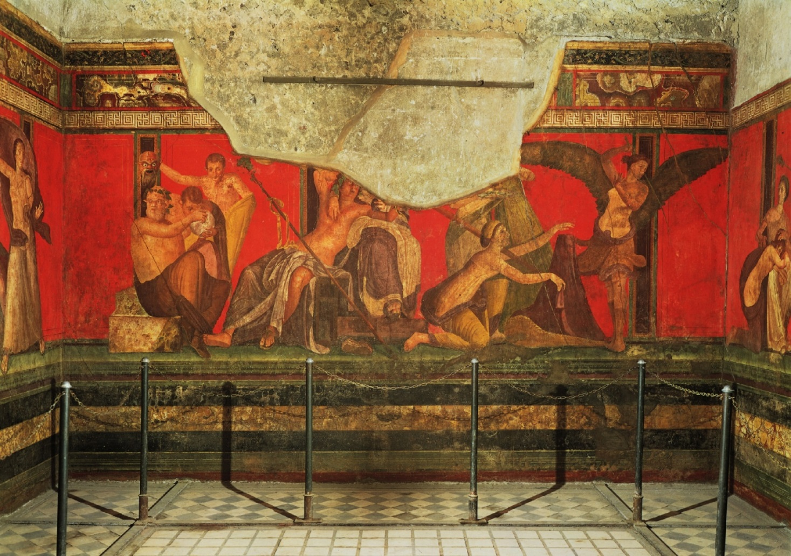
Roman Painting
Dionysiac mystery frieze – 50 BCE

Slide 46
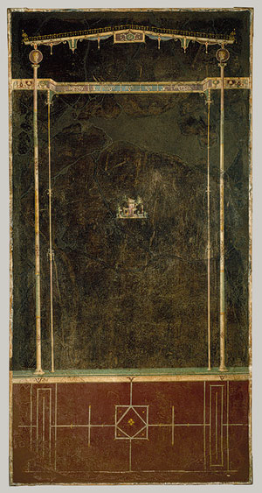
Black Room – Style 3 – 1BCE

Slide 47
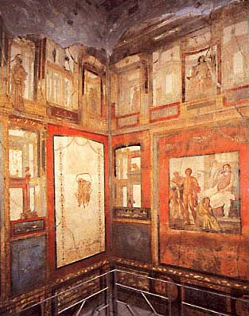
4th Style Painting – 70 CE

Slide 48
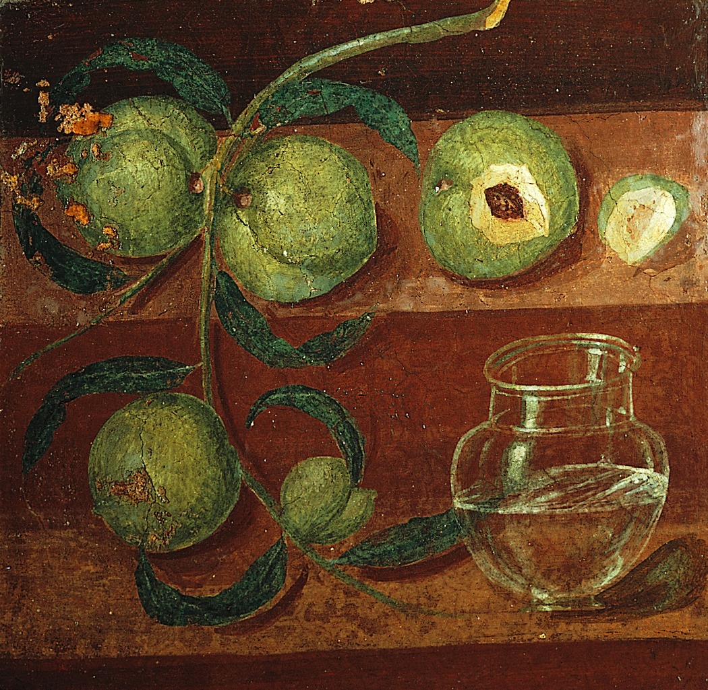
Still Life with Peaches – 70 CE

Slide 49
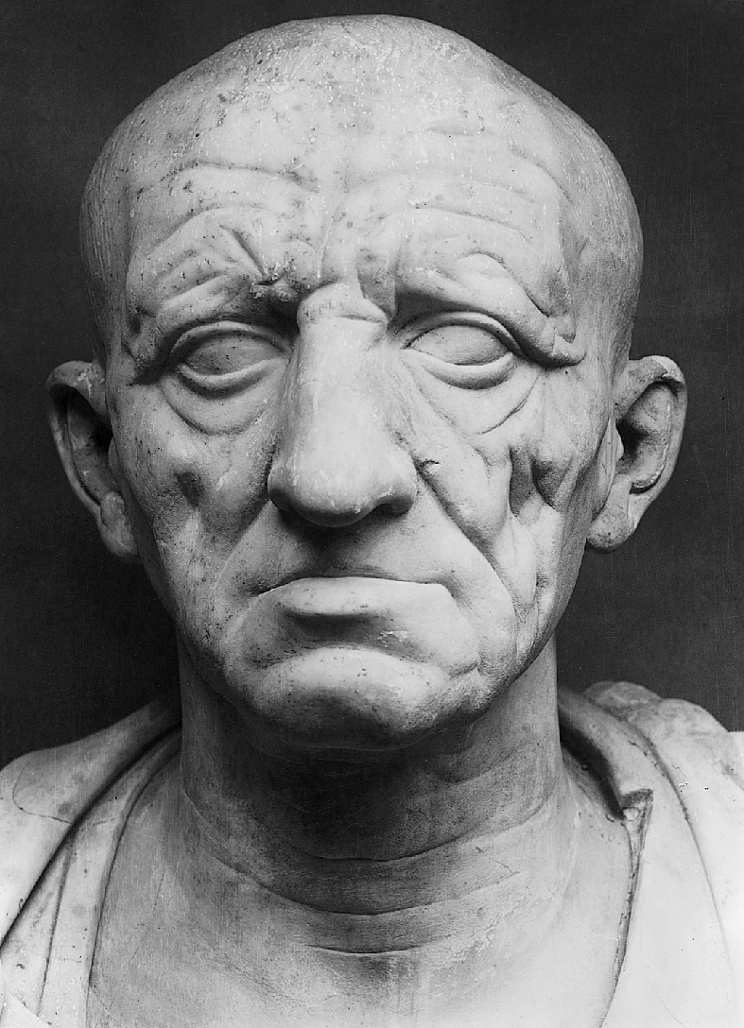
Roman Sculpture
Republican
Head of a Roman patrician
ca. 75-50 B.C.E.

Slide 50
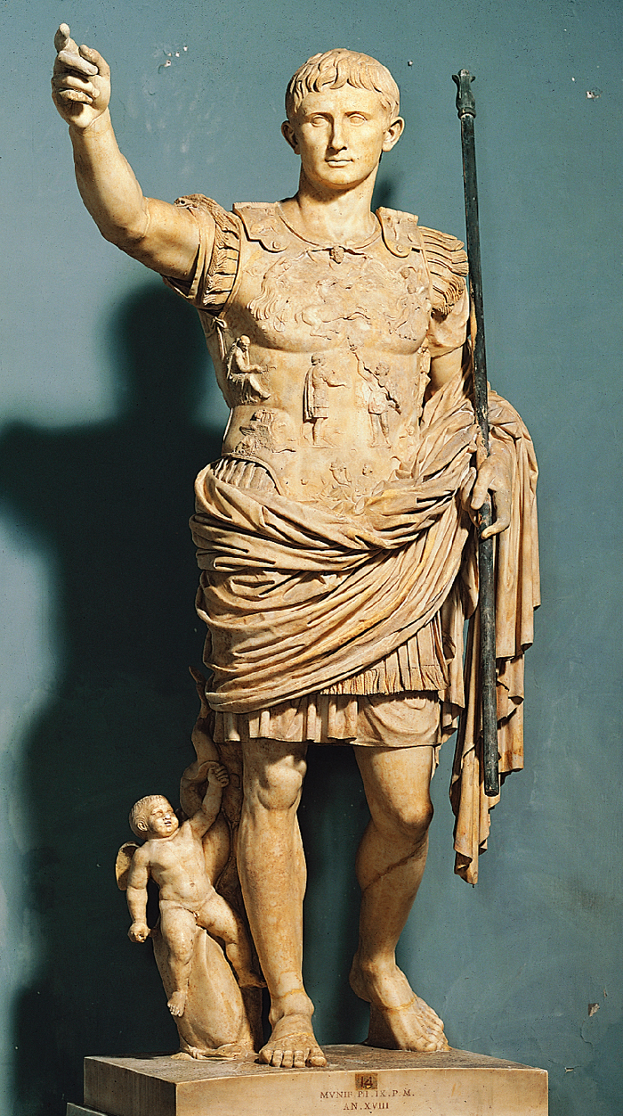
Augustus as General – 20 BCE Early Imperial

Slide 51
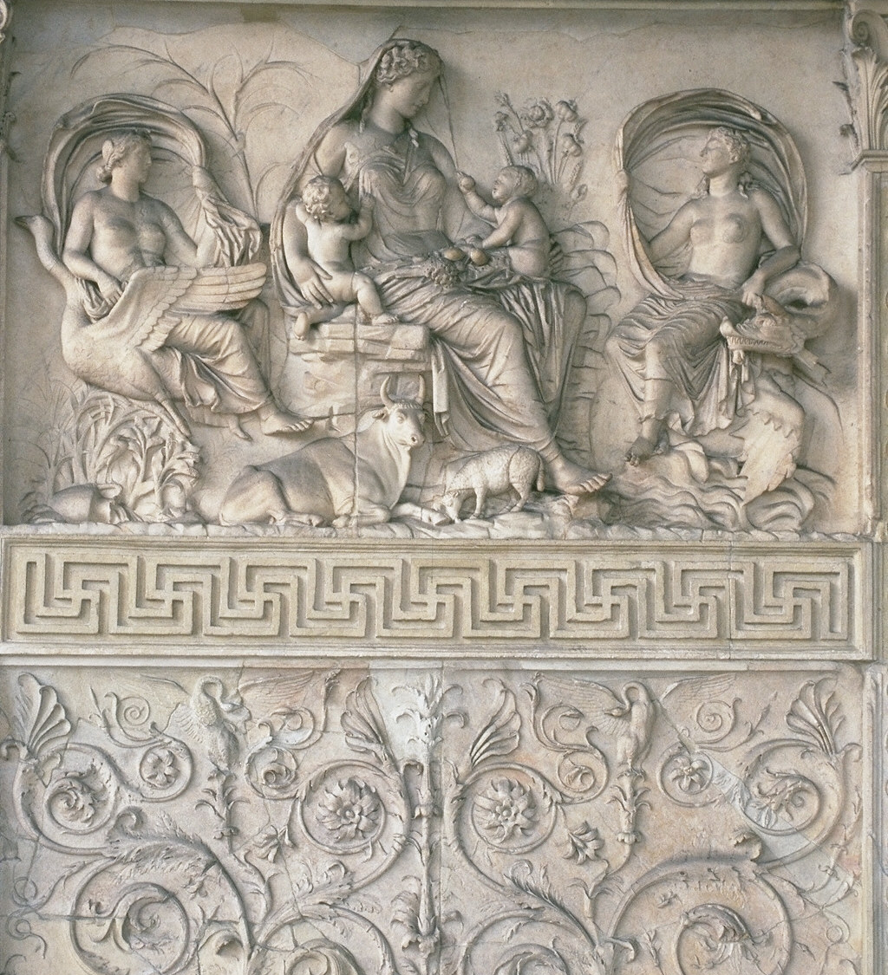
Façade of Ara Pacis – 13 BCE Early Imperial

Slide 52
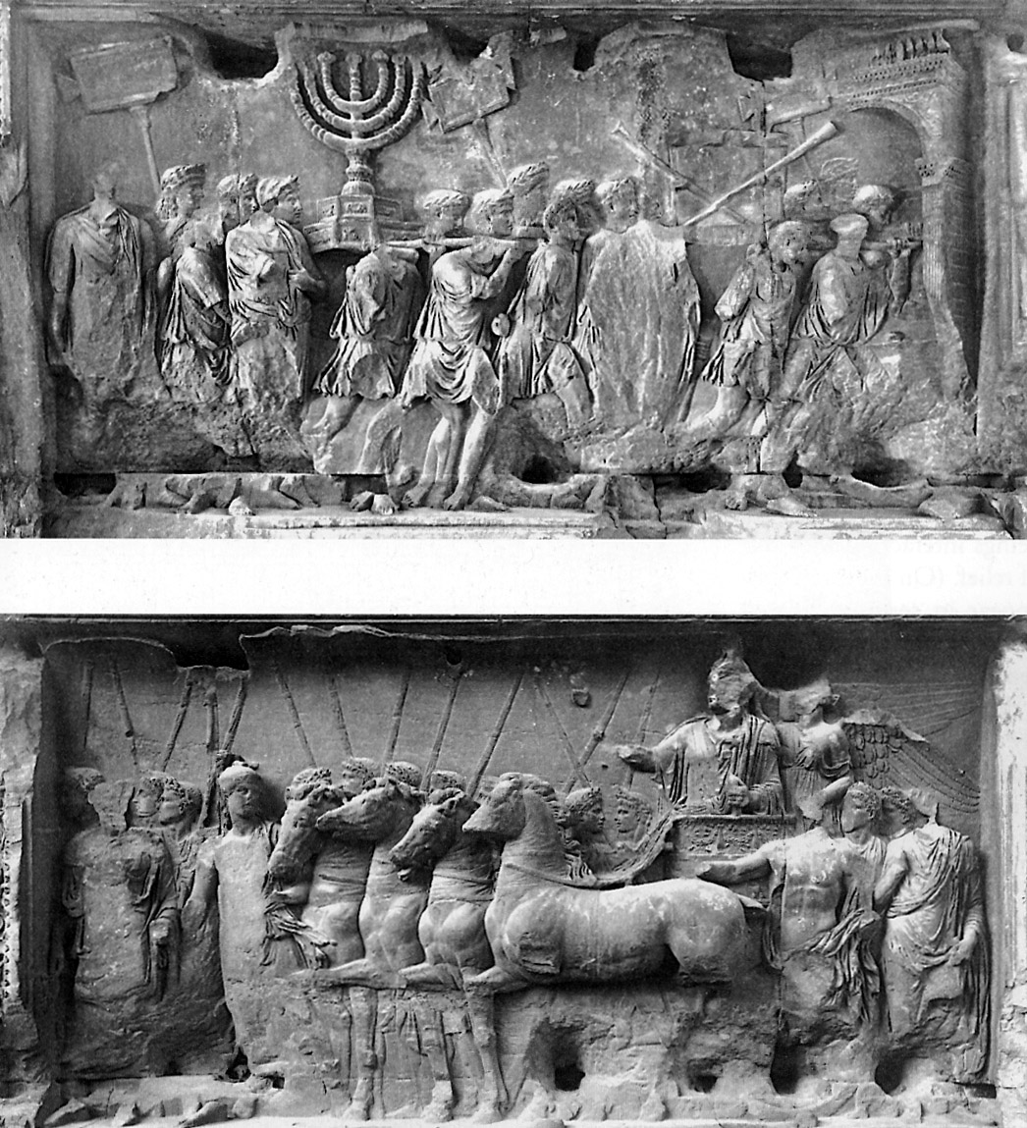
Spoils from the Temple of Jerusalem Arch of Titus – 81 CE

Slide 53
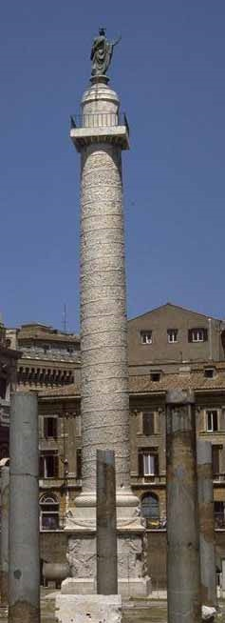
Column of Trajan – 112 CE

Slide 54
Marcus Aurelius – 175 CE High Imperial

Slide 55
Ludovisi Battle Sarcophagus – 250 CE Late Imperial

Slide 56
The Tetrarchs – 305 CE Late Imperial

Slide 57
Portrait of Constantine- 315 CE Late Imperial

